Slide 1
Land use and transport

Slide 2
Where are we?
Remember, there are four exam categories
Demand modelling with Logit
Assignment
LUTI
Models and appraisal

Slide 3

Content Demand
Demand (contd)
Logit model (repetition)
Nested logit model
Trip generation, Trip distribution and modal split
Locational choice modelling
(car ownership)

Slide 4
Assignment
2. Assignment
Dec 4

Slide 5
Content 3. LUTI
This is the topic today!

Slide 6
Content 3. LUTI
This is the topic today!
Chapter 5 in vW book
(also recommend ch 9 on accessibility)

Slide 7
Content Modelling and Appraisal
4. Modelling and Appraisal
Other models than Logit
Car ownership modelling
Scheduling models (Mon Dec 9)
Appraisal: What is it?
What is it, really?
Critique and defense (more on Dec 16)

Slide 8
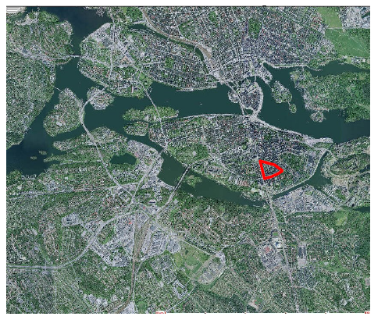
Why do we travel?

Slide 9
Why do we travel?
Travel is
Derived Demand

Slide 10
Derived demand
”The theory of utilitarian travel demand”

Slide 11
Derived demand
There is no benefit from the trip in itself
(per se)!
It is the activities at the destination we want/need/derive utility from
Dwelling, workplace, services, facilities…
Depends on the preferences for activities
and
the (generalized cost) to reach the destination

Slide 12
Derived demand
This is really the central core:
Depends on the preferences for activities
and
the (generalized cost) to reach the destination

Slide 13
Urban change process
Networks and land use
Workplaces and housing
Employment and population
Travel, goods transport
speed

Slide 14
LUTI
LUTI
Land use
Activities
Transport system
Accessibility

Slide 15
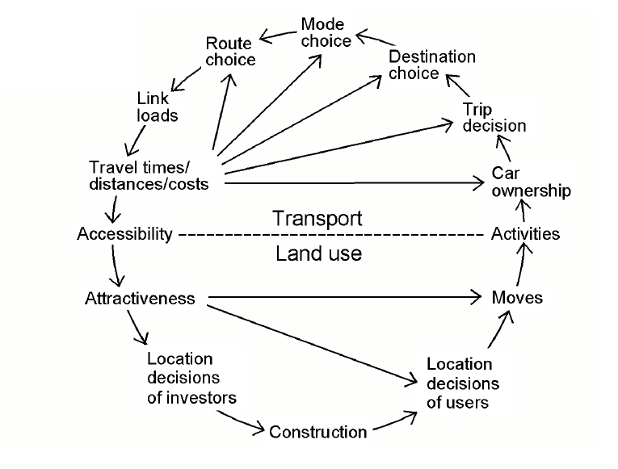
Land-use and transport

Slide 16
Land-use variables
Density (first order effect, second order effect)
Mixed land use
Neighbourhood design
Connectors: PT
Interactions: land use -> demand for PT -> supply for PT

Slide 17
If travel is derived demand
Preferences for activities
Generalized cost
Then…
… demand for travel will depend on
spatial structure of activities (land use) and
determinants of generalized cost (friction, impedance, resistance, deterrance function…. associated with the transport system)

Slide 18
(Remember generalized cost)
Pecuniary (monetary) cost
In-vehicle travel time
Waiting time
Mode specific constant
… any effort to cover the distance between the origin and the destination

Slide 19
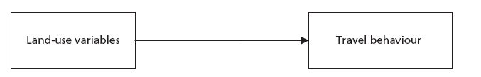
First attempt
In a simple four step model

Slide 20
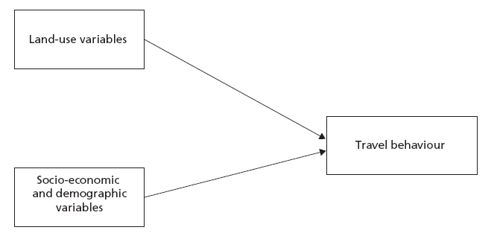
Second attempt
In a more clever four step model

Slide 21
Travel demand and the 3Ds
Density
Diversity
Design
”Elasticities are moderate to modest, but certainly not inconsequential”
Cervero and Kockelman (1998)

Slide 22
Self selection problem
Attitudes are important for travel behaviour
(some would call this preferences)
Attitudes are important for locational choice
Therefore, it is difficult to disentangle what is what!
Locational choice: residential choice, choice of workplace location, choice of shopping destination, or any other destination/activity

Slide 23
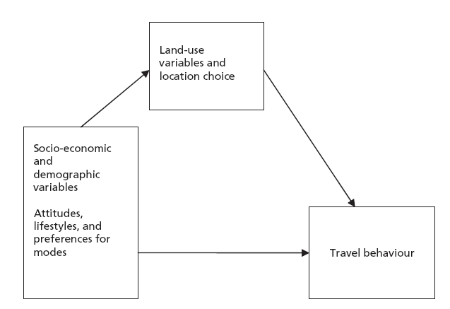
So, a new attempt
Complex interplay of all variables
Impact of LU can easily be overestimated, if not carefully addressed

Slide 24
A sustainability paradox
Land-use policies will have only a minor effect as a measure for increased sustainability
Land-use pattern is a dominating factor with a huge impact of sustainability

Slide 25
So why the different conclusions?
Different (some bad) research methods
Different levels
Different geographical scales
Time horizon
Differences between countries
Impact of policy

Slide 26
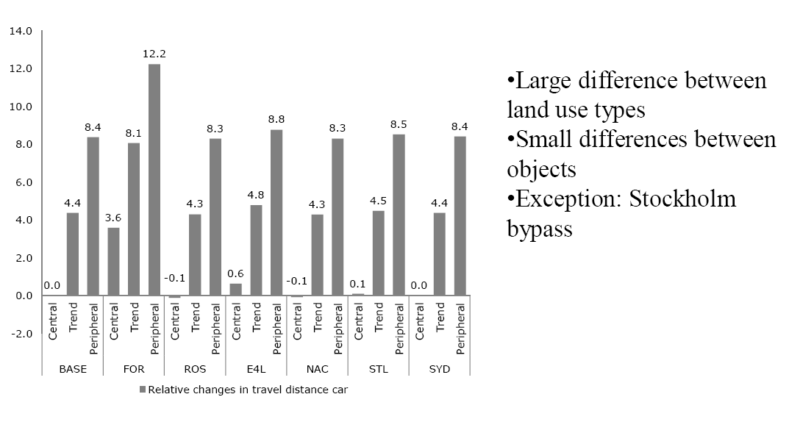
Land use matters

Slide 27
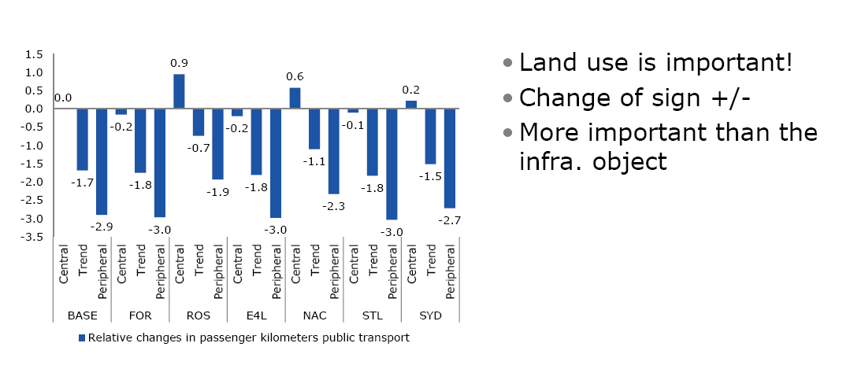
Oh yes, it matters

Slide 28
Evaluation
1. Indicators
2. Evaluation methods

Slide 29
1. Indicators
Accessibility
To what extent does the spatial structure and the transport system enable us to travel between locations we want to visit and thereby participate in the activities desired?
Accessibility measures based on
The spatial structure and transport network only
… or also based on people’s revealed preferences (behavior)

Slide 30
1. Indicators
Accessibility
Accessibility measures based on
The spatial structure and transport network only
(most measures used in geography, and travel time indicators)
… or also based on people’s revealed preferences (behavior) (so-called utility based indicators, used in transport modelling and economics)

Slide 31
1. Indicators
(ii) Saftey
(iii) Environmental impact indicators
(iv) Livable streets
(v) Health
(vi) Non-use benefits: option value
….
(See PROSPECTS Methodological Guidebook 3.3)

Slide 32
2. Evaluation methods
CBA
MCA

Slide 33
Relationship between consumer surplus and accessibility
Consumer surplus can be measured in terms of the log sum formula
It captures both the benefits due to GC, and the benefits derived from the activities in the destinations!

Slide 34
Ex Section 5.7 in vW
Assume a closed region
Suppose we can shrink the region
r -> r/2
Area -> Area / 4
Assume that configuration of activities are kept constant
-> All distances are reduced reduced by 50%
If no behavioural change, GC would be reduced by 50%
r
r

Slide 35
Ex Section 5.7 in vW
All distances are reduced by 50%
But now we can travel more!
Suppose that CTTB hypothesis holds
By trading off travel time disutility against activity utilities, people can choose more destinations, or more remote destinations
In the end, no change in total travel!
But certainly, there are accessibility benefits!
r
r

Slide 36
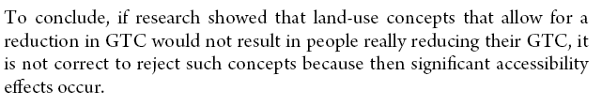
Ex Section 5.7 in vW
r
r
(Se PMG chapter 9.1-9.4, the latter is rather technical, not included in course literature)

Slide 37
Integrated land-use and transport system policies
Land use measures
Infrastructure provision
Infrastructure management
Operations
Information provision
Attitudinal measures
Pricing
If we could use policies in concert….

Slide 38
Take-aways
Transport is derived demand (surprice!)
Travel demand will depend on spatial structure and generalized cost (transport system)
Discuss different time scales at operation
Discussion about land-use and transport demand interaction wrt impacts, in particular the ’LUTI sustainability paradox’, and reconciliation efforts
Discuss the concept of accessibility
Discuss the potential of integrated Land-use and transport policies

