Slide 1
Assignment

Slide 2

Where are we?
There are four scopes
1. Logit
2. Assignment Today!
3. LUTI
4. Other models and appraisal

Slide 3
Where are we?
There are four scopes
1. Logit
2. Assignment Today!
3. LUTI
4. Other models and appraisal
Mostly Monday Dec 9

Slide 4
Remember the four steps
Trip generation
Trip distribution
Modal split
Assignment
Which route on a network?
Traffic flow per link, transit stop etc

Slide 5
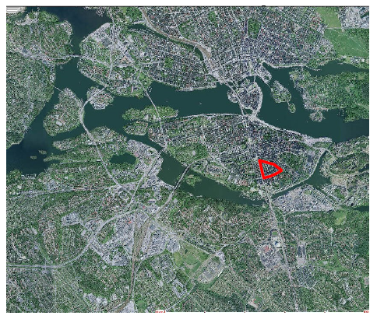
Car assignment network definition

Slide 6
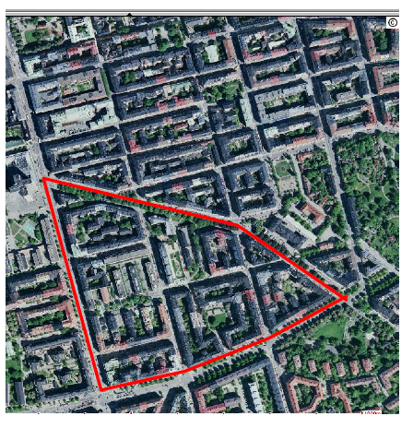
From the real world…

Slide 7
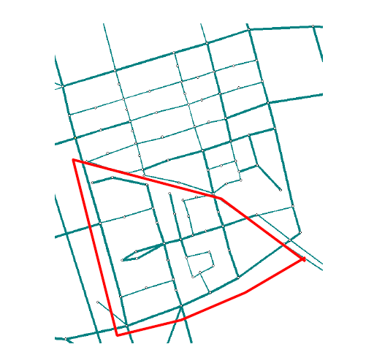
… to a network representation

Slide 8
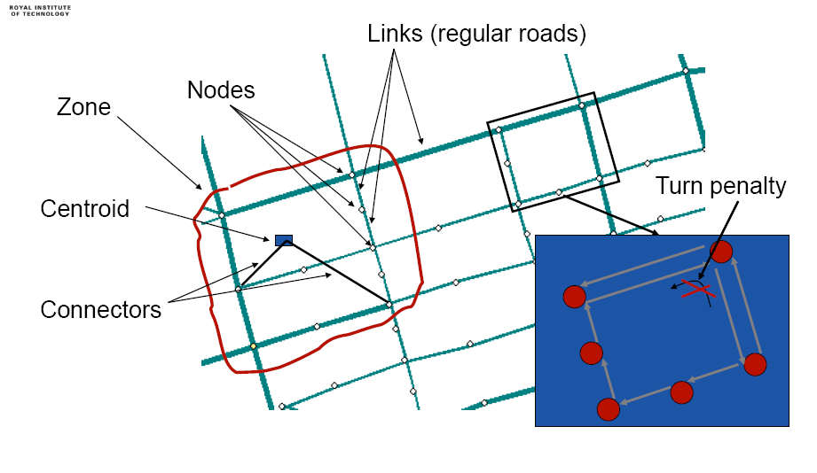
Definitions

Slide 9
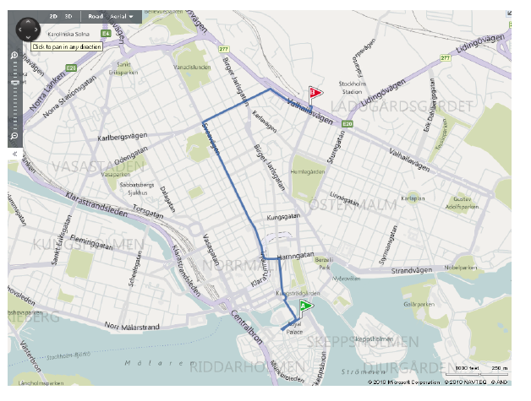
How do we choose route?

Slide 10
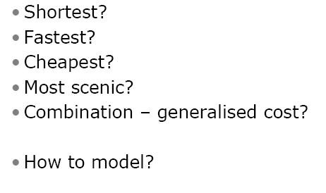
How do people choose route?

Slide 11
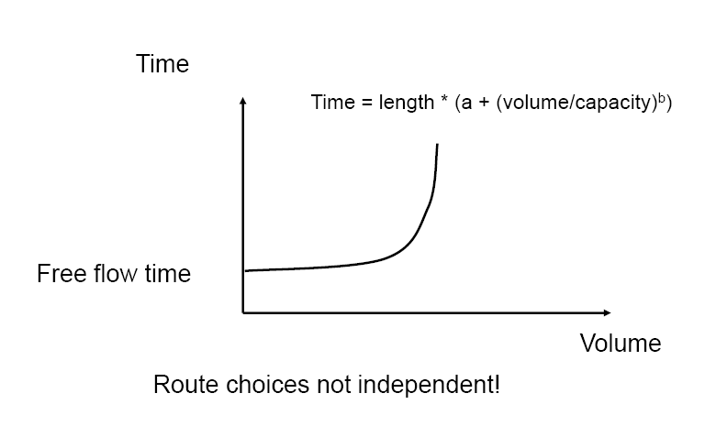
Volume-delay function
Several functional forms, see 10.1.3
For instance famous ”BPR” used in the US

Slide 12
All-or-nothing
Use ”shortest path” (more generally, the one with least generalized cost)
Allocate all demand to shortest path
May not be the shortest anymore

Slide 13
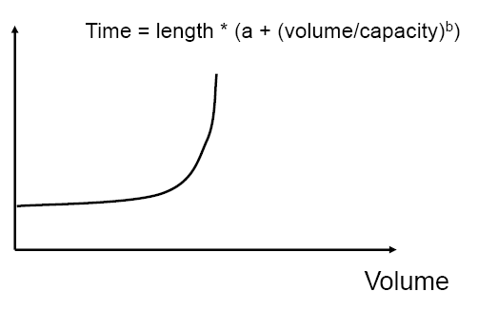
Supply and demand
and equilibrium?

Slide 14
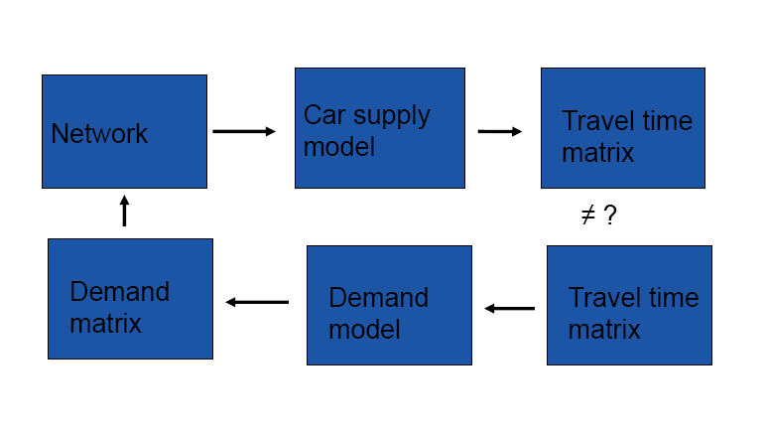
Supply and demand interaction

Slide 15
Equilibrium
What would make people change route?
•User equilibrium (Wardrops 1st principle):
-All used routes will take the same time
-No unused route will be take less time
•System optimum
-Minimum total travel time
The difference is known as
Price of Anarchy

Slide 16
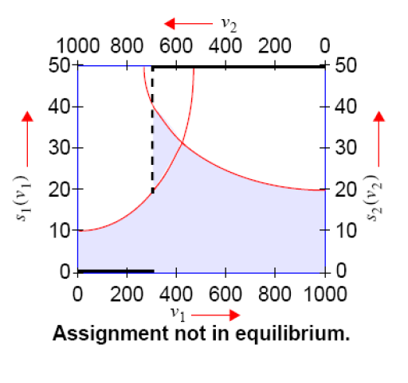
Graphical illustration

Slide 17
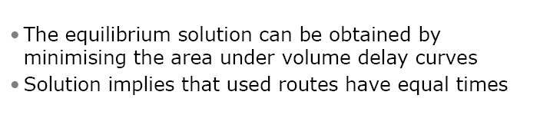
An optimization approach

Slide 18
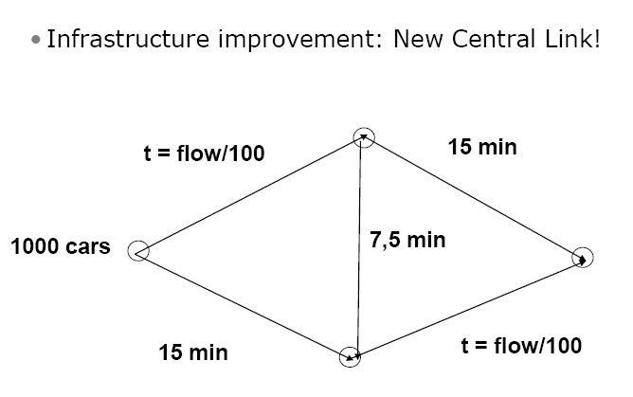
A paradox

Slide 19
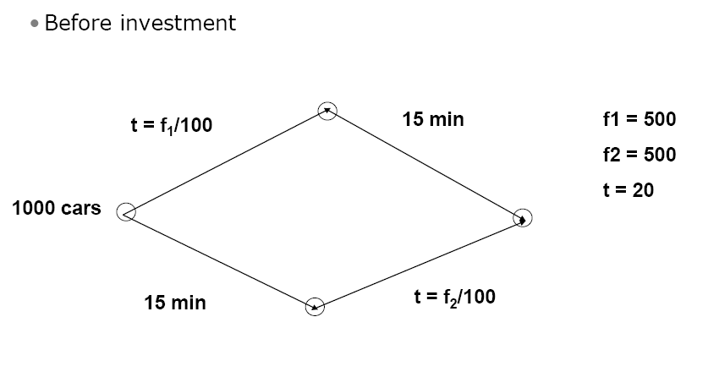

Slide 20
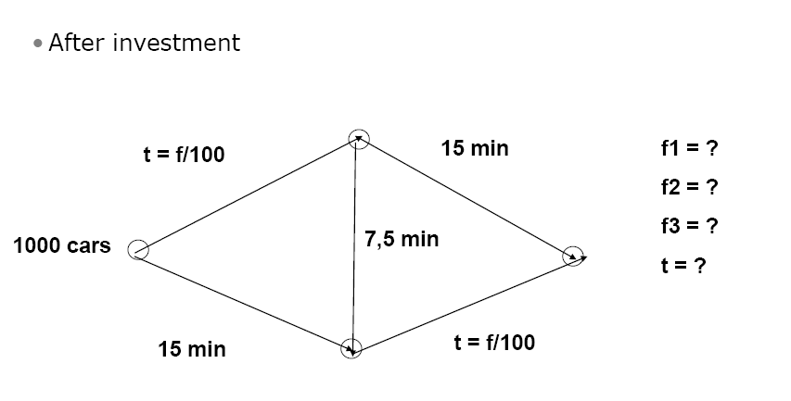

Slide 21
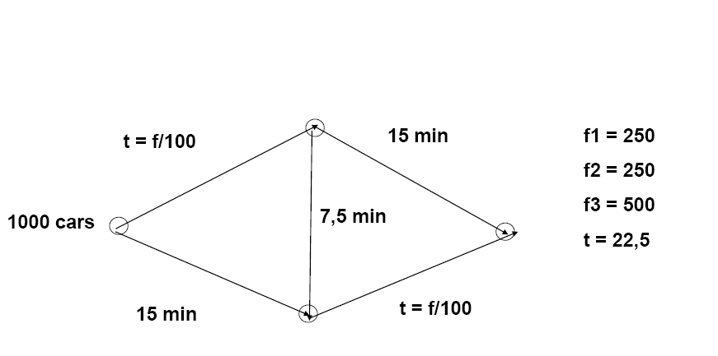

Slide 23
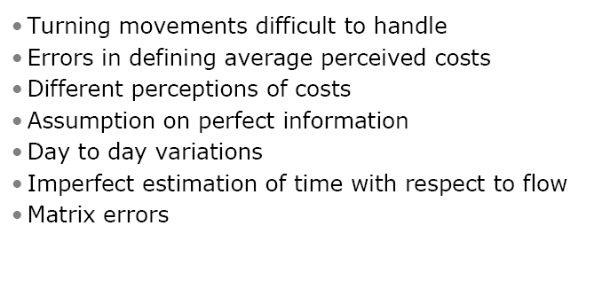
Limitations

Slide 24
Public transport assignment
(transit assignment)

Slide 25
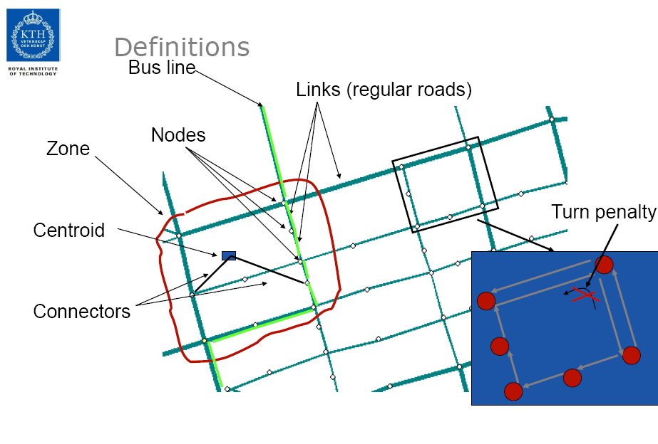

Slide 26
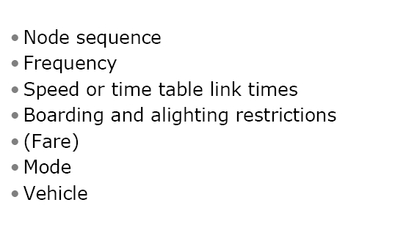
Definitions

Slide 27
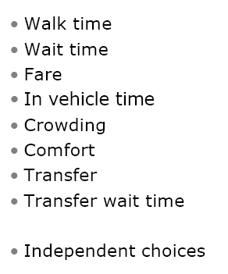
Factors of route choice for transit

Slide 28
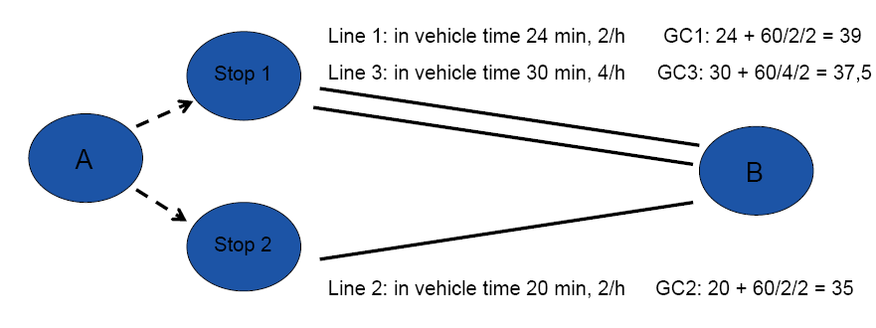
How to model?

Slide 29
How to model?

Slide 30
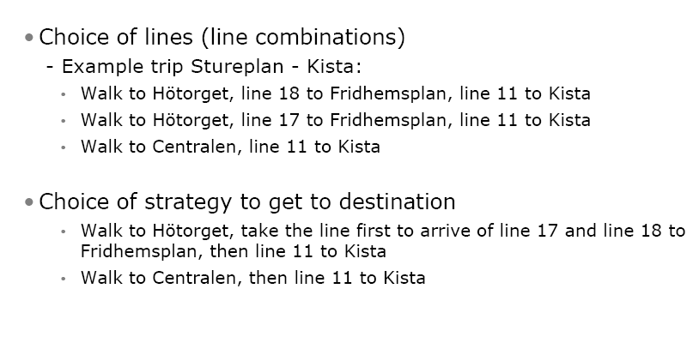
Different possible models

Slide 31
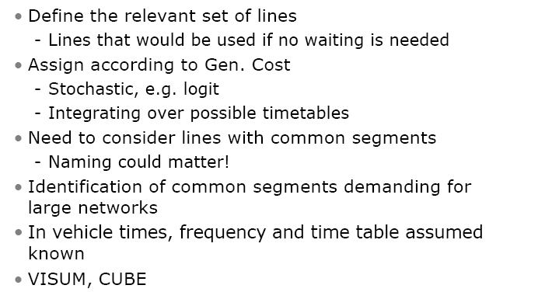
Line choice model

Slide 32
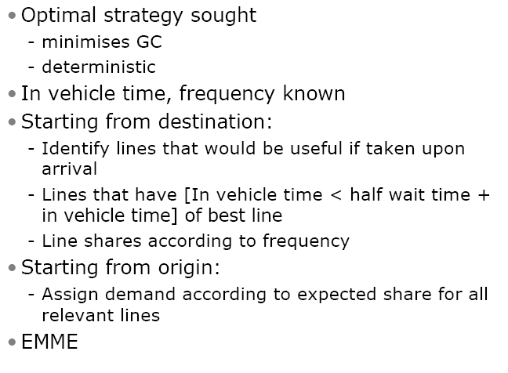
Strategy choice model

Slide 33
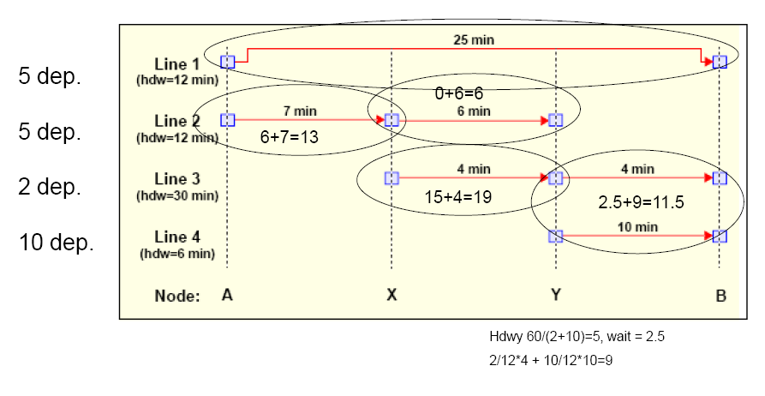
Example

Slide 34
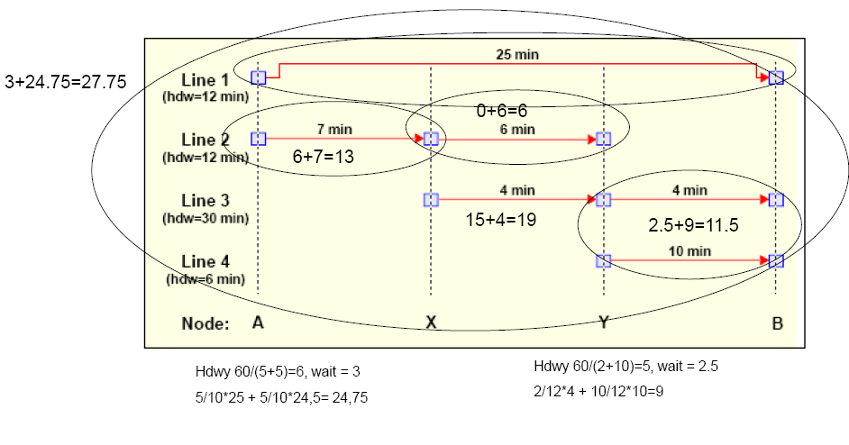

Slide 35
