Slide 1
Disordered semiconductors,
Stimulated emission

Slide 2
Luminescence of disordered semiconductors
Disordered semiconductor (amorphous) No order in atomic arranagement
e/h wavevector k, Bloch theorem, E=E(k): shouldn’t be used since no long-range order
Conduction/Valence bands, forbidden gap and density of states are conserved since short-range order is preserved

Slide 3




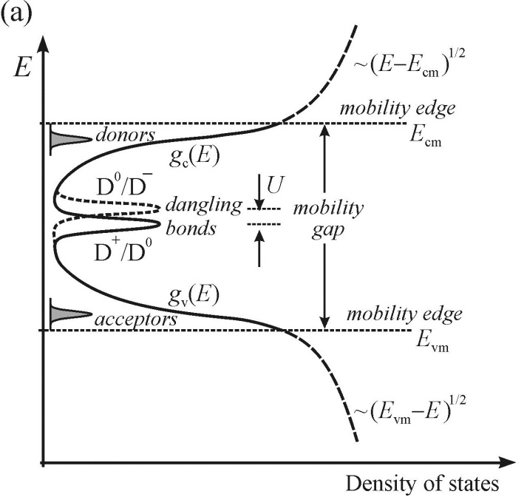

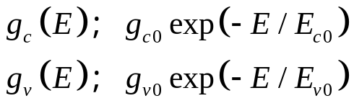
Densitiy of states in bands
Difference in bond lengths/angles from crystalline lattice
(mobility edge) Free electrons
Spatially localized in traps
Charge transport: through hopping mechanism/multiple trapping
Energy bandgap in crystalline semicondutors
but DENSITY OF STATES IS NOT ZERO IN THE BANDGAP,
plus DANGLING BONDS (D) as DEEP LEVELS
Correlation energy

Slide 4
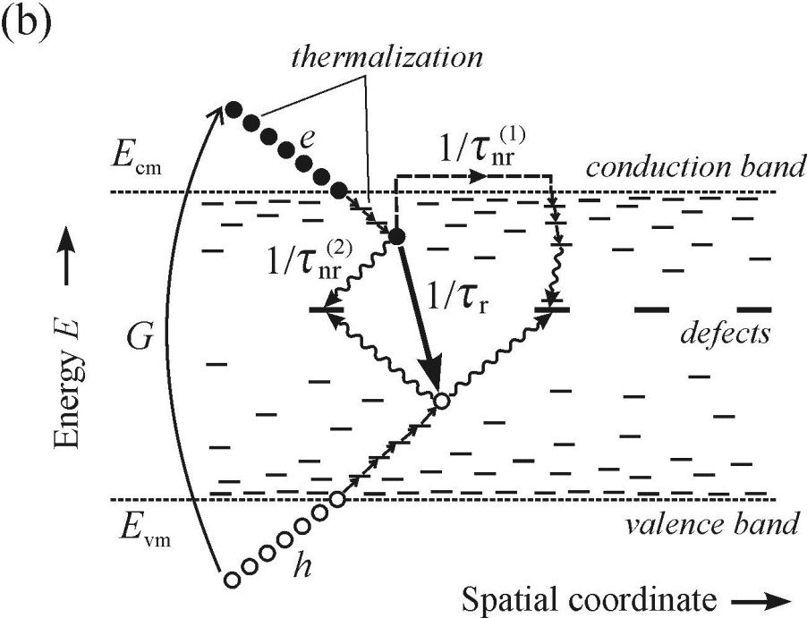
Disordered semiconductors: radiative and non-radiative recomibinations
Nonequilibrium e-h pairs (generation rate G)
Thermalize (ps) toward mobility edges
Fall down into tail states
Tunneling between neibouring
States radiative recombination
(longer time scale)

Slide 5
Disordered semiconductors: radiative and non-radiative recomibinations
Deflected covalent bonds in Neighbouring atoms
Mechanical strain
Dangling or
Unsaturated bonds
unpassivated bonds (ex. Through Hydrogen
passivation like a-Si:H) introduce deep localized
electron states in the middle of the BG- non-radiative centers

Slide 6
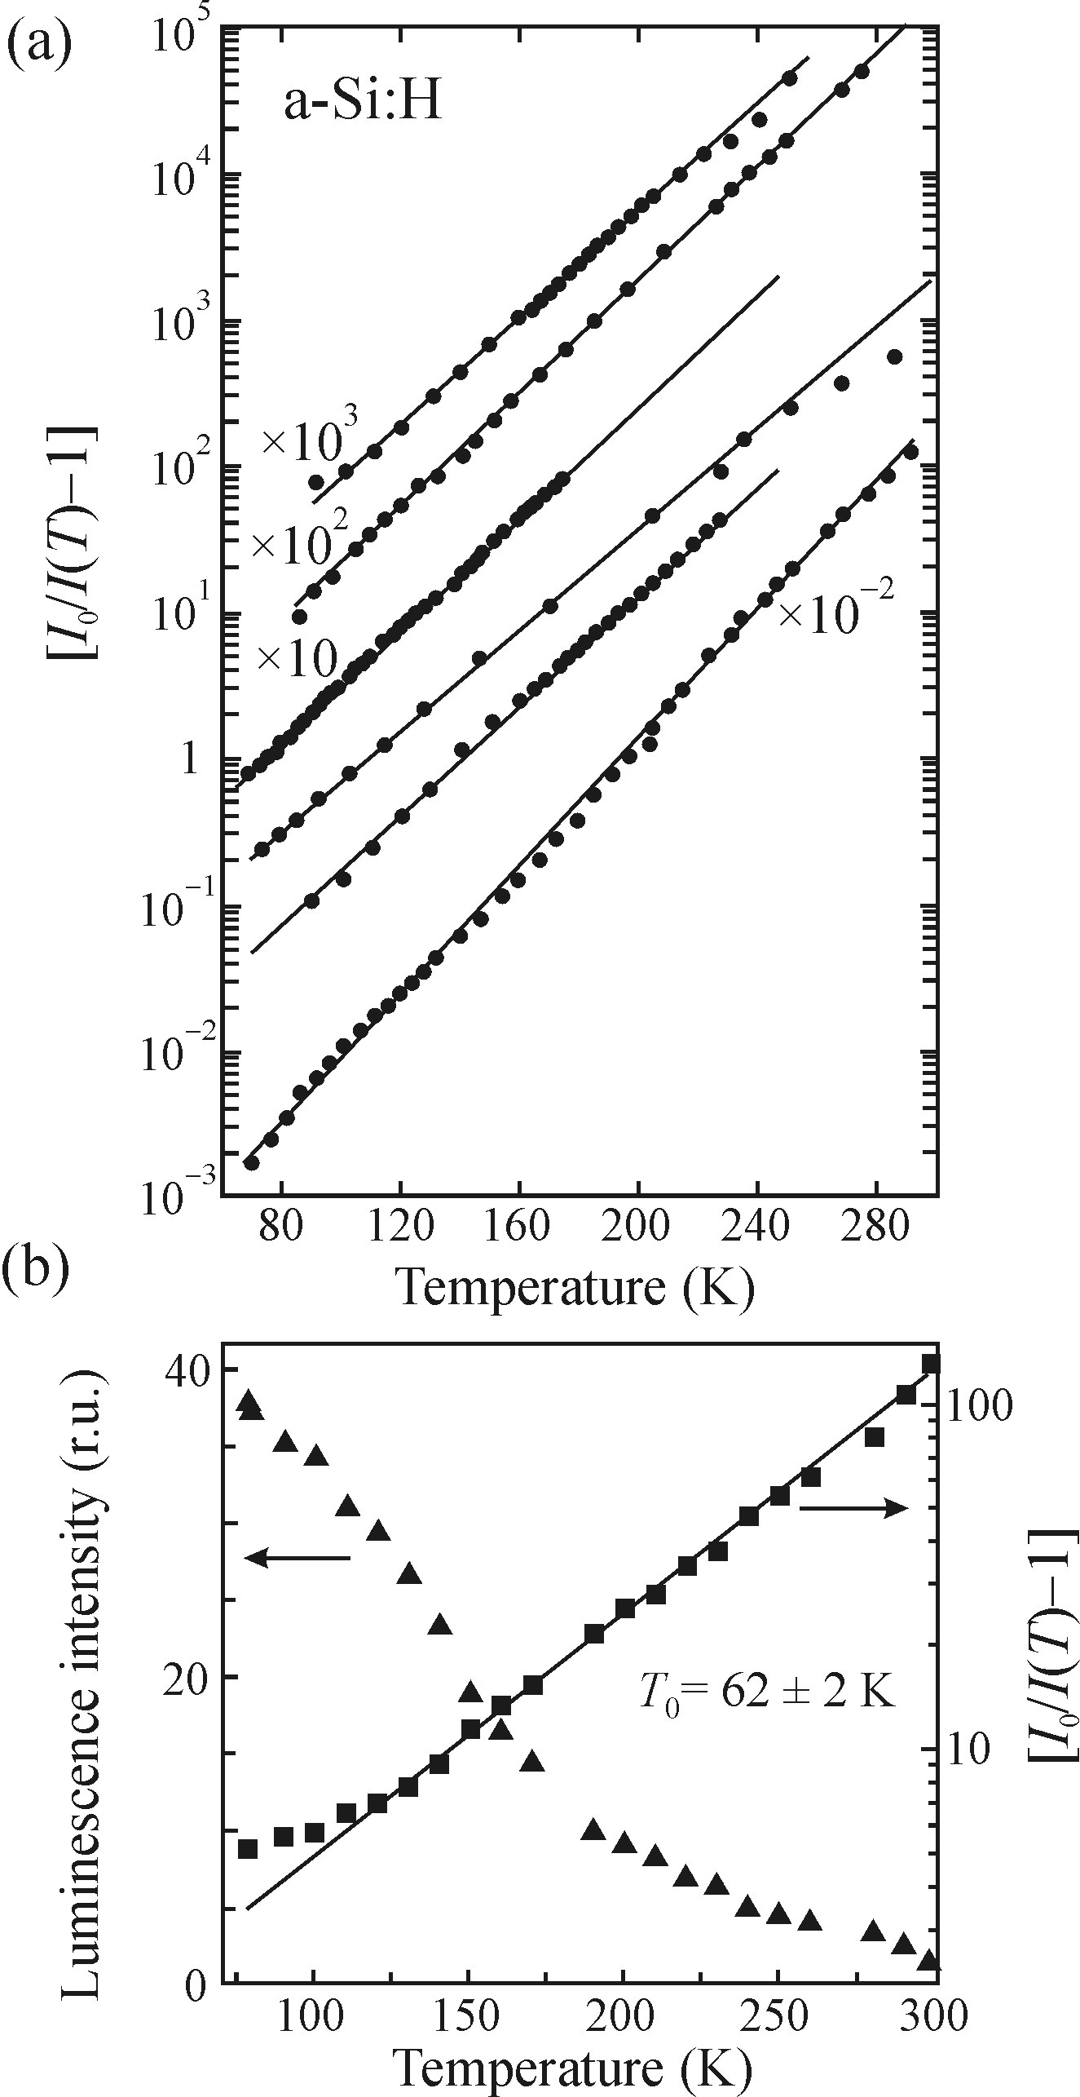




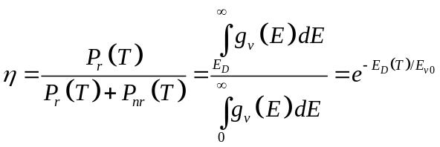
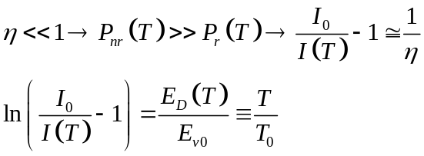

Temperature effect on luminescence
Probability of
thermal excitation
leading to nr recombination
Deeper than ED states
recombine radiatively
Frequency factor:
characterizes
The width of the
tail states

Slide 7

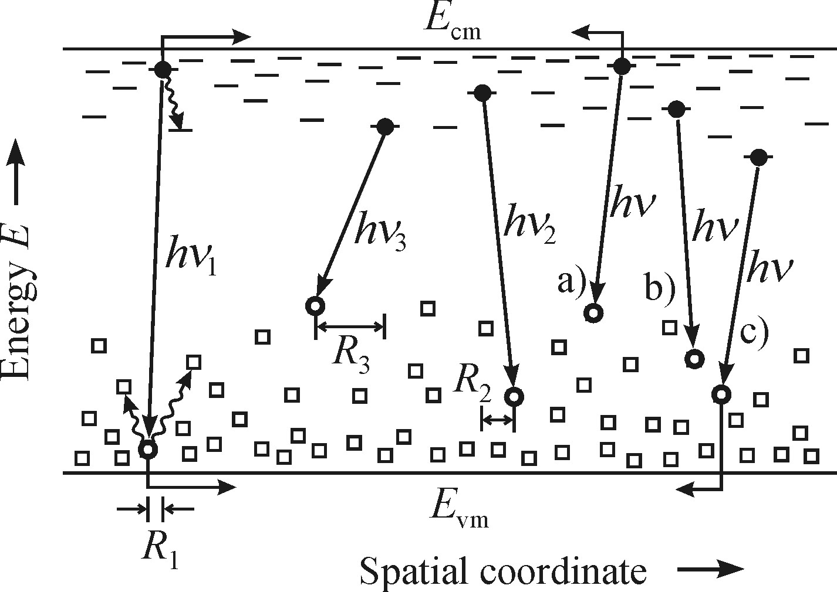

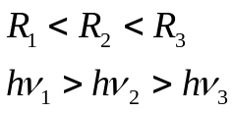
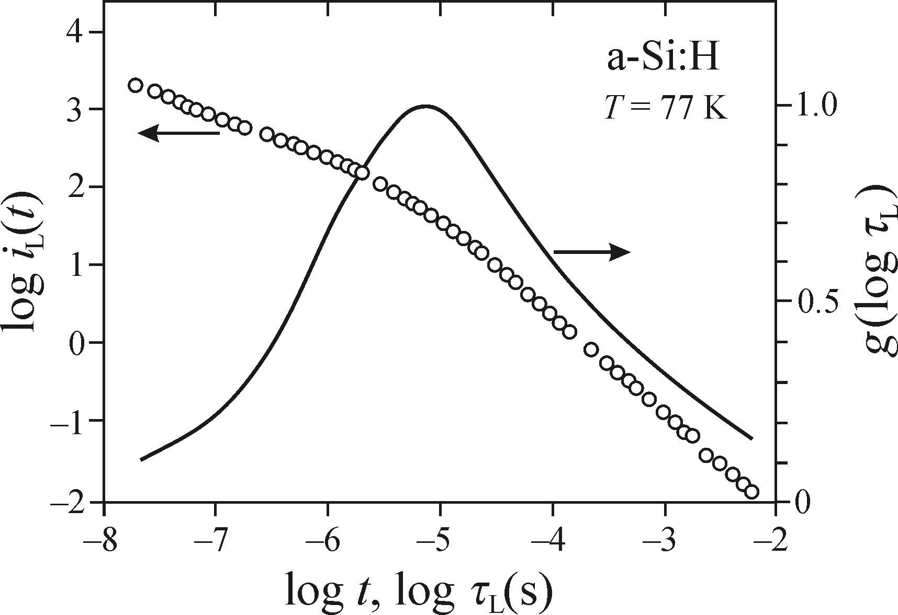


Distribution of luminescence lifetime
Large life time range (between )
Tail states are broad and have variable spatial density
Probabality of the radiative tunneling
Where R is separation between localized
electron and localized hole, less chances
to recombine at higher R
Continuous distribution of luminescence
decay times
Because of the considerable width it is plotted
a function of logarithmic decy time

Slide 8
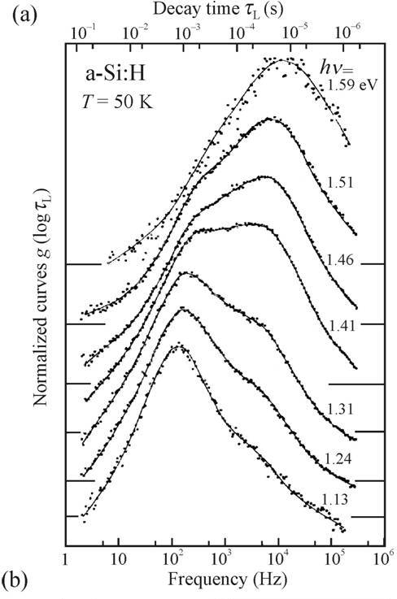
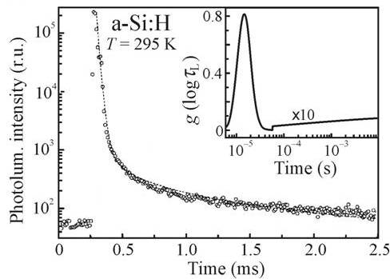
Distribution of luminescence lifetime
Lifetime distribution is wavelength dependent
At room temperature this distribution narrows
(only deeply localized carriers are involved)

Slide 9
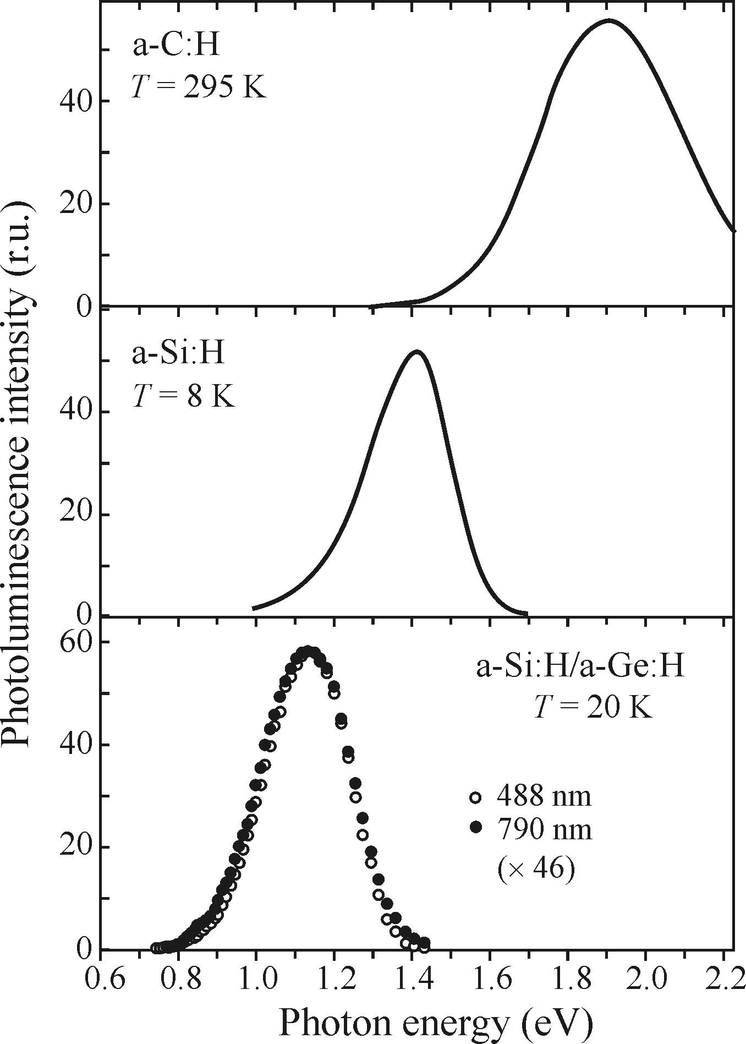


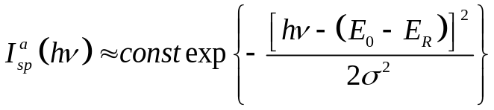
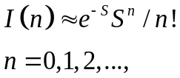

Spectral shape of the emission band
PL emission spectra of pure amorphous
semiconductors is typically broad FWHM: 200-400 meV
To explain spectral shape:
Free e-h pairs (localized carriers here) ×
Radiative recombiantion type or ×
EHL and EHP (high excitation only)×
Electron-phonon coupling √
no-phonon energy
Spectral shape
Broad emissin band of a-Si:H
Phonon broadening model
Large Huang-Rhys factor S>>1
Emission peak a-Si:H : 1.4 eV
a-Si:H Bandgap: 1.9 eV
Stokes Shift:

Slide 10
Some properties of luminescence of disordered semiconductors
Correlation effects
Non-radiative recombination
Luminescence of impurities and defects
Luminescence ’fatigue’
Correlation effects
Non-radiative recombination
Luminescence of impurities and defects
Luminescence ’fatigue’
No excitons but
Geminate e-h pairs: Electron and hole couple created by the absorption of a given photon in a given site
Non-geminate e-h pairs: Electron and a hole that have originated in different parts of the sample as a
consequence of two absorption events
Photocarrier diffusion length is short:
Low excitations: Geminate pair recombination dominates
High excitations: Non-geminate recombination is not negligible anymore
In injection EL all the electron hole pairs are non-geminate
In a-SiC:H p-i-n EL is of high intensity (QE~ 10⁻³ %)
Proves radiative recobination of non-geminate e-h pairs

Slide 11
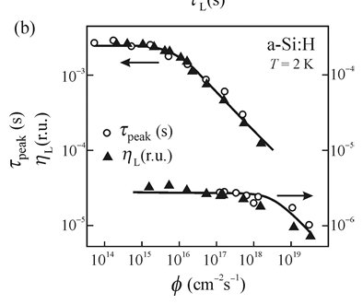

Some properties of luminescence of disordered semiconductors
Correlation effects
Non-radiative recombination
Luminescence of impurities and defects
Luminescence ’fatigue’
Possible paths of non-radiative recombination of
e-h pairs in amorphous semiconductors:
Recombination mediated by dangling bonds
(Shockley-Read recombination of defects in
the middle of the bandgap)
Thermal quenching
Recombination of non-geminate e-h pairs
Auger recombination (high excitation)
Surface recombination (unsaturated bonds at surface)
Thickness of non-luminescence layer:
D is a photocarrier diffusion coefficient (small in disordered semiconductors, such that L ≈10 nm)
Although the concentration of surface defect is high,
the contribution by the surface non-radiative recombination is small (~ 10%)

Slide 12
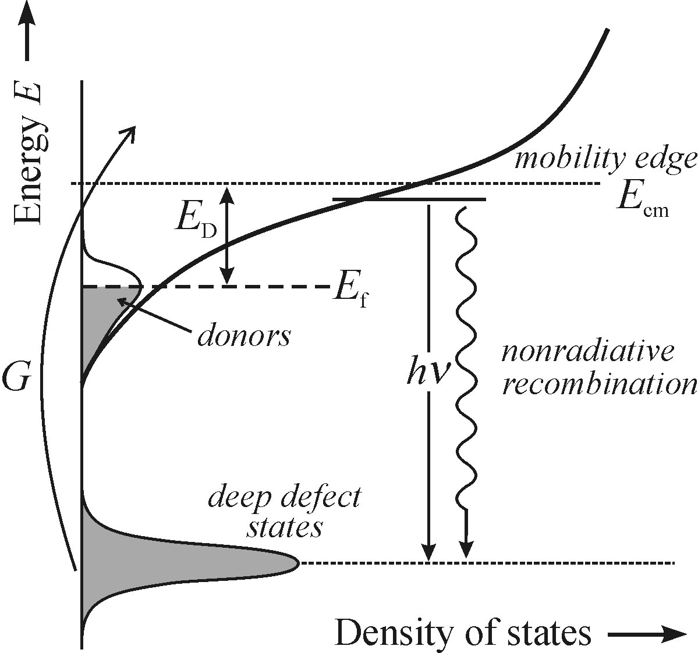
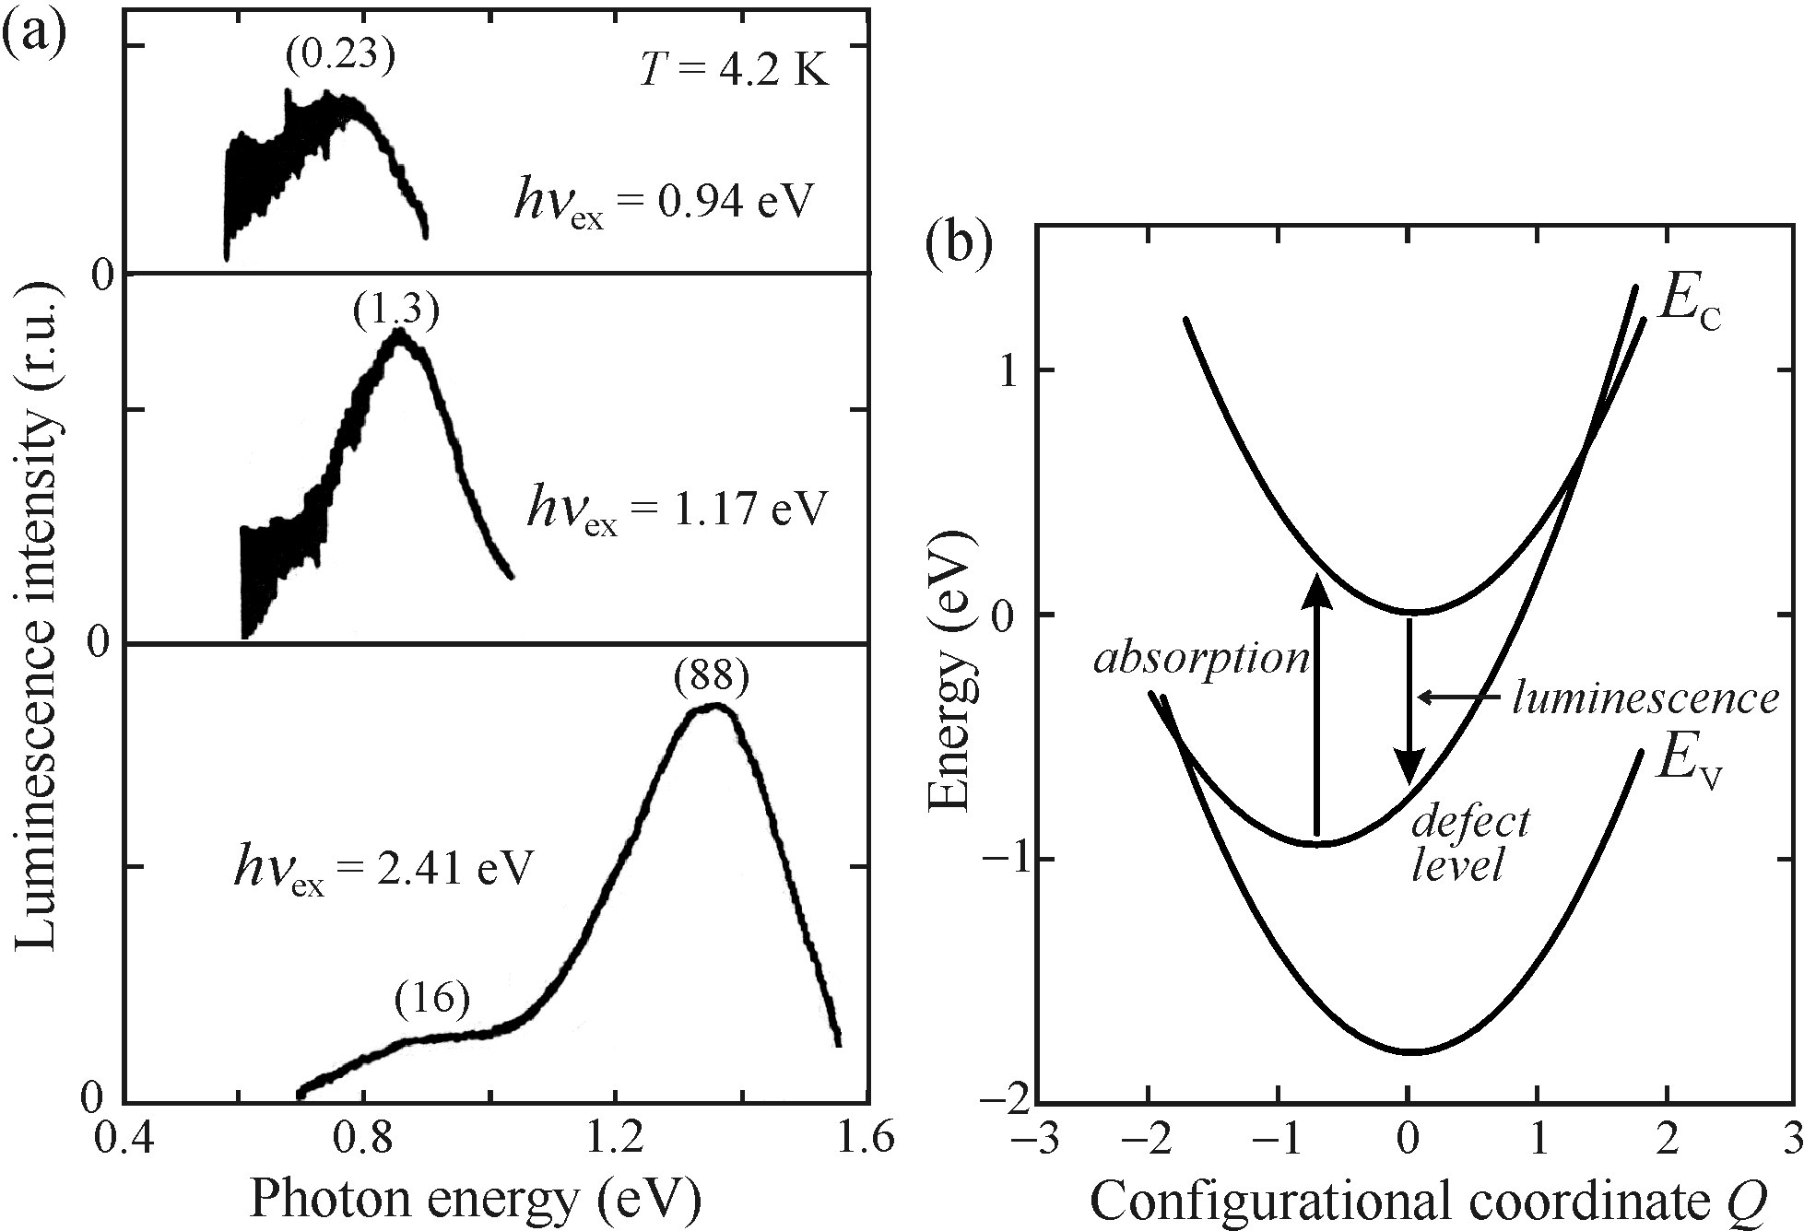
Some properties of luminescence of disordered semiconductors
Correlation effects
Non-radiative recombination
Luminescence of impurities and defects
Luminescence ’fatigue’
Distribution of binding energies, such as E_{D}
Impurities: new dangling bonds
Mainly non-radiative
High doping: weak luminescence
a-Si:H doped with phosphorus/boron
new emission band in Infrared ( ~ 0.8 eV)

Slide 13
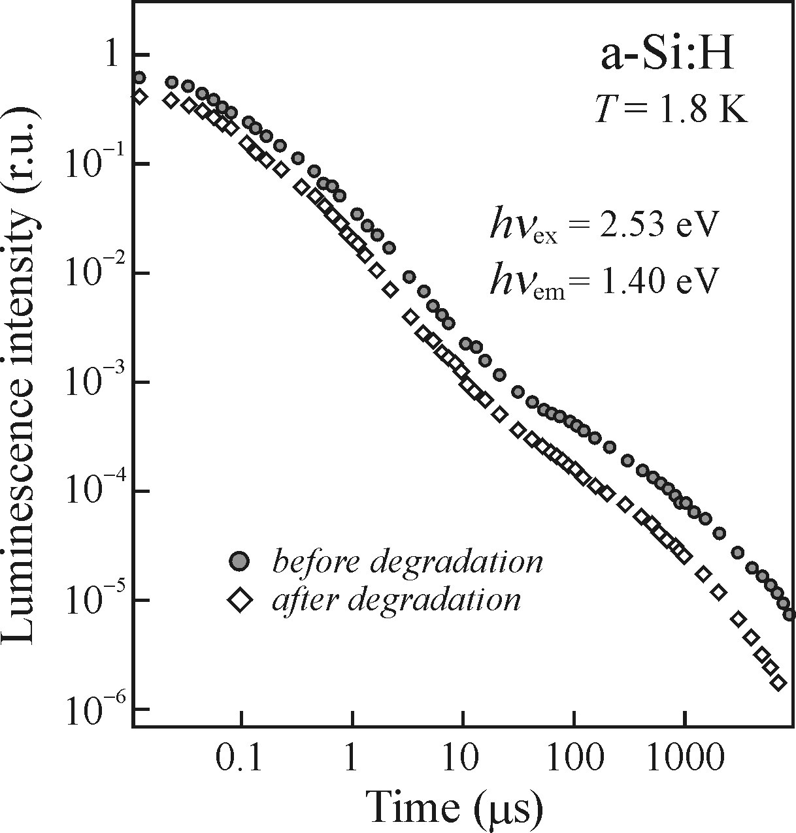
Some properties of luminescence of disordered semiconductors
Correlation effects
Non-radiative recombination
Luminescence of impurities and defects
Luminescence ’fatigue’
Gradual fading of main emission band under
high excitation due to dangling bond formation
Staebler-Wronski effect (solar cell degradation)
Annealing at 150-200 of a-Si:H for 1 hr recovers it

Slide 14
Stimulated emission
Special case of luminescence
Non-equilibrium thermodynamic conditions are needed: population inversion
Non-linear effect

Slide 15
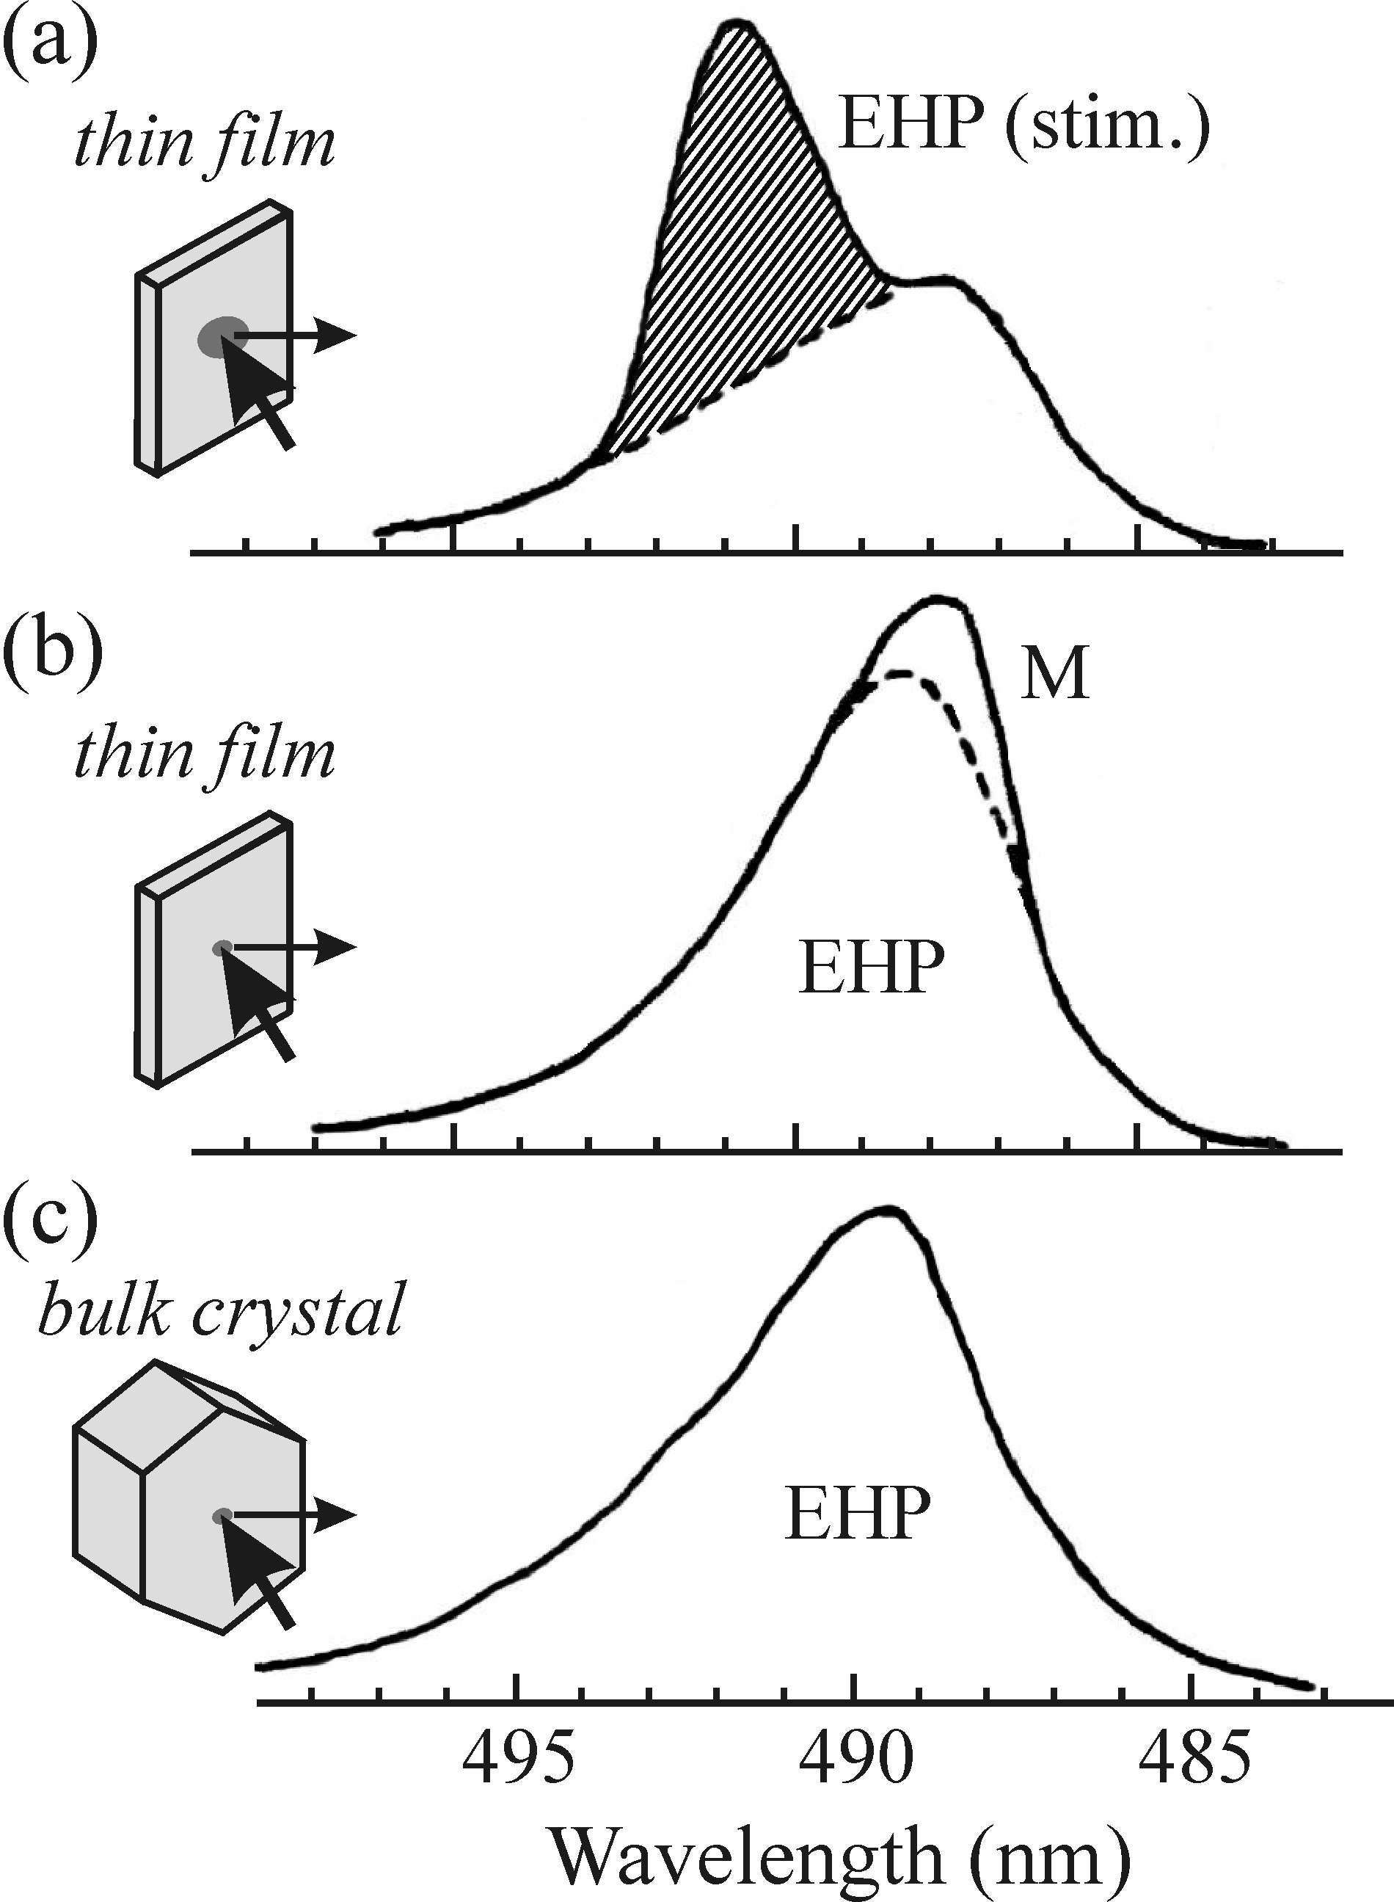
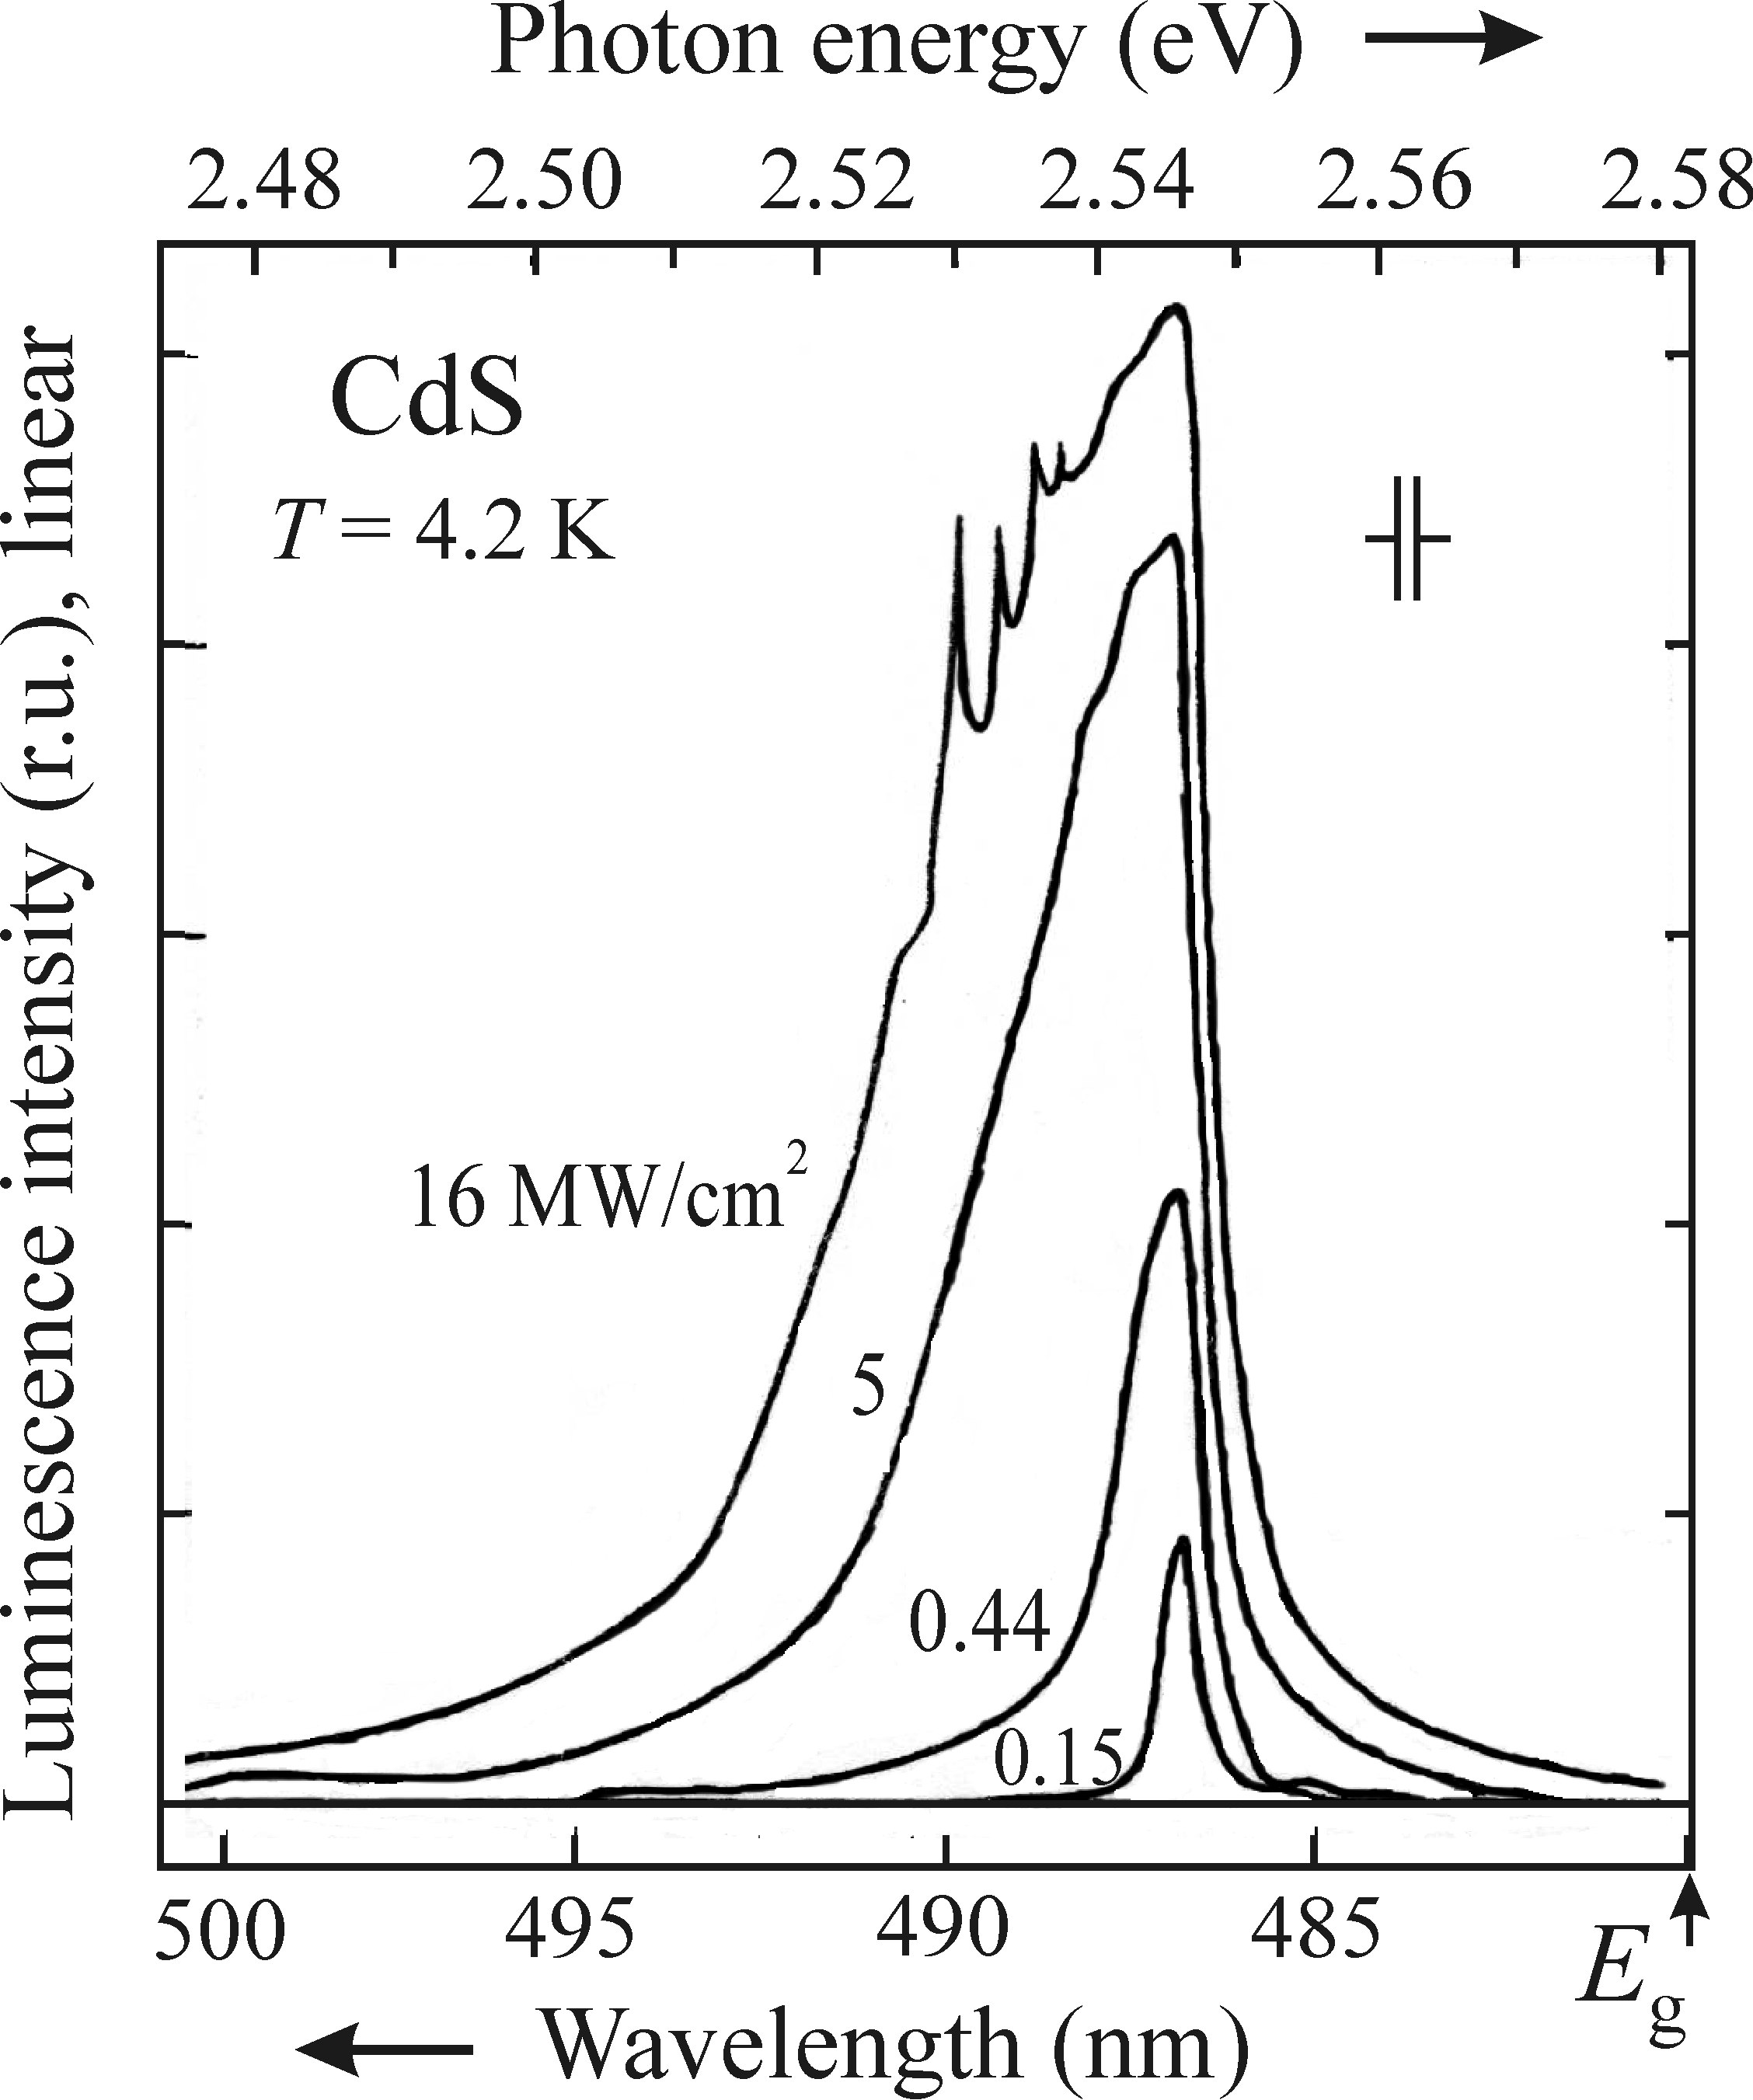
Stimulated emission in PL experiments
Shape of the sample and the applied
geometery of experiment
As a fundamental principle of lasers √
Basic research on radiative recombination ×
Large excited spot (~ 1mm) and high optical quality
surface: spontaneous emission will stimulate the
emission of other photons
Even a very small spot 10x10 um² can give rise to
stimulated emission at high excitation power
Decay time of stimulated emission is much faster than
spontaneous emission

Slide 16







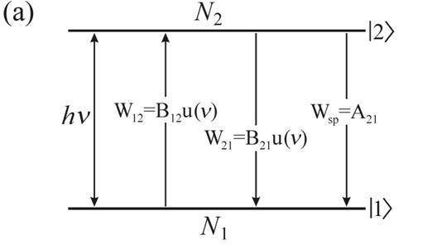
Spontaneous versus stimulated emission
Rate of transitions from I2> to I1> by spontaneous emission:
( Einstein coefficient )
Rate of stimulated emission and absorption from I2> to I1>:
and
specral energy density of resonance radiation
Einstein coefficients of absorption and stimulated emission

Slide 17
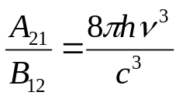
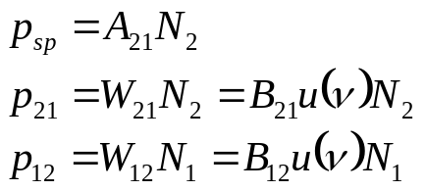
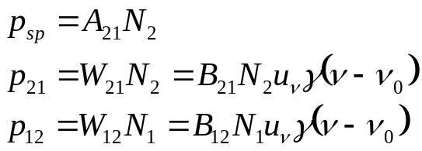





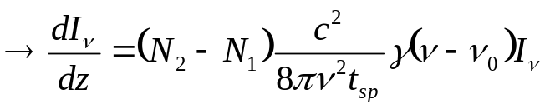
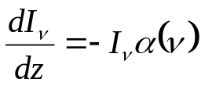
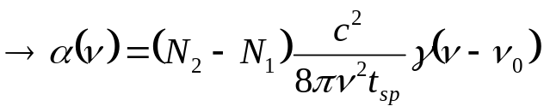
Absorption coefficient (optical gain coefficient) in atoms
Introduction of
Lineshape function
Population of individual levels: N
Number of atoms per unit volume and time participating: p
Parallel beam of photons with power flux density (Intensity)
Impinging to the atomic system in the z-direction
Intensity variation
Contribution of spontaneous emission in given direction is much smaller than stimulated emission
For non-degenerate levels
Lambert-Beer law:
for inverse population N₁<N₂ – optical gain, for normal population – absorption

Slide 18

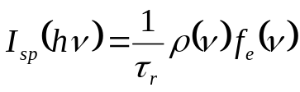
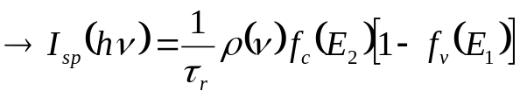
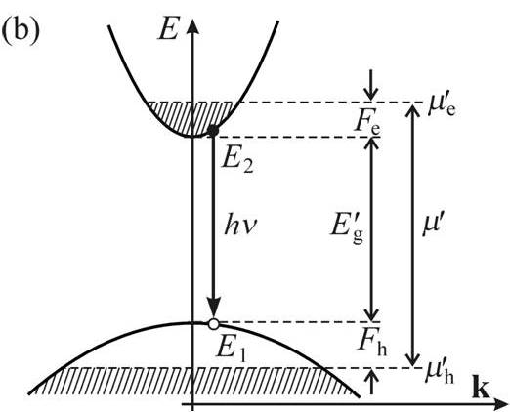

Optical gain in semiconductors
Instead of discrete atomic lines – bands in a semiconductor
Density of states in the conduction and valence band
For band-to-bad spontaneous emission under low excitation
f(v): probability of ’suitable occupancy of states’
Occupied joint states per unit volume then
Light with a broad spectral distribution: u(v)

Slide 19

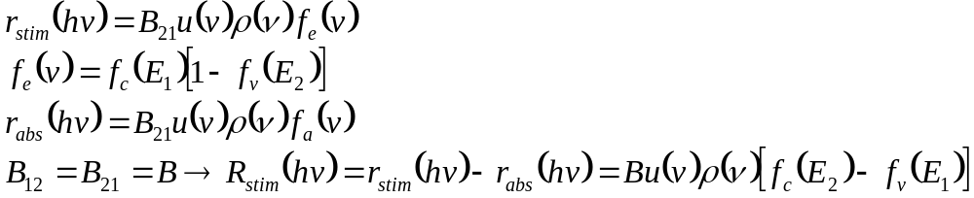
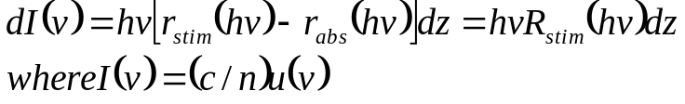

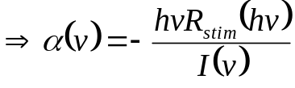
Optical gain in semiconductors
Probability density of stimulated emission
(Stimulated emission rate (the number of the photons) emitted per 1Hz & 1cm˄3)
The overall stimulated emission rate
Linewidth of energy levels in semiconductor is much smaller than the frequency band of
stimulated emission, approximation:
probability of photon emission (electron and hole co-existence)
Spectral distribution of the intensity
I(v) should satisfy Lambert-beer law

Slide 20
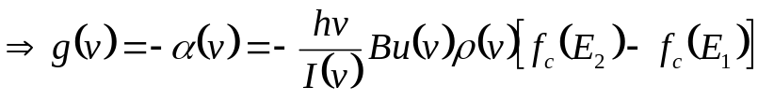
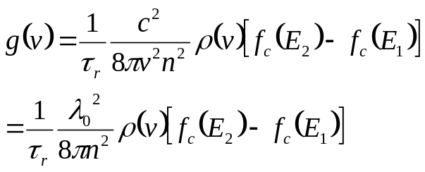

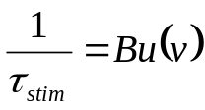
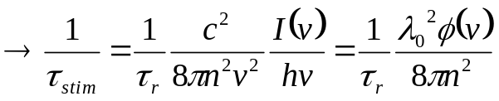
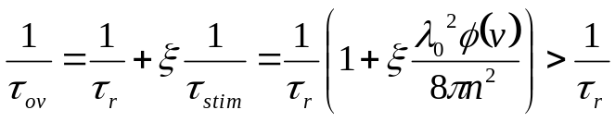

Optical gain in semiconductors
Light wavelength in vacuum
n refractive index
Time characteristics:
Experiment: detected emission spectra: both spontaneous & stimulated with overall radiative life
relative part of the excited volume of material that takes part into stimulated emission
Measured lifetime shortening is a typical feature of stimulated emission onset

Slide 21
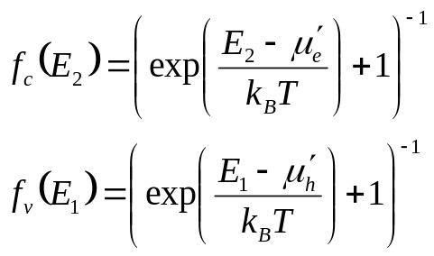



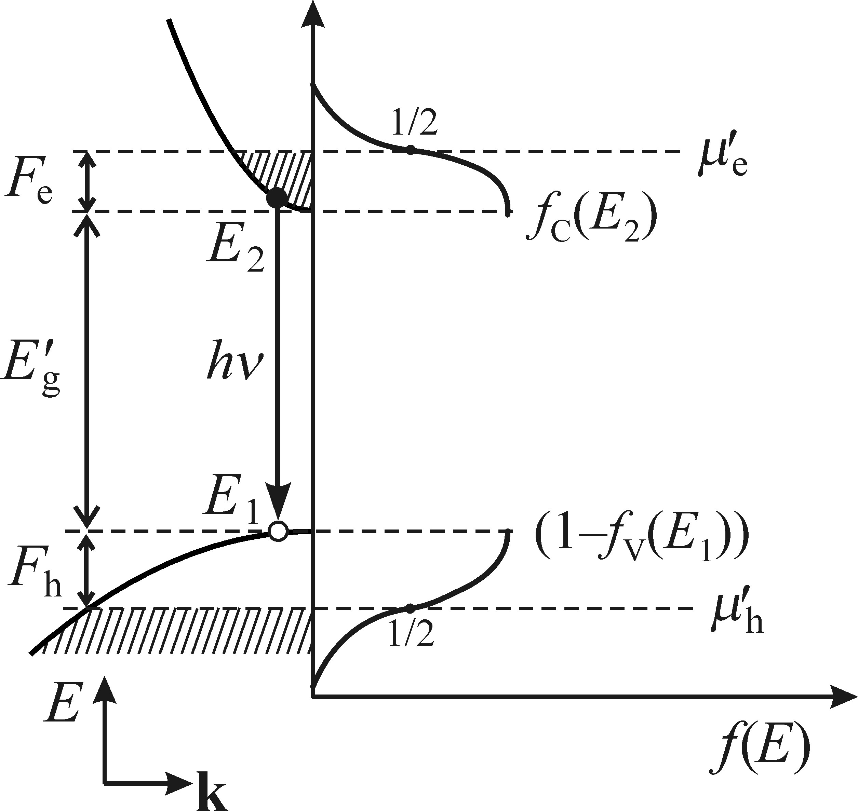



Spectral shape of the optical gain
Separate quasi-Fermi level for electrons/holes
Fermi inversion factor
Condition for the occurance of optical gain in semiconductors Γ (υ)>0
Bernard-Duraffourg condition for inverse population of states (to have gain, not absorption):
Inversion population in atomic levels:
In bulk material:
Amplification of light through stimulated emission in semiconductors occurs only for photons arise from radiative transitions between states in CB with probabilty of being occupied by electrons larger than ½, and states in VB with the probability of being occupied by electrons lower than ½.

Slide 22
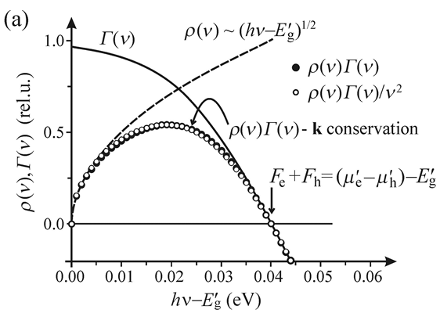
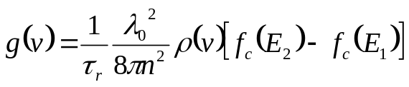
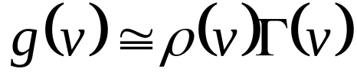
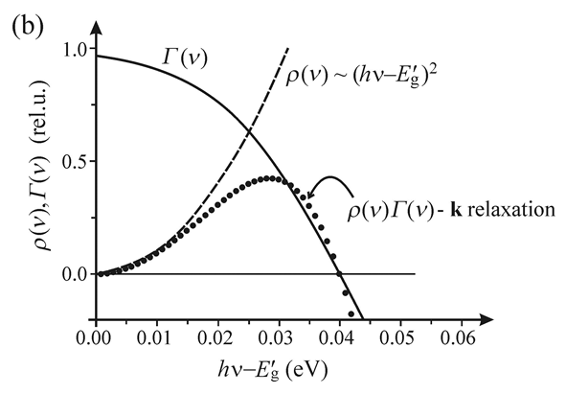
Spectral shape of the optical gain
However, experimental curve
is different!

Slide 23
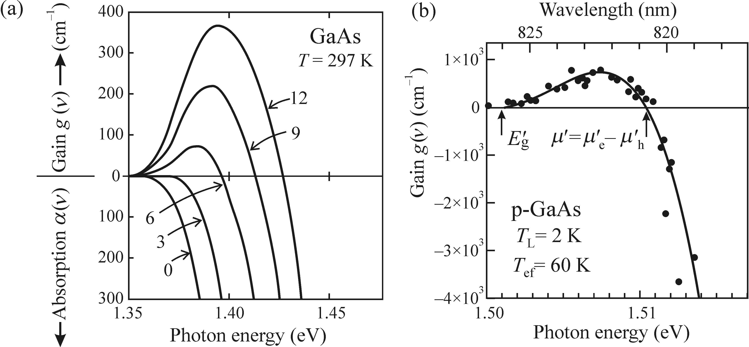
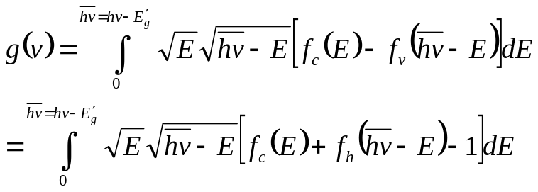
Spectral shape of the optical gain
EHP: effectively ignoring k-conservation law?
Inhomogeneously distributed e-h pairs distort the ideal translational symmetry of the lattice?
The presence of impurity atoms?
Radiative EHP recombination k conservation is hold locally through multiple collisions between electrons & holes?

Slide 24
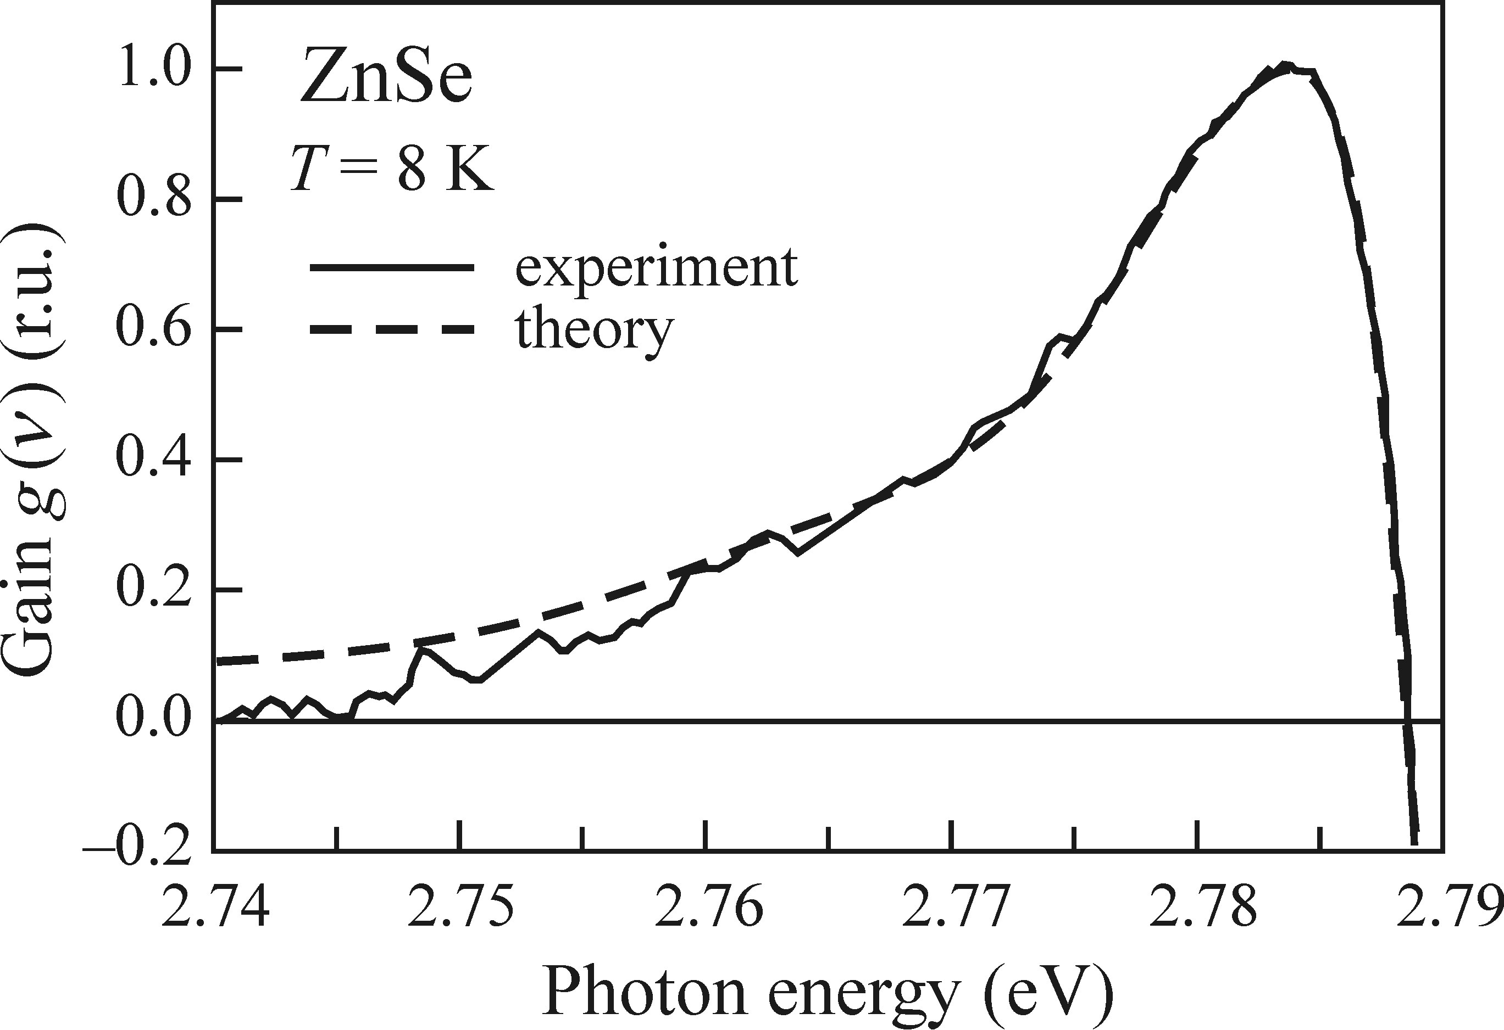
Spectral shape of the optical gain
k-conservation stands, but corrrections factors need to be applied:
Final state damping in EHP (quick filling of just-recombined states)
Excitonic enhancement (exciton resemblence)
Dashed lines: theory calculations, considering k-conservation law and
Final states damping and excitonic enhancement

Slide 25
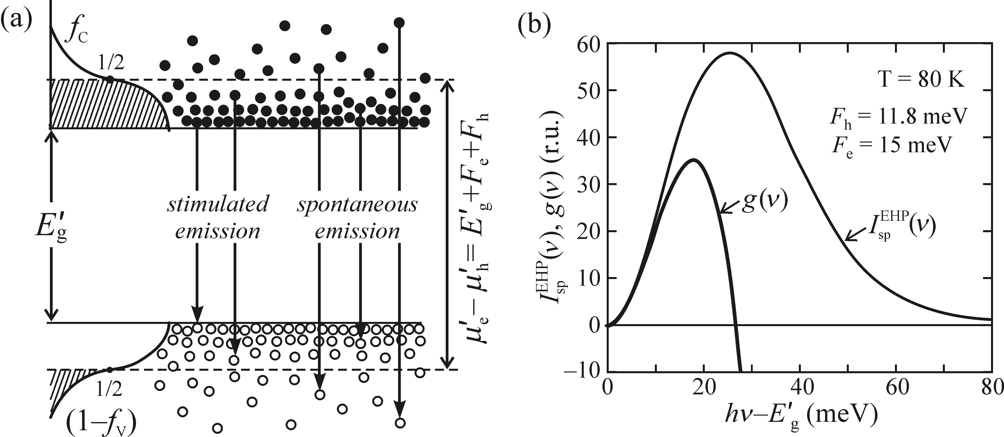

Spectral shape of the optical gain
Spectral position of the gain with respect to the maximum of the spontaneous emission band
The effect of temperature on gain
The higher the temperature the more difficult to obtain gain:
Semiconductor heterostructures were needed to achieve room temperature high gain

Slide 26
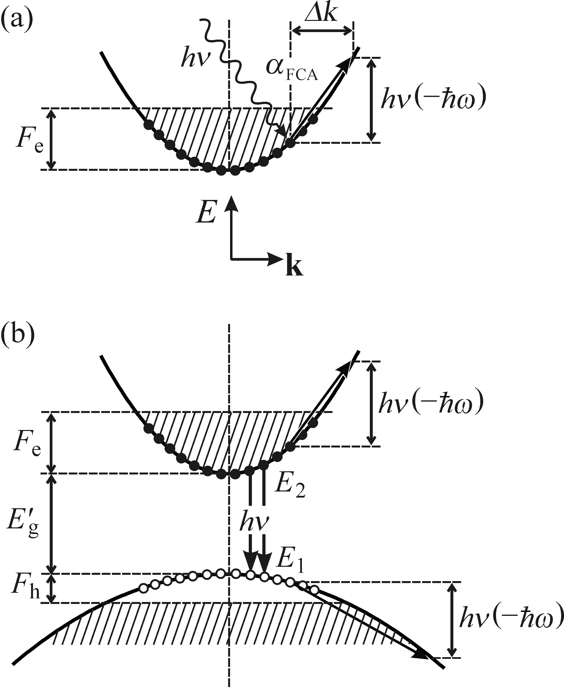
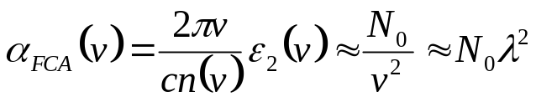




Stimulated emission in indirect bandgap semiconductors
Longer radiative recombination, lower values of optical gain
Free carrier absorption (FCA): Drude model
Free electron gas with free electron concentration
Optical radiation frequency
Imaginary part of dielectric constant

Slide 27


Stimulated emission in indirect bandgap semiconductors

Slide 28
Experimental techniques for measuring the optical gain
Variable stripe length (VSL) technique
Pump and Probe method (P&P)
- Both techniques are based on direct measurements of the amplification of a weak probe beam
Difference: methods in the origin of probe beam

Slide 29










VSL technique
FCA
Impurities
Increase of stripe
length dx
Mode confinement factor
Solution
Modal gain
g(v) is material gain

Slide 30



VSL technique
High optical gain in 1970’s
Deviation between fitted line with
experimental data gets shorter with increasing excitation intensity: Gain saturation
Spectral narrowing by increase of l
High gain value
Low gain values, VLS is less reliable

Slide 31


VSL technique
In the case
Several parameters should be considered:
If t is too large
Const. pump intensity along stripe:
rectangular beam profile & uniformly
distributed pump energy
Part of Gaussian beam can be used
Constant efficiency of coupling of I(SPE)
to monochromator or detector
Diffraction of the pump beam on the slit
or razor blade, limiting utilization of the
stripe length

Slide 32

Pump and probe method (P&P)
Weak external probe beam
Changes in the absorption coefficient
of the probe beam

