Slide 1
Electroluminescence
Ruslan Ivanov
ICT

Slide 2
Overview
Electroluminescence
High-field electroluminiscence
Injection electroluminiscence
Electroluminiscence of a p-n junction biased in the reverse direction

Slide 3
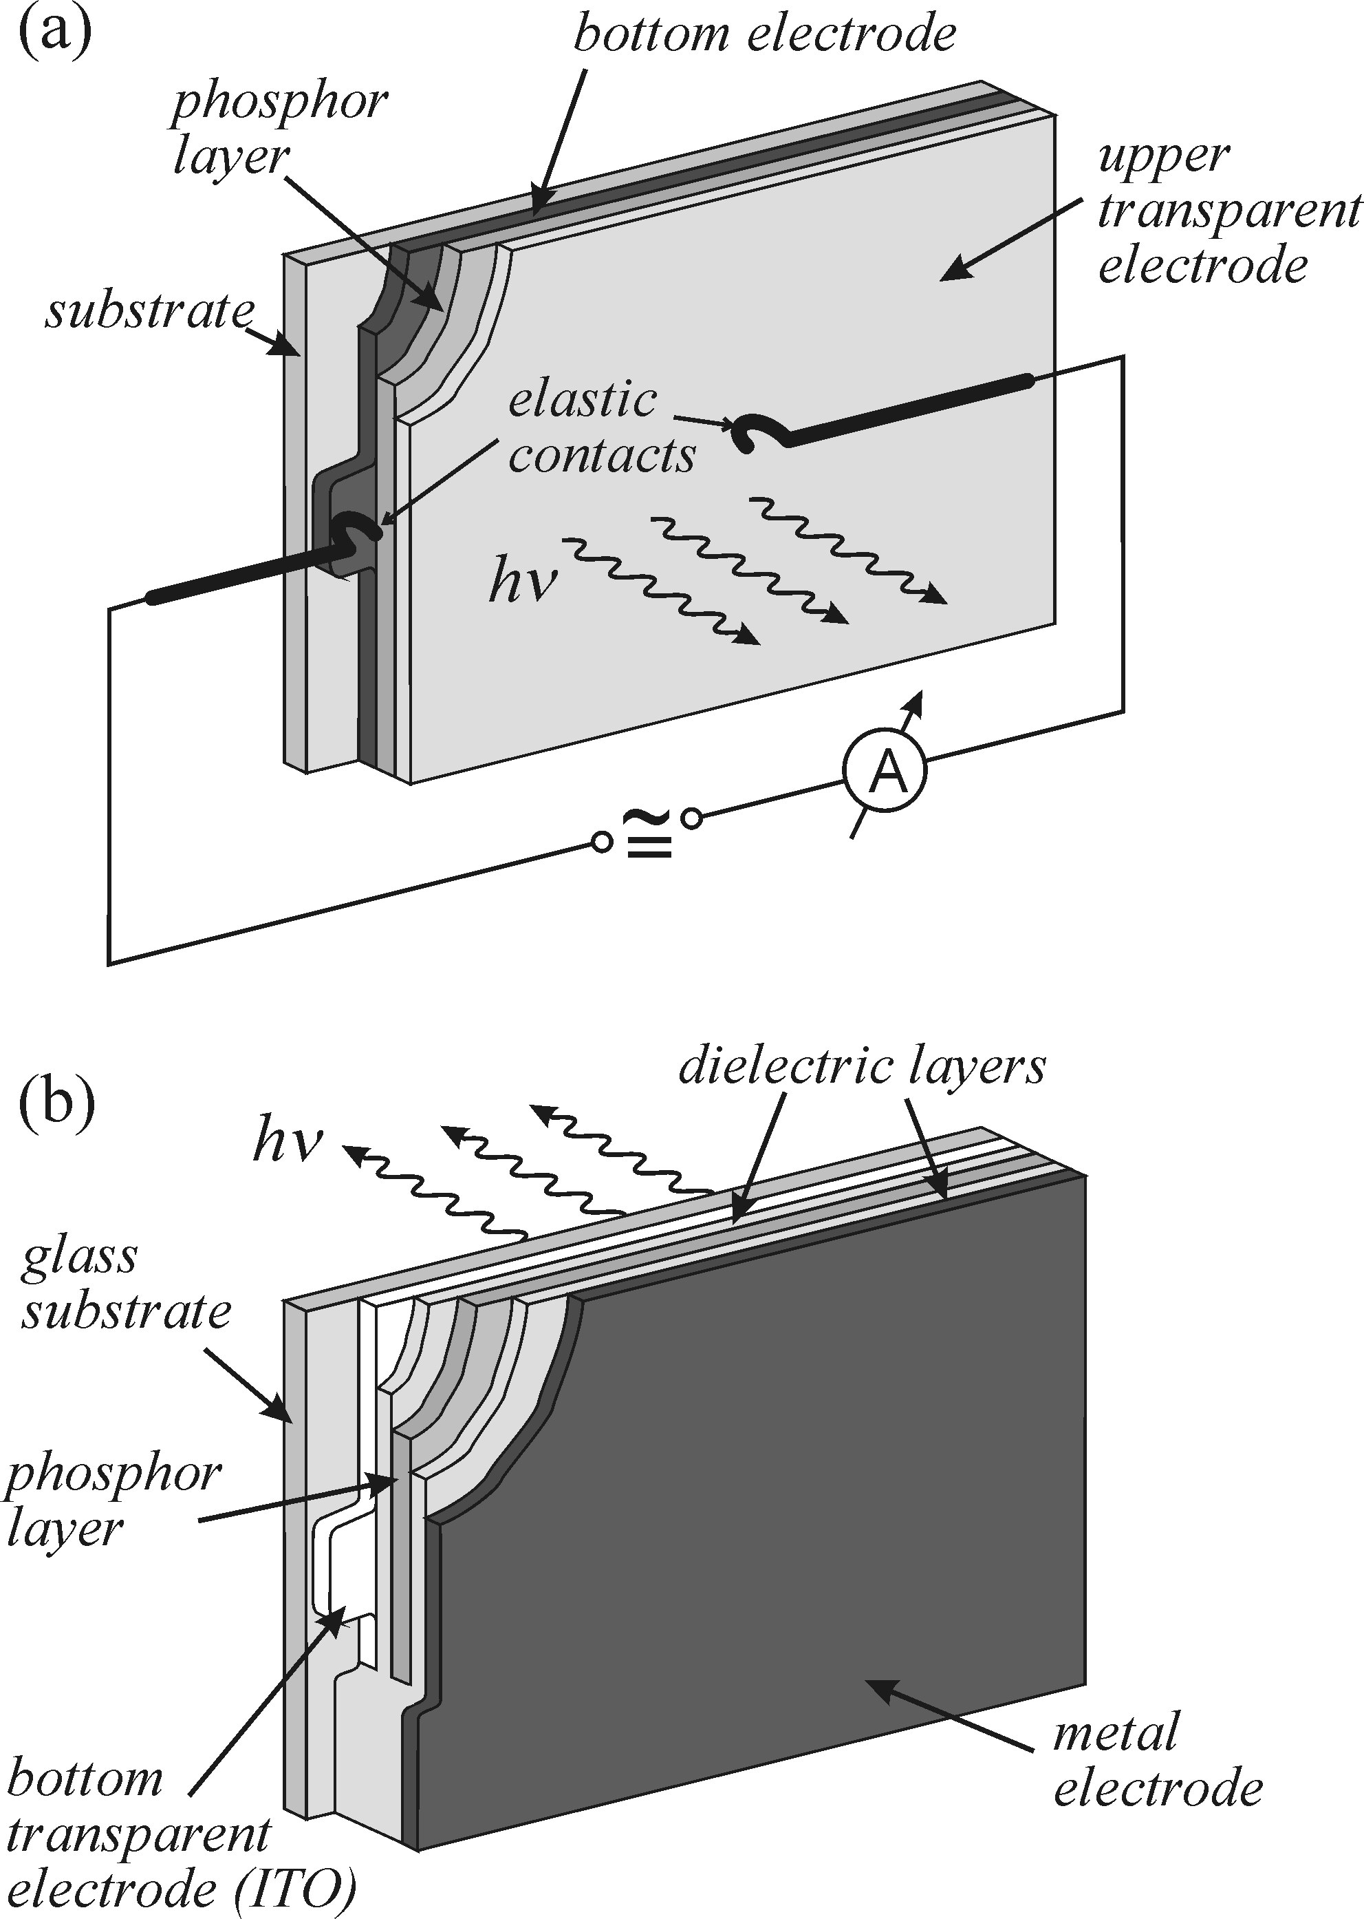
High-field electroluminescence
Can be divided into subcategories:
• electroluminescence of powder phosphors (the phosphor particles dispersed in a dielectric);
• electroluminescence of thin films (a homogeneous thin layer of a phosphor between electrodes);
• electroluminescence of a reverse-biased p-n junction
Principal schematic of a sample for
high-field electroluminescence studies:
(a) galvanic connection (DC, AC)
(b) capacitance coupling (AC excitation only) – less degradation of sample

Slide 4
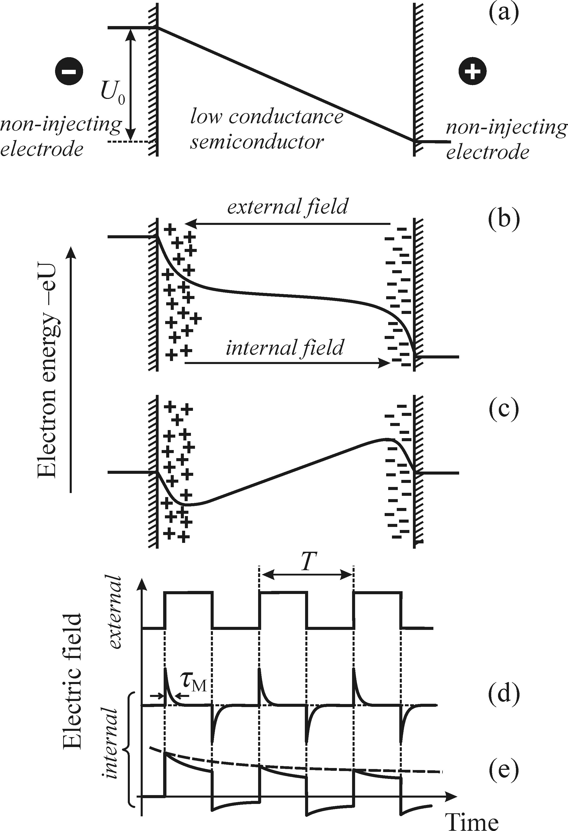

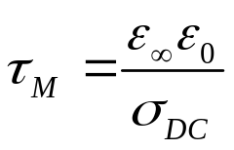


High-field electroluminescence
Difficulties of using pulsed excitation
External voltage – ON → polarization by free carriers and formation of the space charge near electrodes → intrinsic electric field
External voltage – OFF → field of opposite polarity appears for time ~
- dielectric relaxation time
Other important effects:
High electric fields at grain boundaries and in the vicinity of the electrodes and the presence of hot electrons in these regions; the processes of the recombination of electrons with holes and of surface recombination; inhomogeneities of the phosphor and the presence of potential barriers, etc.

Slide 5

High-field electroluminescence
Problems of measuring
Measurements at low temperature
Studies of electroluminescence at low temperatures are not common as photoluminescence studies.
luminescence intensity increases since non-radiative processes decreases rapidly with T
the efficiency of excitation of luminescence centres decreases, because with T
the importance of applications of electroluminescence requires that electroluminescence processes are investigated at room temperature

Slide 6
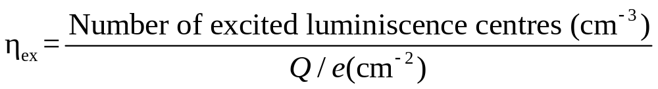
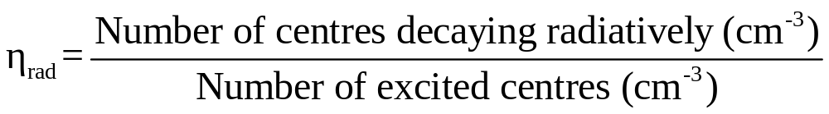
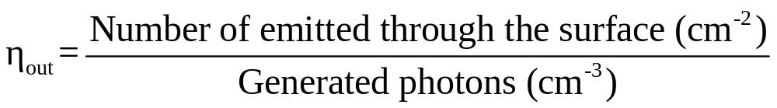
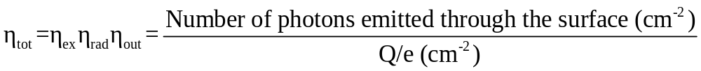
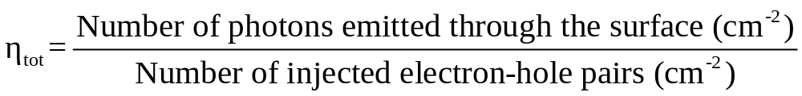
High-field electroluminescence
Electroluminescence efficiency
Excitation efficiency
Radiative efficiency
Outcoupling (external) efficiency
Total efficiency
Total efficiency of the injection electroluminescence
limited mainly by the optical transmission of the semitransparent output electrode, total internal reflection and by the surface morphology

Slide 7
Mechanisms of high-field electroluminescence
Processes excluding cases of:
Low temperature (recombination of free and most bound excitons, luminescence of the electron–hole liquid)
High excitation
Extrinsic luminescence of localized centres, primarily ions of the transient metals and rare-earth ions
Recombination processes involving the participation of neutral donors and acceptors, in particular the luminescence of donor–acceptor pairs. (the ionization energy of donors and acceptors is sufficiently high for the impurities to exist in their neutral state also at room temperature)
Intrinsic recombination of free electron–hole pairs. The probability of such a process is, however, in comparison with processes (1) and (2) very low at room temperature
Presence of free carriers

Slide 8
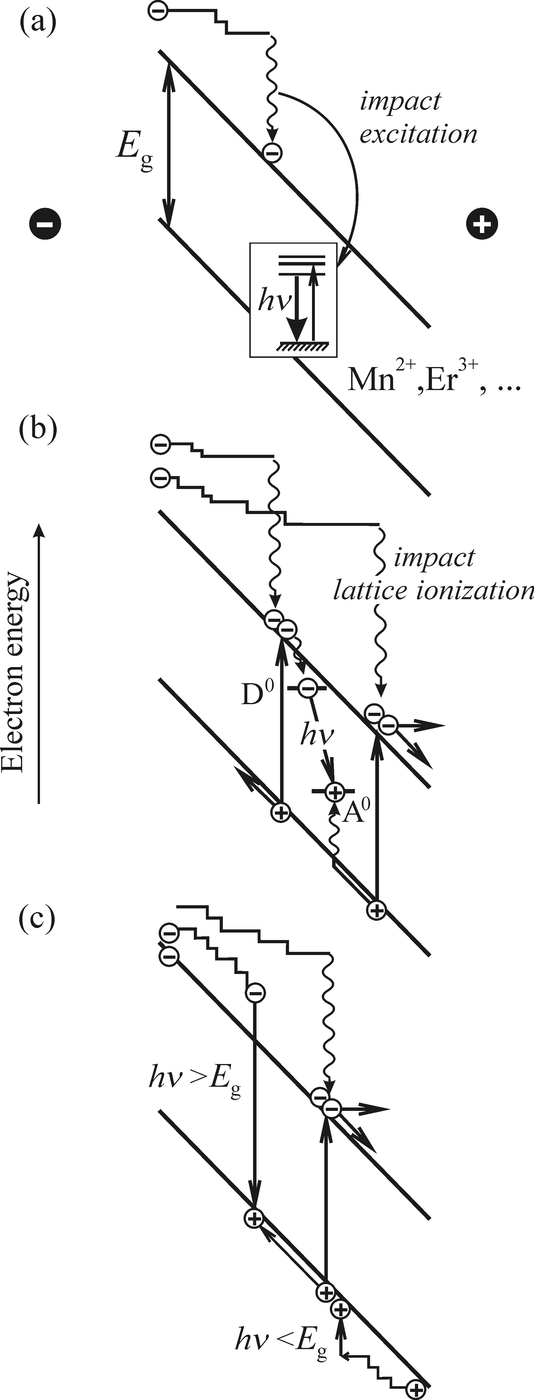
Impact ionization and excitation
Impact excitation
Free carriers (e) are accelerated in an electric field → transfer energy to luminescence centres due to inelastic collisions → electrons relax to the bottom of the conduction band; photons are emitted owing to the electron transitions in luminiscence centre between levels of the not fully occupied (3d) shell (ZnS: Mn²⁺)
Impact lattice ionization
leads to the luminescence of donor – acceptor pairs
Intrinsic electroluminescence process

Slide 9

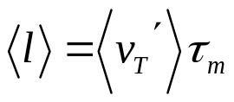
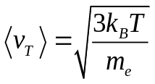

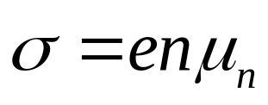
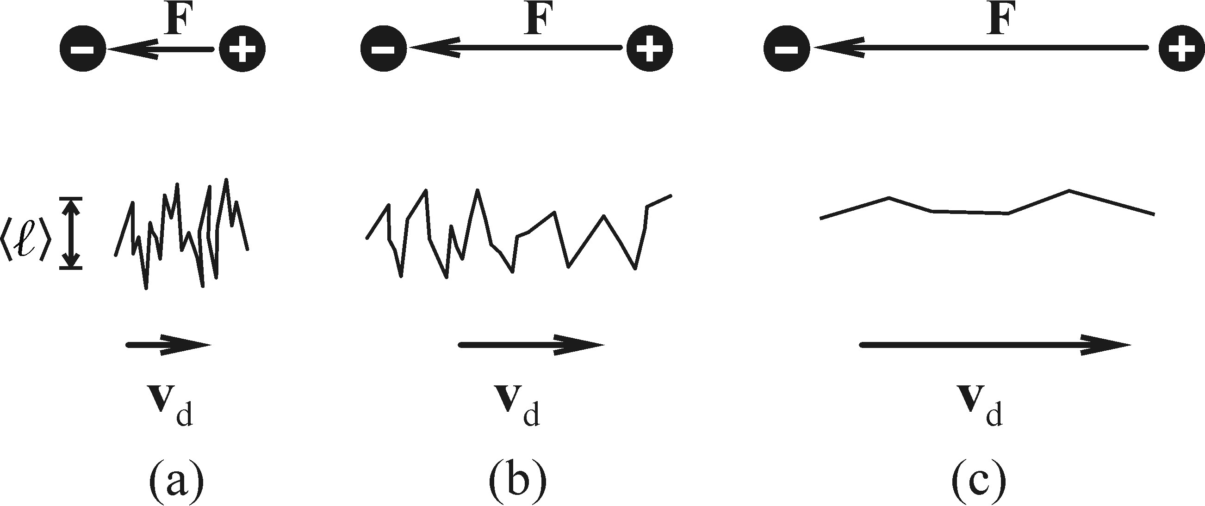
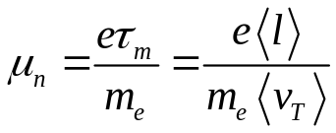
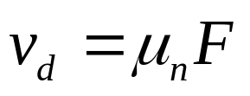
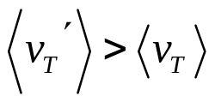




Hot electrons
The minimum required energy of an accelerated electron is much higher than the lattice temperature T (~2eV for ZnS: Mn²⁺), i.e. hot electrons required for the excitation process.
In weak fields (F 10³ V/cm ) electron distribution – Boltzman:
- mean free path between collisions
- mean velocity of thermal motion
When field is low, drift velocity and Ohm’s law is applicable:
, n – electron concentration
- electron
mobility
Since some F₀ → electron systems heats up, , scattering on acoustic phonons →
Further increase of F → slow increase of , beginning of inelastic scattering on optical phonons → saturation of

Slide 10
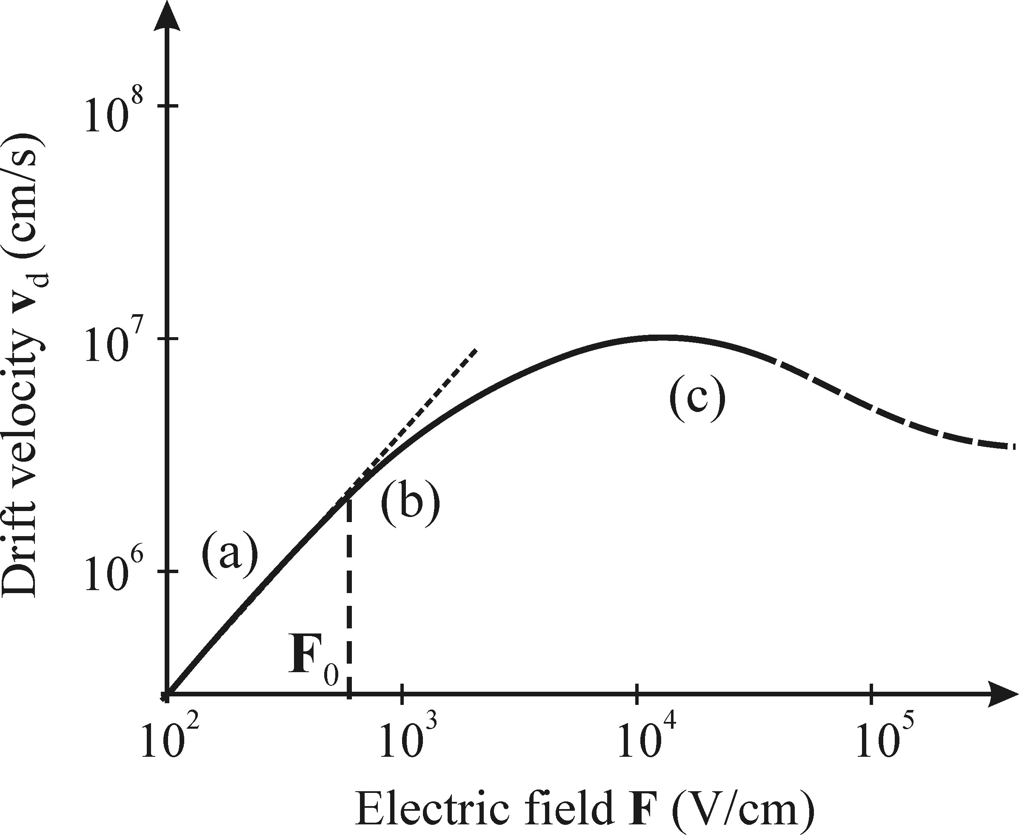
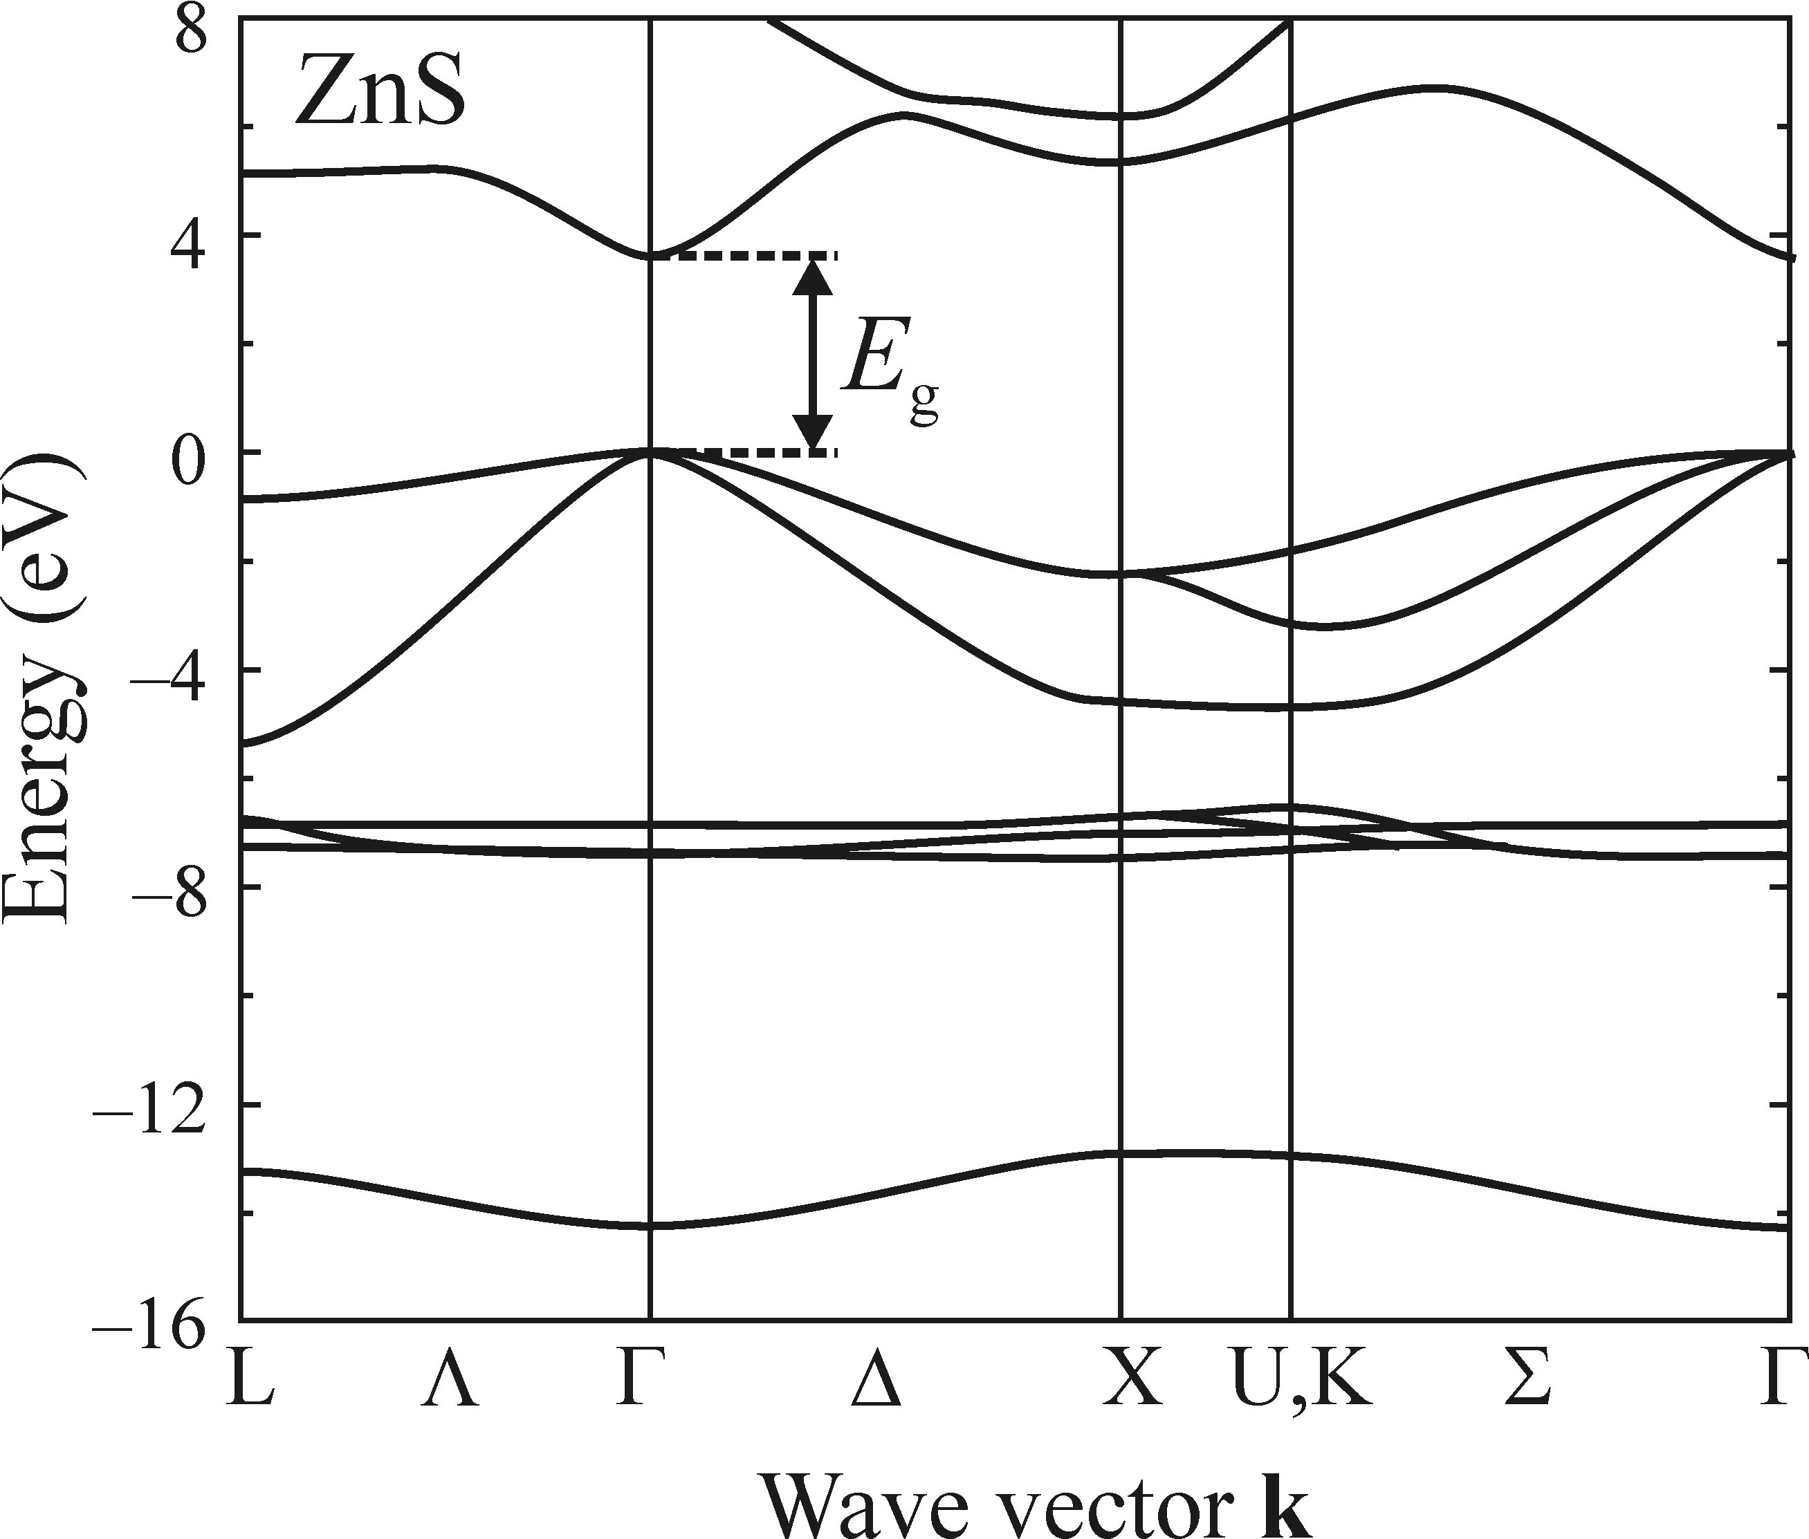
Hot electrons
Further increase of F leads to decrease of mobility. F~10⁷V/cm → lattice ionization accompanied by the generation of free electron–hole pairs can occur
High-field electroluminescence processes lie at the edge of semiconductor avalanche breakdown
Negative differential conductivity
- arises from transitions of the accelerated electrons from the absolute minimum of the conduction band at the Г-point to a higher-situated minimum at some other points of the first Brillouin zone (intervalley scattering)\
Required high electrical field
Specific band structure: the energy separation between the minima is much higher than k_{B}T and, at the same time, smaller than the bandgap width E_{g}

Slide 11
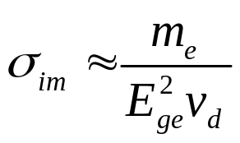
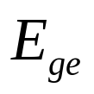

Hot electrons
Interband transfer of hot electrons to higher valleys is very important for high-field luminescence
Impact excitation cross-section - the efficiency of impact excitation of the luminiscence (Mn²⁺ in ZnS) centres
,me – electron effective mass (increases for higher located band valleys)
- energy loss of electrons corresponding to the excitation of the Mn²⁺ centre from its ground to the excited state
- drift velocity
Although the decrease in mobility of hot electrons with increasing Fturns out to be a prerequisite for efficient and safe electroluminescence, we have to realize that the initial high mobility μ n in low fields is no less important. It helps to attain the desired energy of hot electrons in fields of a reasonable intensity F.

Slide 12
Generation of free carriers
Mechanisms:
injection of majority carriers from electrodes;
release of carriers from deep traps localized in the phosphor, due to both high electric field and tunnelling;
release of carriers from traps on the boundary between a dielectric and the phosphor.
(galvanic)
(both)
(capacitance coupling)

Slide 13
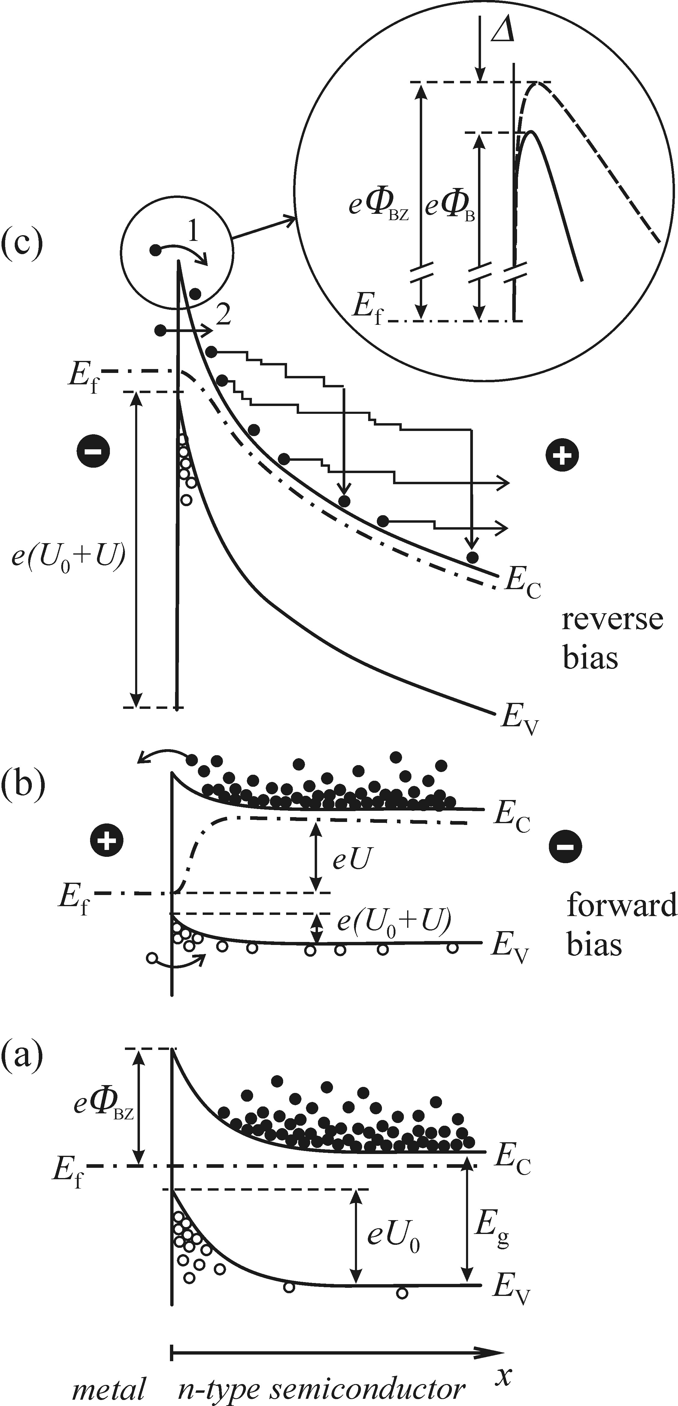
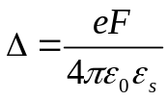
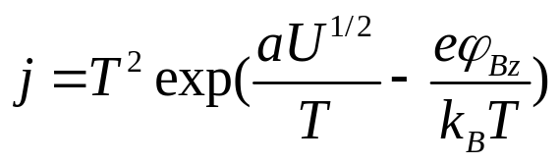
Injection of majority carriers from electrodes
Charge carrier injection - a disturbance of the equilibrium space distribution of carriers by a local increase of their concentration beneath the surface, or at an interface with another material
‘Injection’ refers to the injection of minority carriers
To achieve electroluminescence in high fields the crucial process is the injection of majority carriers
Steady state
Forward bias U<0 →injection of minority carriers
Reverse bias U>0 → the built-in potential barrier for electrons is decreased by → field keeps the injected electron current at a magnitude sufficient to sustain the stability the electron concentration and keeps the injected electron current at a magnitude sufficient to sustain the stability the electron concentration
Fowler–Nordheim tunnelling

Slide 14
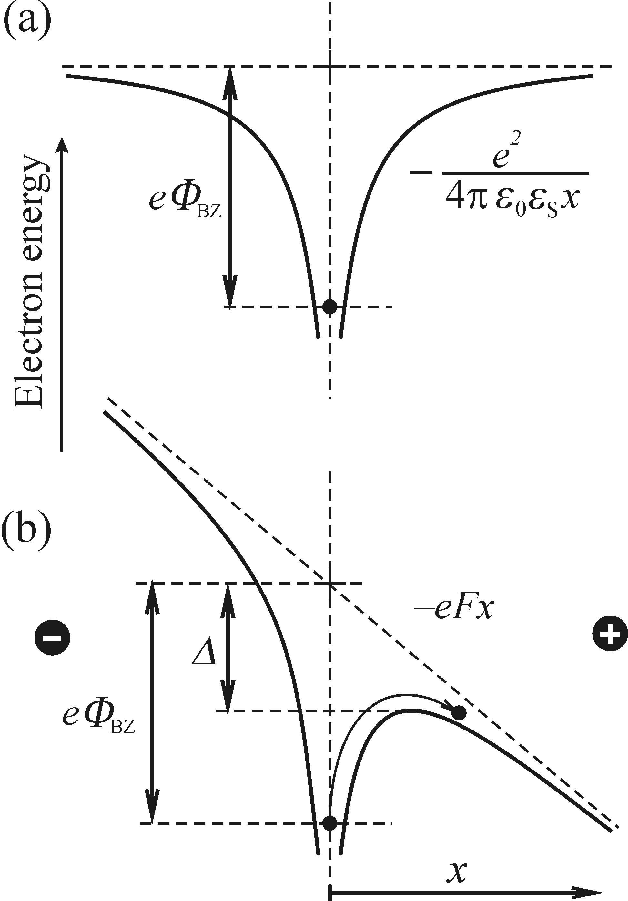
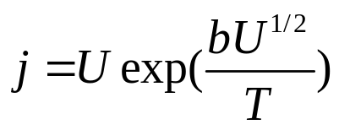
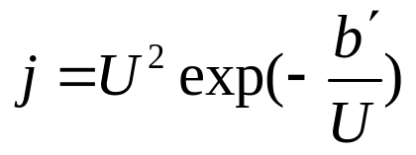
Release of carriers from deep traps
Lattice defects in semiconductors act as deep traps (potential wells) for charge carriers.
Poole – Frenkel effect - upon the application of an electric field, a decrease in the potential barrier of the trap occurs leading to the thermal release of trapped electrons into the conduction band
At very high fields dominating contribution is from tunneling:

Slide 15
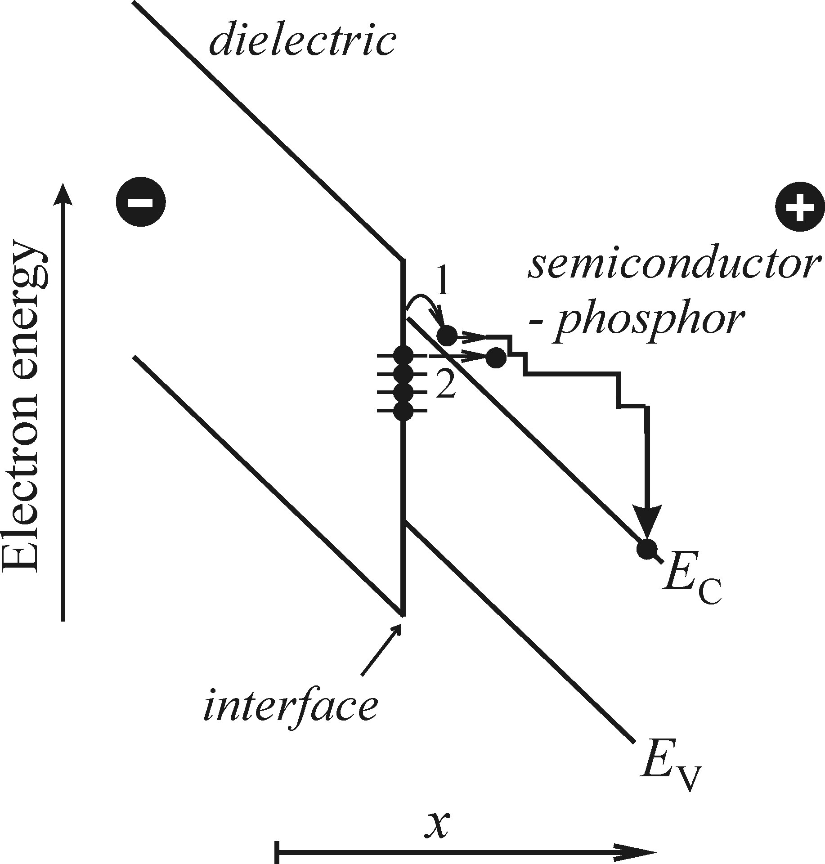
Release of carriers from traps on the boundary between a dielectric and a phosphor
If a semiconductive phosphor is in contact with an insulator lattice defects are formed at the interface. The corresponding electronic states are localized within the forbidden band
Under application of an electric field, electrons captured in these traps can be injected into the conduction band, again either thermally owing to the Poole–Frenkel effect (i.e thermally) or by tunnelling

Slide 16
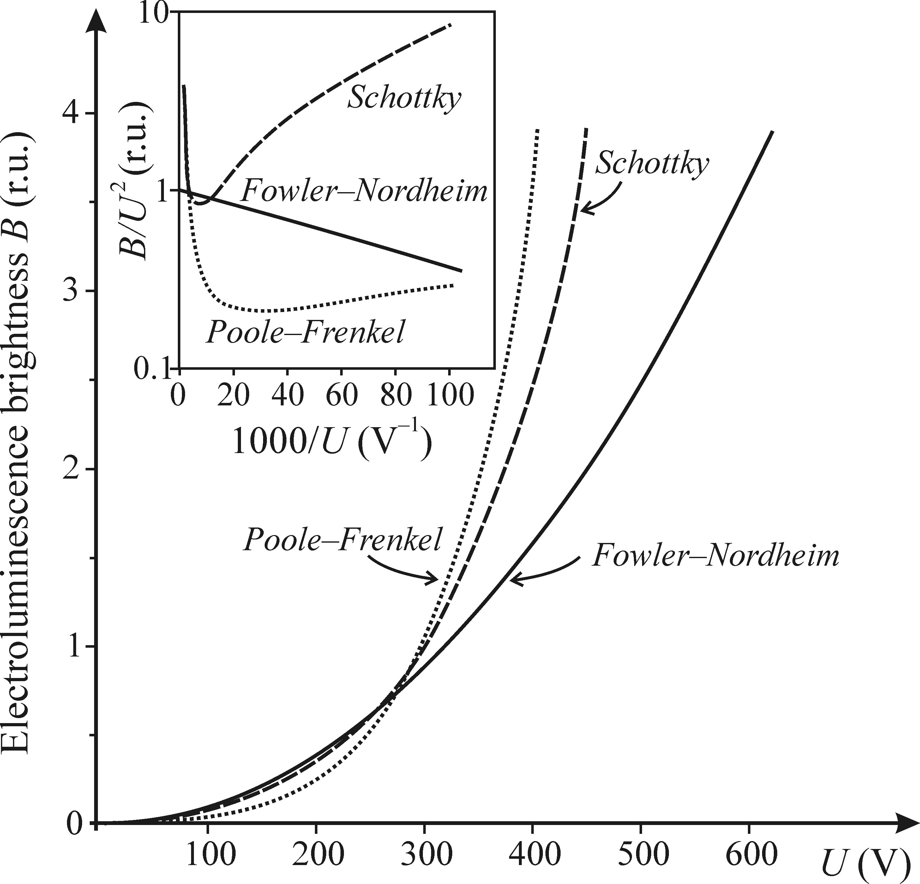
Intensity characteristics of high-field electroluminiscence
Dependence of the electroluminescence intensity (film brightness B) on the applied voltage U
we make the assumption that the brightness B is proportional to the injection current density j
But if we plot in a logarithmic scale B/U²~j/U²(1/U)
Fowler–Nordheim straight line for the case of tunnelling
The study of the B=B(U) dependence on its own can be a sufficiently reliable approach for the determination of the transport or injection mechanisms in electroluminescence in exceptional cases only
Temperature behaviour of the brightness B:
We can’t distinguish the temperature dependence of the excitation current density from that of the radiative process itself.

Slide 17
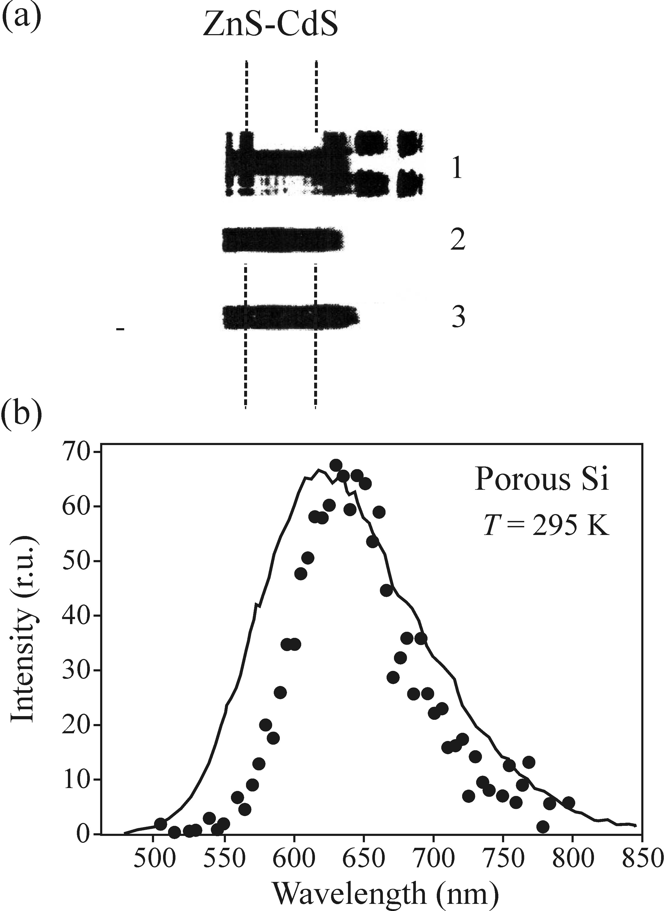
Spectral characteristics of high-field electroluminiscence
If we measure the emission spectrum under both electrical and optical pumping and both the spectra look the same, we can quite reliably conclude that in both cases the same luminescence centre is active
There is no complete identity of both spectra:
the PL emission spectrum can slightly depend on the excitation wavelength
the EL spectrum can depend on the applied voltage, frequency of the AC field
the influence of the semitransparent electrode cannot be neglected
PL
EL

Slide 18
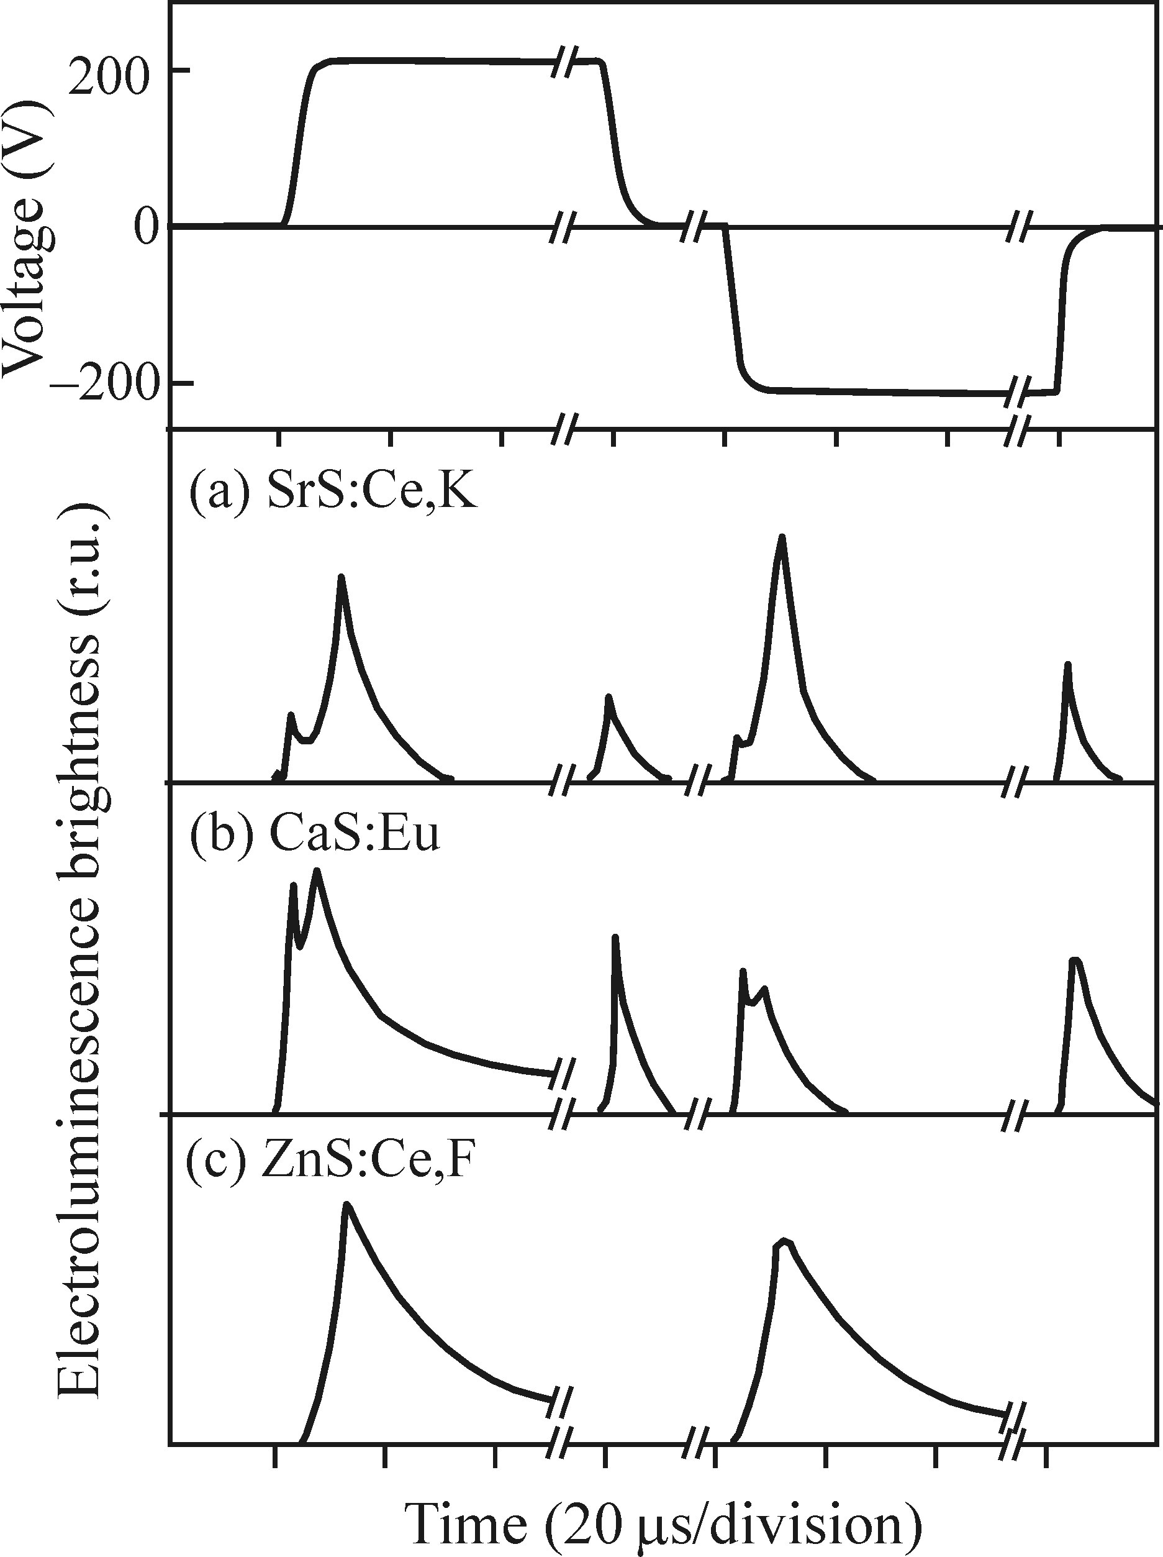
Temporal characteristics of high-field electroluminiscence
The luminescence, pumped with electrical pulses, has the form of short flashes both during switching on and off the voltage
The excitation mechanism:
Impact excitation of the Ce³⁺ and Eu²⁺ centres → their ionization in high electric field creating Ce⁴⁺ and Eu³⁺ ions → electrons released into the conduction band get subsequently localized in traps
Impact excitation of Ce⁴⁺ centres
Voltage is switched off →captured electrons get released into conduction band (via the Poole–Frenkel mechanism) → Radiative transition 4f^{n−1}5d → 4f^{n} inside the luminescence centre
No ionization of the Ce³⁺ centres occurs, but, like the ‘classical’ case of ZnS:Mn²⁺, impact excitation by the accelerated electrons should be considered instead.

Slide 19
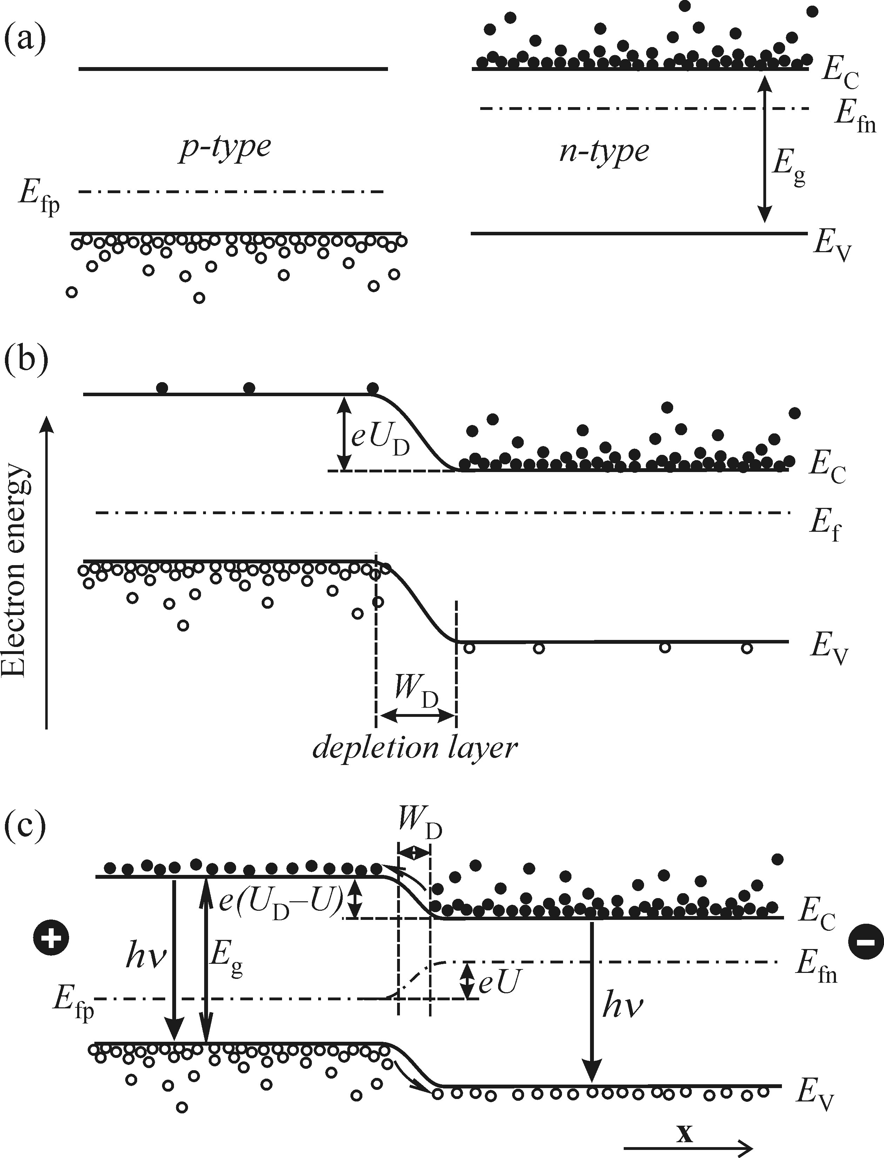
Injection electroluminescence
the radiative recombination induced by the injection of minority carriers into a semiconductor p-n junction
U=0 → mutual diffusion of carriers from p- to n- and from n- to p- regions → electric field, preventing further diffusion of carriers arises → Fermi levels are equalized and a potential barrier U_{D} rises → depletion layer appears on the interface
U>0 (forward bias) → the coincidence of the Fermi levels is perturbed, the internal potential barrier decreases to a value (U_{D} –U) and excess electrons are injected from the n region to the p region → recombination of mixed minority and majority carriers

Slide 20
Electrical properties of a p-n junction

