Slide 1
Car ownership

Slide 2
Why?
Market research: if you are a vehicle manufacturer
Public policy: how much infrastructure, transport planning, land use planning, obvious essential input to travel demand models, equity, sustainability
Planning on a very high level (national, and regional level), but also in detailed planning (block level)

Slide 3
Two different approaches
Time series analysis (either very aggregate, or segmented population)
+ low data requirements
- limited scope
Disaggretage models of household behaviour
+ can be applied for many different research questions
- high data requirements

Slide 4
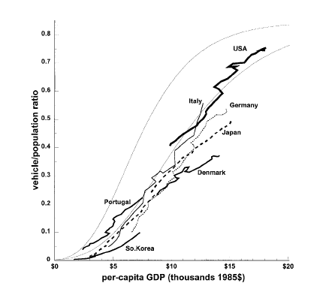
Car ownership versus GDP per capita
26 countries 1960-1992
Dargay and Gately (1999)

Slide 5
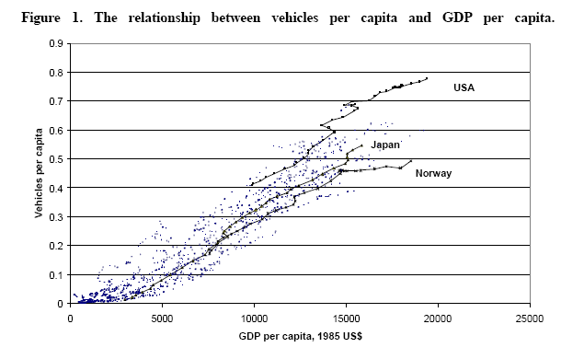

Slide 6
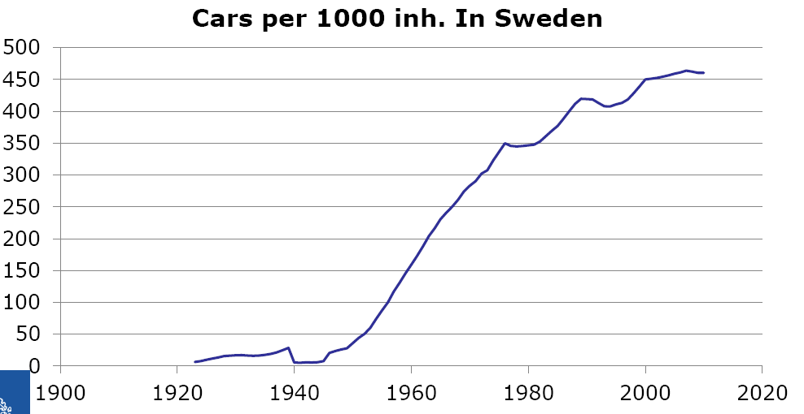

Slide 7
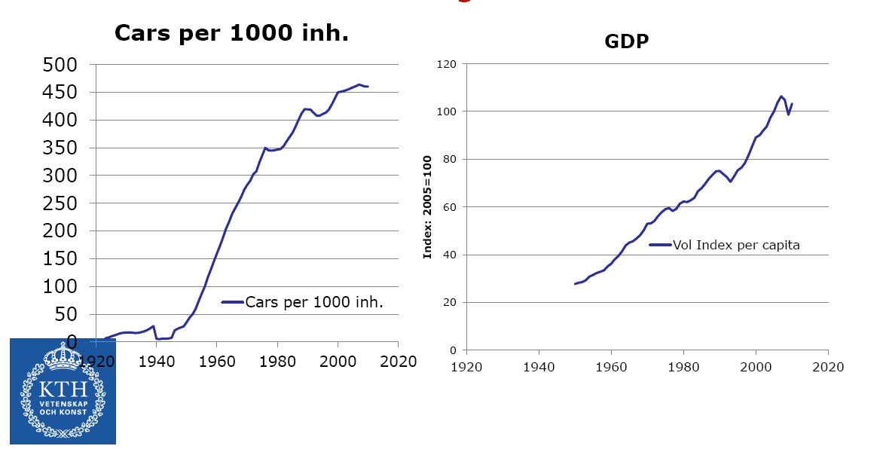
Cars and economic growth in Sweden – over time

Slide 8
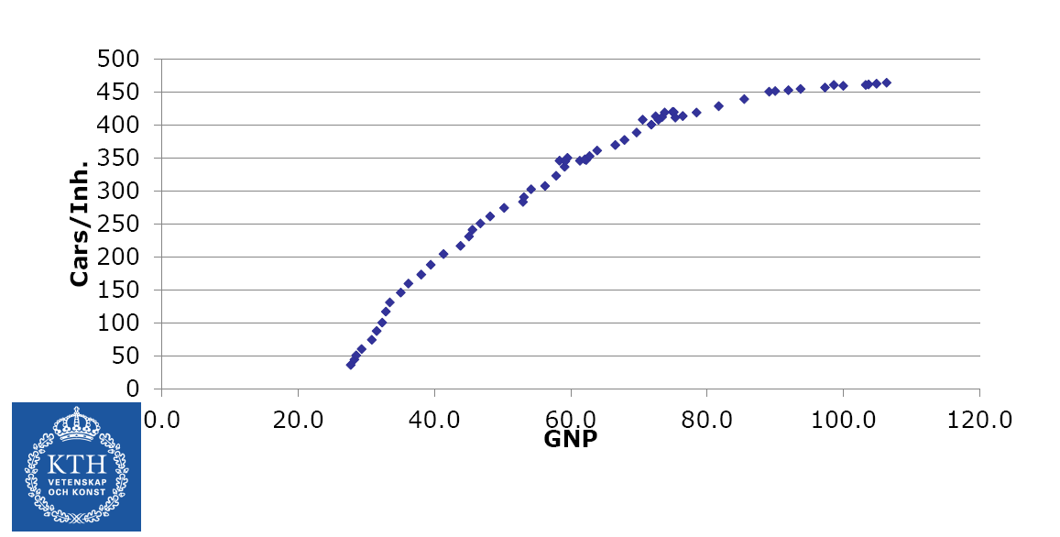
Plot!
Let’s try a quadratic model….

Slide 9
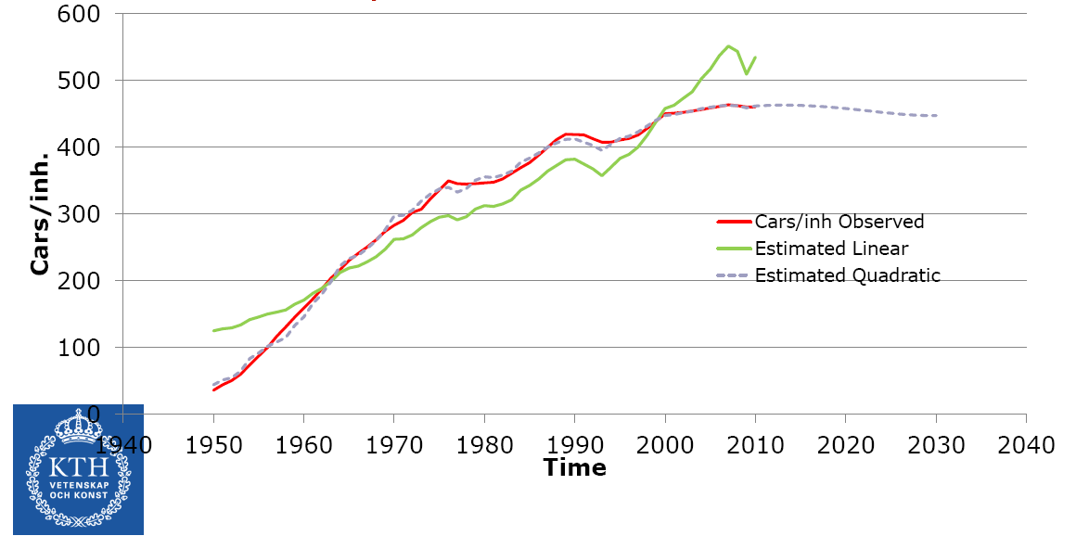
Easily modelled:

Slide 10
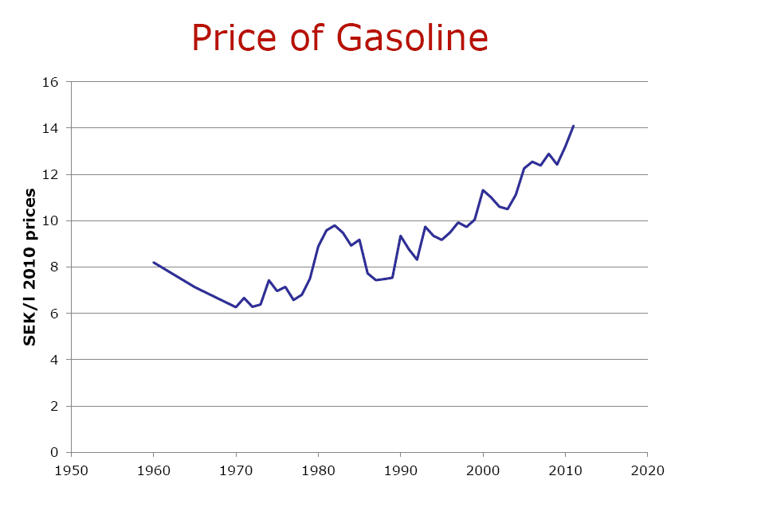
Next, maybe price on gasoline is important?

Slide 11
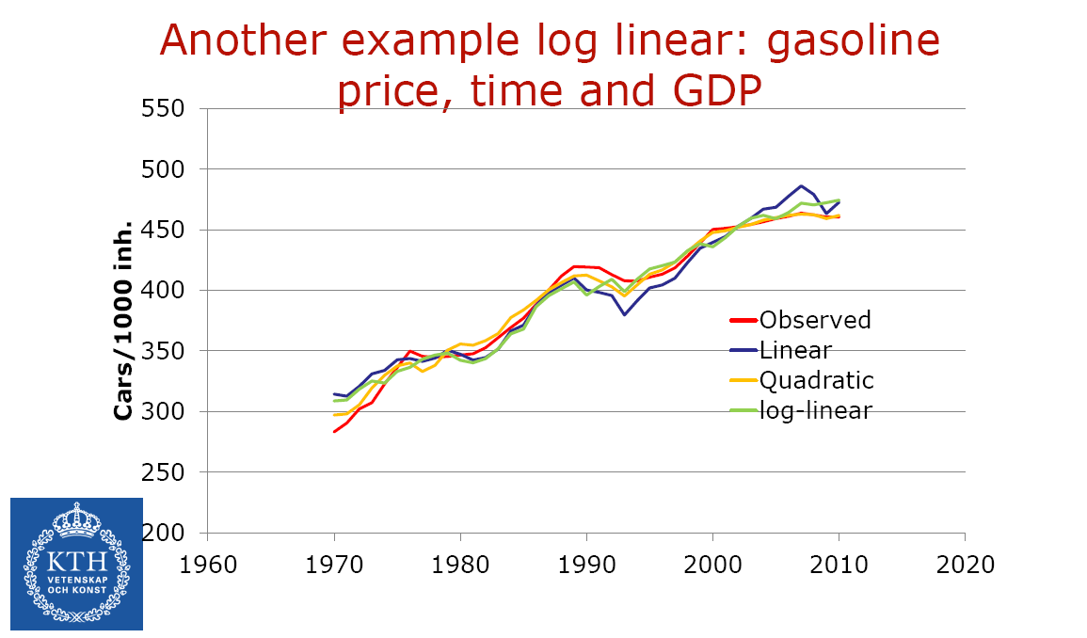
Improve the model

Slide 12
Another improvement
A separate model for segments of the population, in particular cohorts

Slide 13
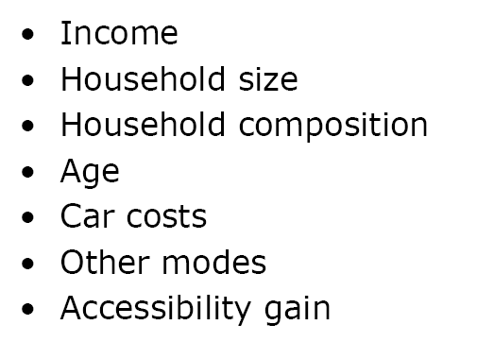
Factors relevant for car ownership?

Slide 14
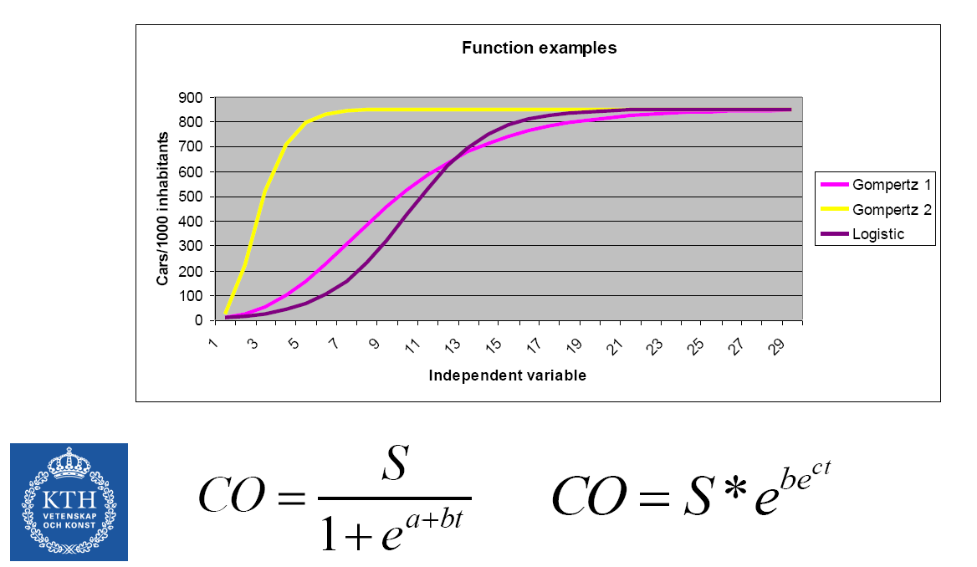

Slide 15
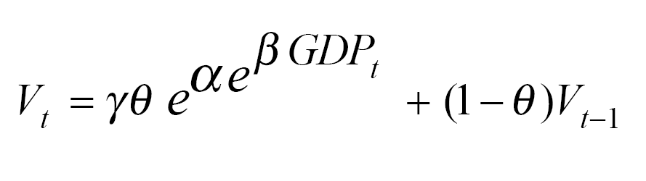
Gompertz model
(Dargay and Gately, 2001)
Cars per capita

Slide 16
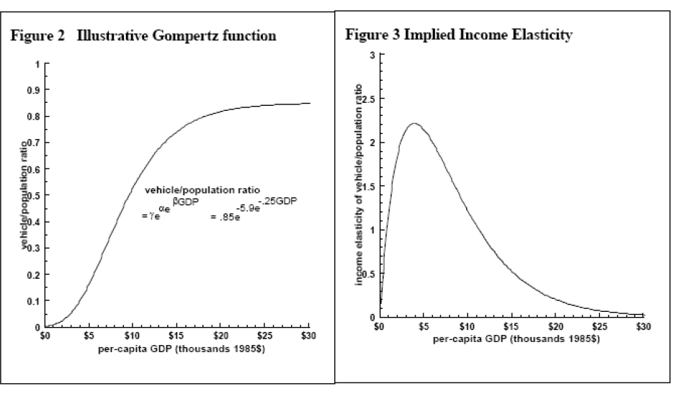
Example

Slide 17
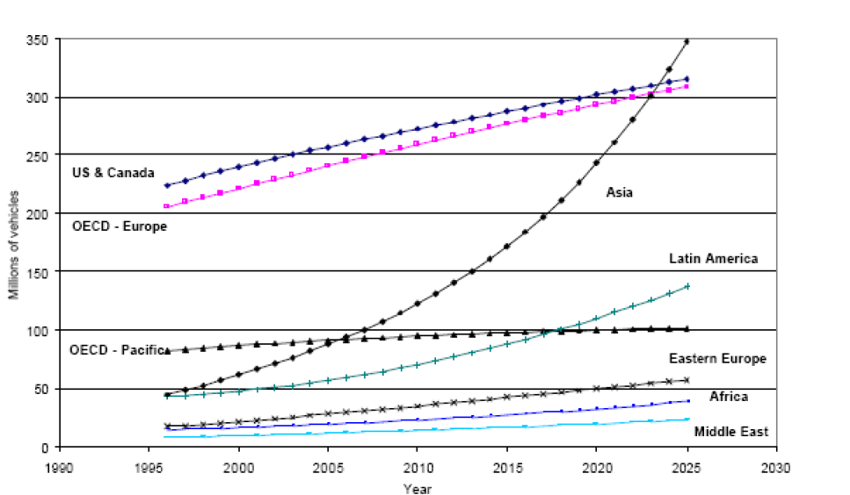
Projections…

Slide 18
Let us pause
What are the assumptions behind these projections?

Slide 19
Let us pause
What about attitudinal change?
What about technological change?
Alternative fuel types
Self-driving cars
….
Cars as public transportation

Slide 20
Cars as public transportation?
Electronical coupling
V2V, V2I, I2V
Fleet management, systems optimum within reach
Land use: suppose that cars can be parked anywhere
What happens with land use?

Slide 21
Take-aways car ownership
For which policy questions do we need to forecast car ownership? Explain.
Time series modelling on aggregate data
Which variables have the highest explanatory power? (what explains car ownership?)
What assumptions are being made for forecasting?
Compare aggregate time series models with disaggragate model of household behavior

Slide 22
Departure time choice and travel time uncertainty
(11.5)

Slide 23
Travel is derived demand
… so is also departure time choice
Two different views (depending on context)
Preferred departure time or
Preferred arrival time (PAT)

Slide 24
Simple Scheduling Model
Schedule Delay Early (SDE)
Schedule Delay Late (SDL)
Slope 2.5
0.5
Slope 0.60
Early
Late

Slide 25
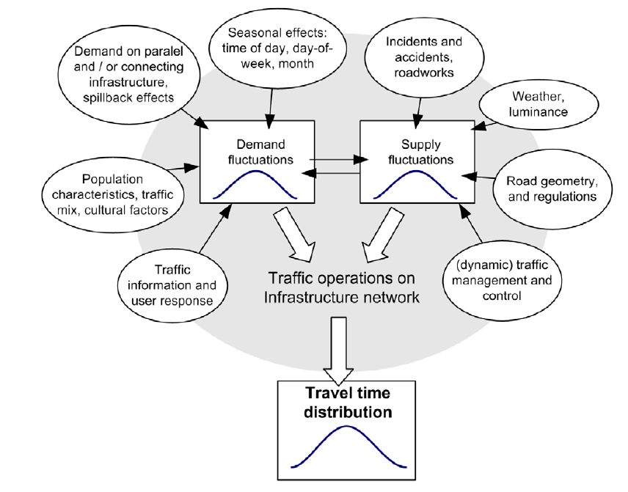
Travel time uncertainty

Slide 26
Value of travel time
Travel time is a number
We may value different aspects, such as
Waiting time
In-vehicle travel time
But these are numbers, finite dimensional
At the most, a vector
It is ”easy” to communicate,
”the value of 1 minute shorter travel time is 5 SEK”.

Slide 27
Value of travel time reliability
What is the value of this?
Standard deviation
Variance
What about skewness?

Slide 28
Simple Scheduling Model
Important for travel time uncertainty
Slope 2.5
0.5
Slope 0.60
Early
Late

Slide 29
Value of travel time reliability and scheduling
It has been shown that the value of travel time reliability can be captured by standard deviation or variance, in the case of different scheduling models
Empirical evidence suggests that there are more than scheduling: penalty for being late per se, and the tail of the distribution matters

Slide 30
Bottleneck (11.5.3)
origin
destination

Slide 31
Bottleneck
t

Slide 32
Exercise
In the urban road network during morning peak hour, is the congestion due to
A. Volume-delay relationships (remember assignment)
or
B. Bottleneck?
C. Or is this a trick question?

Slide 33
Take-aways departure time and scheduling
Explain a simple scheduling model
Relation to departure time choice
… and valuation of travel time uncertainty
Explain the simple bottleneck model and it relevance to urban congestion

