Slide 1


Project
Development models
Tools

Slide 2
S=cm²
Success = Competence * Methodology * Motivation

Slide 3
ulf.bergqvist@nordforce.se
www.nordforce.se

Slide 4
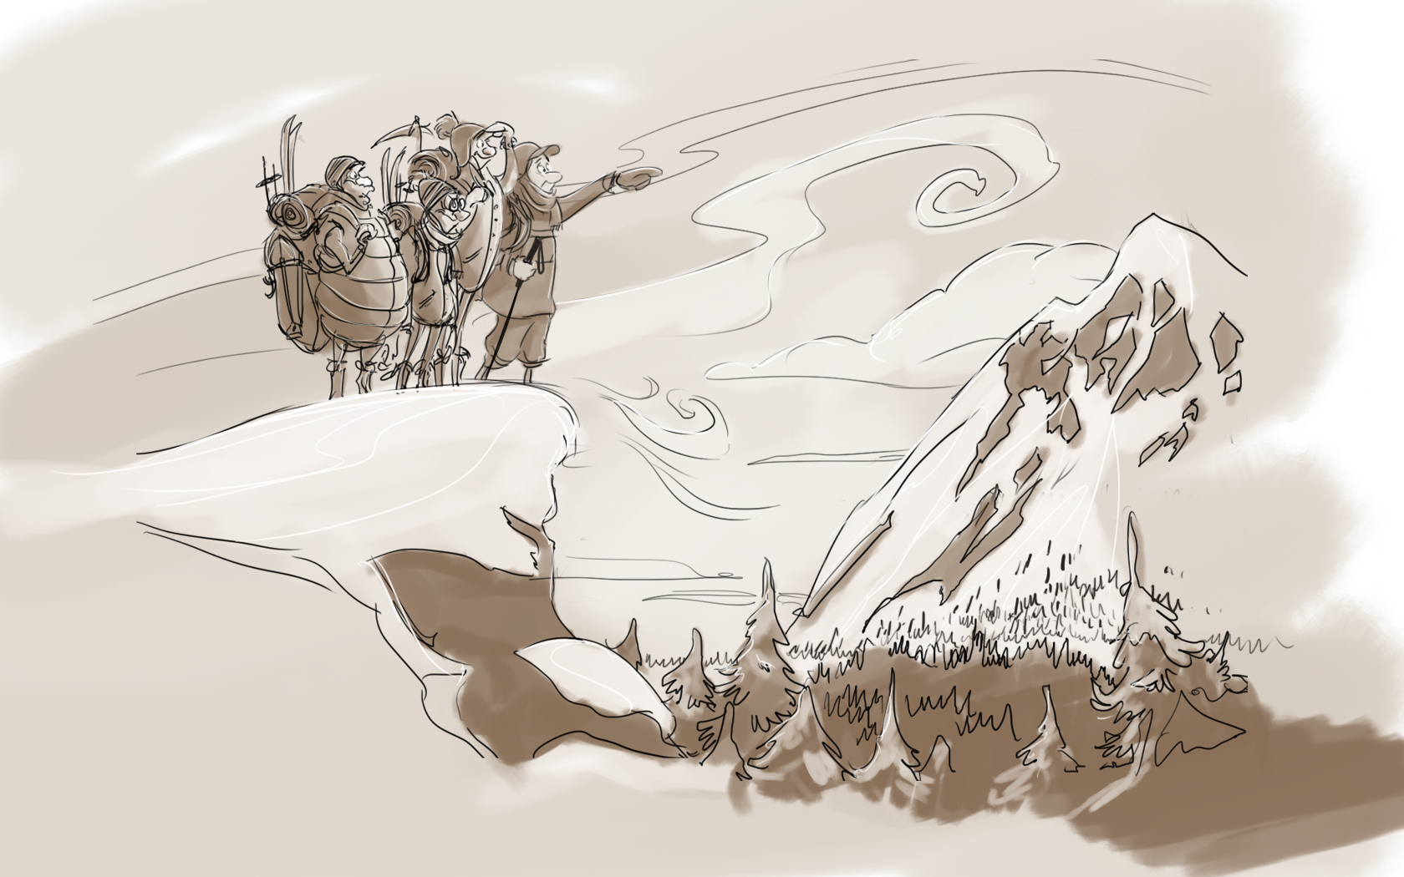

Slide 5
Some useful tools
Mile stone plan
Responsibility matrix
Customer interaction tools
Risk analysis

Slide 6
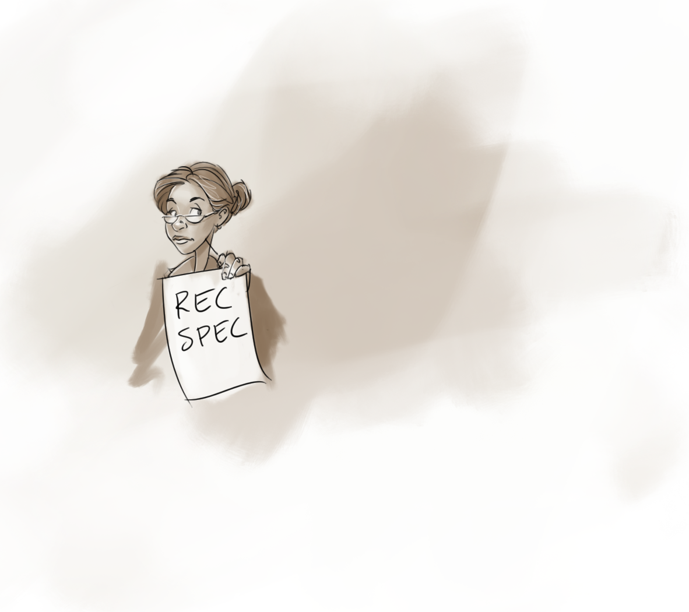
Customer interaction
One person’s view
limited by language
Not the complete
Requirements

Slide 7

Methods (development models)
Tools
The way we work to reach the goal
The different software tools that help us do our work throughout the project

Slide 8
What tools do we need?
IDE
Document handling
Code management
Trouble Reporting

Slide 9
Document handling
Everyone has access to what has been achieved/decided so far
In the latest revision
Documents can be found

Slide 10
A simple approach that works
Naming convention of documents
  What it is
  Revision
  Number (optional)
Use filename in document header
Store in Dropbox or similar

Slide 11
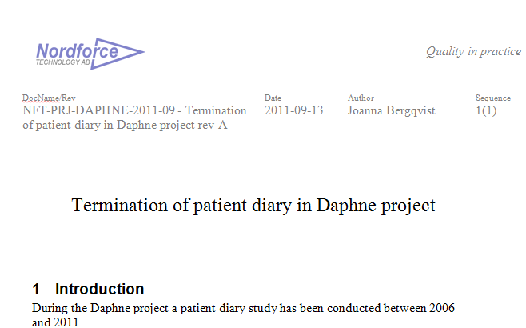

Slide 12
Code management
One repository for the code
Version control for free
Discipline check out /check in
Spend time on rules and naming
Be careful if you do branching

Slide 13
Code management
CVS, Subversion, Git, ClearCase...
Free source code hosting
Appoint a police

Slide 14
Trouble Reporting
Keep track of all errors
And how they are resolved
And verified

Slide 15
Reported
Classified
Assigned
Fixed
Verified
Closed

Slide 16
What most companies have got
...that works
IDE
Document handling
Code managment
Trouble Reporting

Slide 18
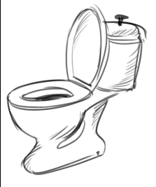


Star Träck
Export
API

Slide 19
CPU
GPRS/3G
Sensor
Incoming
Water
Sensor
Outgoing
Water
Future
Extensions
Mechanics

Slide 20
ITS software architecture
Interrupts
Flow detect
Timer
GPRS call
Main-loop
Data
Aquisition
DB
Handler
Reporting
Sensor
Driver
Data
Base
ITS-P
HTTP
TCP/IP
Sensor and
A/D
Flash
Driver
PPP
GPRS HW driver

Slide 21
ITS
Server
Ready to report
Send your status
My status
Send data after <time>
My data after <time>
Permission to erase data before <time >
OK
Over and out
Over and out

Slide 22
Organisation
Project manager
ITS team
Server team
Test team
Hardware (external)

Slide 23
Agile Software Development
Incremental and Iterative
Responsive to change
Time boxed
Self organizing teams
Involved product owner

Slide 24
Feature Prio
F1 160000
F2 800
F3 330
F4 211
F5 122
.
.
.
.
.
.
.

Slide 25
Functional Baseline plan
Server
FB1
F1
F2
F3
FB2
F4
F5
F6
FB3
F8
F9
F13
F7
FB4
F14
F22
F23
F16
FB9
F17
F21
F24
Doc
Doc
ITS
FB1
F1
F2
F3
FB2
F4
F5
F6
F7
FB3
F8
F9
F13
F16
FB4
F14
F22
F23
FB9
F17
F21
F24

Slide 26
FB3
F8
F9
F13
F7
Negotiate
FB3
F8
F9
F7
Working demo
F8,F9
F7,F13
  Sprint
~3weeks

Slide 27
FB3
F8
F9
F13
F7
Negotiate
FB3
F8
F9
F7
Working demo
F8,F9
F7,F13
Sprint
~3weeks

Slide 28
Executing a Sprint
Backlog Items and tasks
Scrum Board
Time estimates, Burndown
Daily Scrum
Scrum Master

Slide 29
Backlog Item:
Importance
223
P&P calculation
Estimate
6,5
Notes
Need to review formula
with Sheila
How to demo
Produce faked input from a GUI

Slide 30
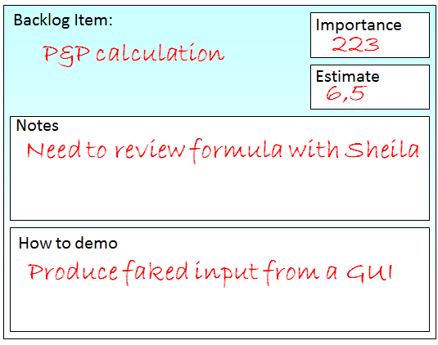
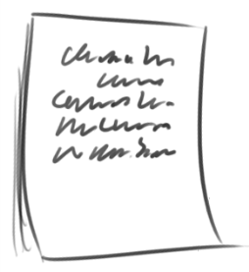
2,5
1
1,5
1,5

Slide 31

Not checked Checked Out Done
out
Goal: Comm ITS-Server
Burndown
New Next

Slide 32
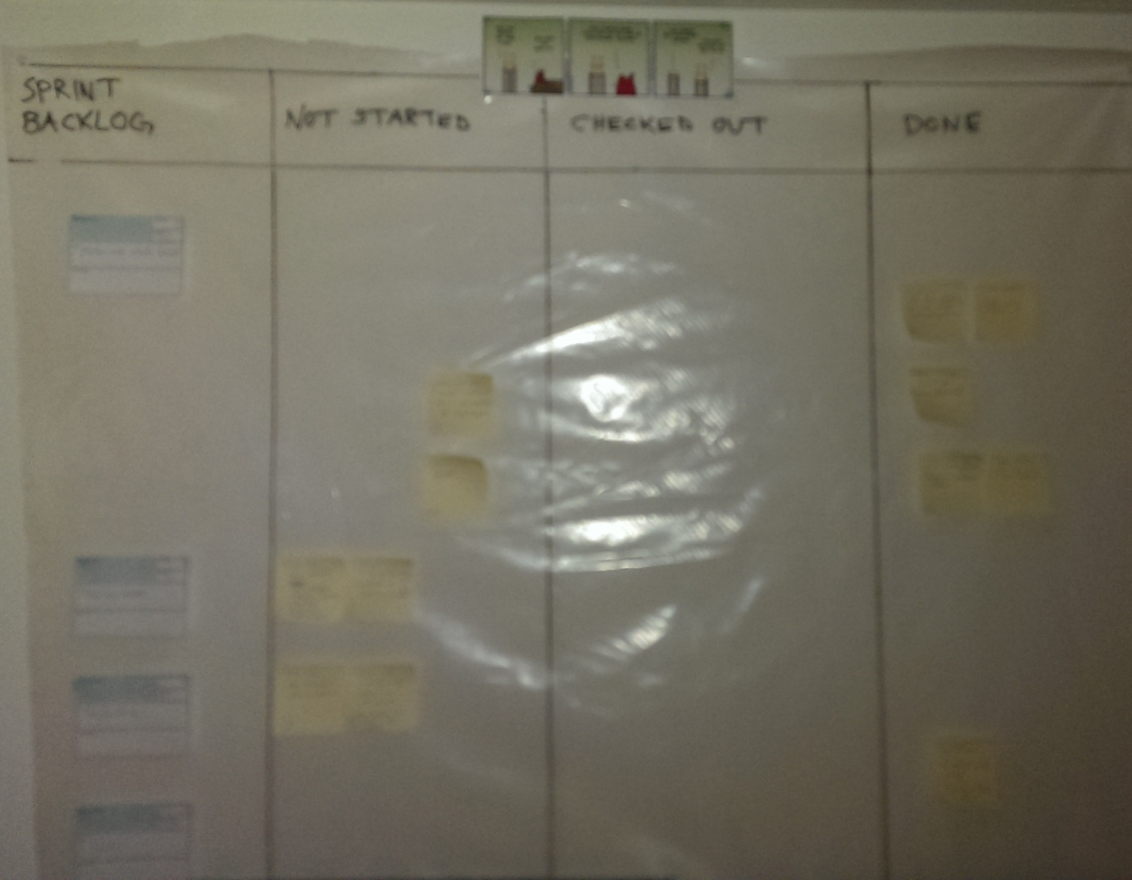

Slide 33
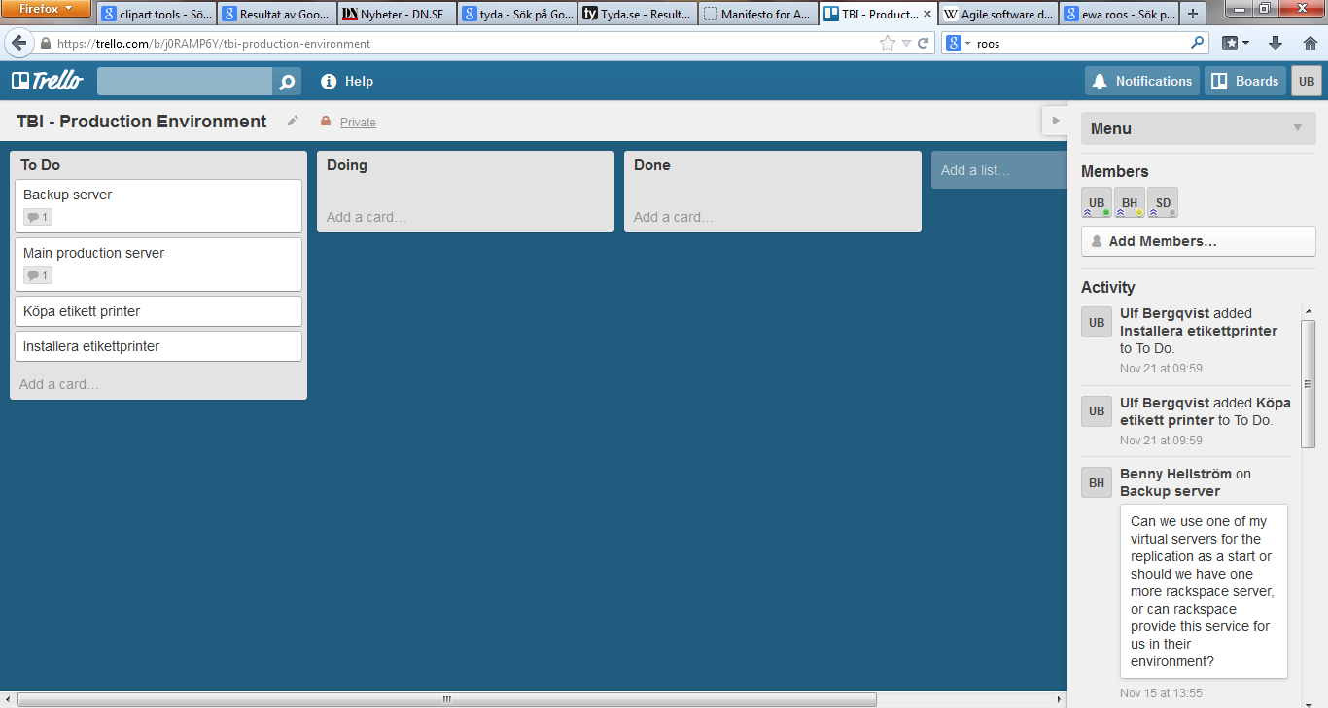

Slide 34
1
1,5
1,5
2,5

Slide 35

After three days
Of work
1
1,5
0,5
1,5
3,5
2,5

Slide 36
Burndown
Mandays left
Day in Sprint

Slide 37
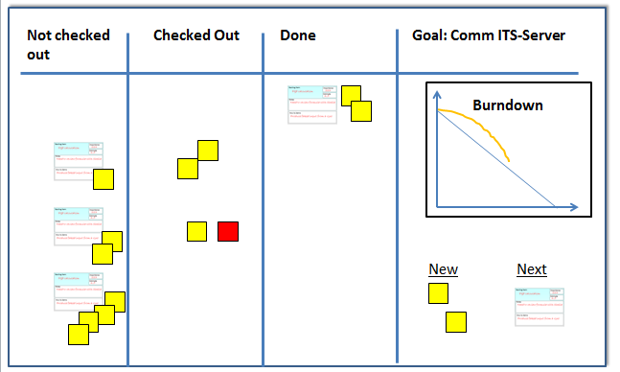
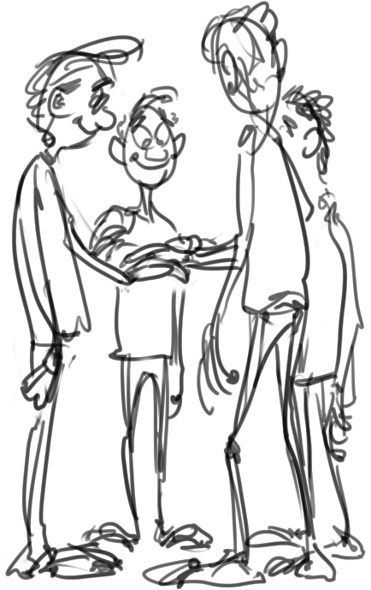
Daily Scrum

Slide 38

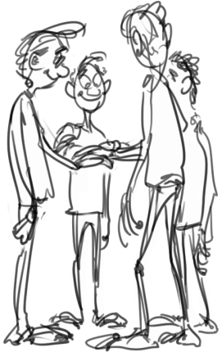
Daily Scrum
Stand up
General info
3 minute round robin report
  What have I done last ”24 h”
  What will I do next ”24 h”
  What are my obstacles
Sometimes allow discussions

Slide 39

Daily Scrum
During the meeting
Move stickers
New time estimates
But some say you should
do it before the meeting

Slide 40
Scrum Master
Beginning of Sprint:
Lead negotiation
Set up Scrum Board

Slide 41

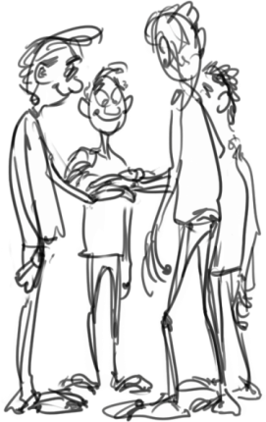
Scrum Master
Every day during the Sprint
  Keep pace at daily scrum
  Make sure problems are
  communicated
  Recalculate Burndown
  Keep an eye on the board

Slide 42
Scrum Master
End of Sprint:
Summons / Conduct demo
(Sprint retrospective)

Slide 43
A quality aspect of agile development
F10
F12
F11
F7
F9
F8
F4
F5
F6
F1
F2
F3

Slide 44

Largest Pitfall 1

Slide 45
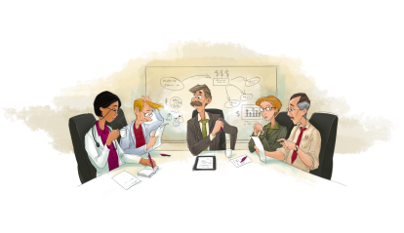

Slide 48
Thou shalt not cheat with the
system architecture
But if you did:
Thou shalt not try to cover up

Slide 49
Largest Pitfall 2
The method becomes the goal...

Slide 50
The Agile Manifesto
We are uncovering better ways of developing software by doing it and helping others do it. Through this work we have come to value:
Individuals and interactions over Processes and tools
Working software over Comprehensive documentation
Customer collaboration over Contract negotiation
Responding to change over Following a plan
That is, while there is value in the items on the right, we value the items on the left more.

Slide 51
It seems to work…
Wonder why?
Success = Competence * Methodology * Motivation
Comprehensible task
Avoid student syndrome
Iow: Human

Slide 52
?

Slide 53
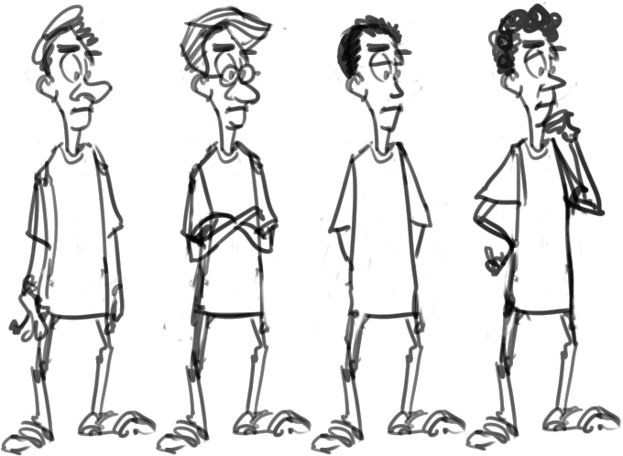

Before: Stone age
Now: The perfect Tool!

Slide 54

Mentor

Slide 55

You didn’t listen to me

Slide 56
Screw you guys!
I’m göing höme

Slide 57
Common
Sense!

Slide 58
Thank you!
ulf.bergqvist@nordforce.se
www.nordforce.se

