Slide 1
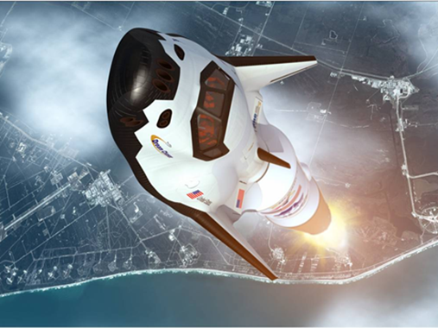
SD2905 Human Spaceflight
Lecture 5, part 2, 4-2-2014
Space vehicles for humans

Slide 2
Today’s class:
Reminder of requirements for human space vehicles
What’s ”human-rating”
Examples of how to protect crew for a few selected systems
- Shuttle
- Soyus
New (orbital) space vehicles in the US

Slide 3
What are specific requirements for space vehicels for humans? In addition to ”any” rocket.
Keep them safe and bring them back alive!
Need: - A cabin with life support system
- A launcher that is not too rough on the human body
- Some way to get back: survive re-entry trough the atmosphere and re- contact with the ground
- Communication
Design safe and robust systems, i.e. with back-up features.
Never a ”single-fault failure” system
Most critical system is two-fault tolerant (You survive two faults; normally can fulfill the mission with one fault)

Slide 4
Human-rating
The process of reducing the probability of loss of crew to acceptable levels
A human-rated system accommodates human needs, effectively utilizes human capabilities, controls hazards with sufficient certainty to be considered safe for human operations, and provides, to the maximum extent practical, the capability to safely recover the crew from hazardous situations.
From NASA human-rating standard: http://nodis3.gsfc.nasa.gov/displayDir.cfm?Internal_ID=N_PR_8705_002B_&page_name=Preface
•How is human-rating achieved?
•Generally, human-rating is achieved by providing redundancy in key subsystems; notable examples would be the launch abort systems used on Mercury and Apollo or redundant fuel cells in Gemini, Apollo, Shuttle
•Features such as self-helping mechanisms or passive cooling can be employed
•Trajectories designed to include features such as "free-return" (no burn required for safety)

Slide 5
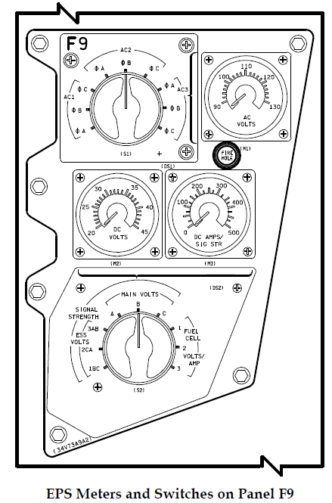
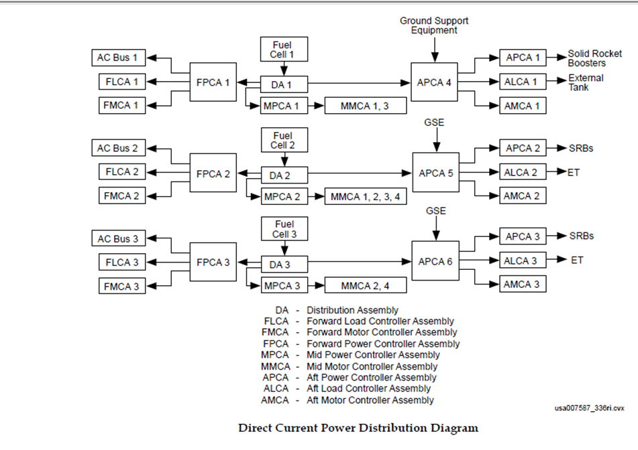
Examples Redundancy: Space Shuttle
5 Built-in identical computers, with one running idenpendent s/w
3 Auxillary Power Units
3 Fuells with electrical buses
...etc

Slide 6
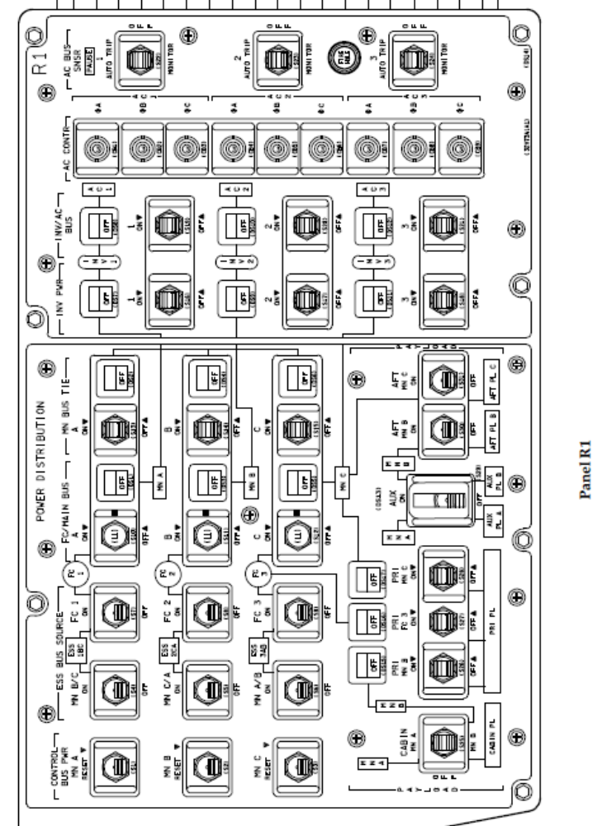
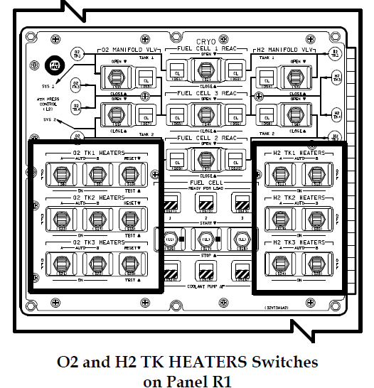
Some switches in the Shuttle for power system control

Slide 7
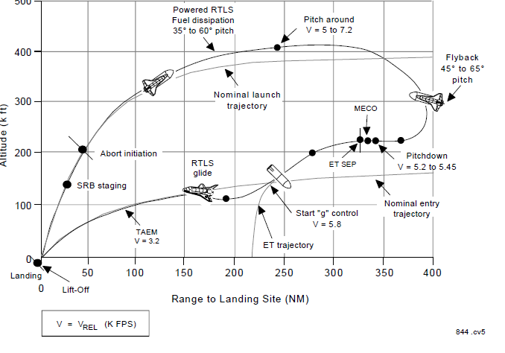
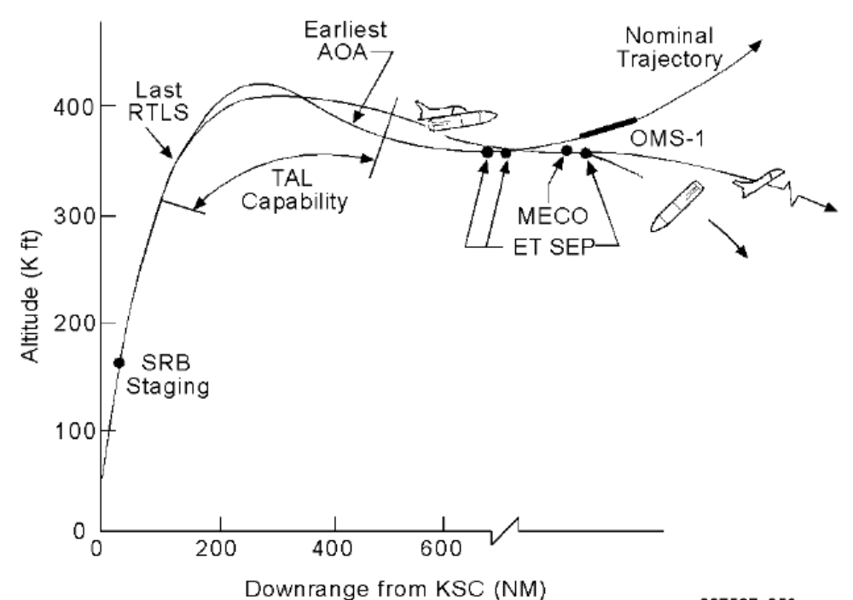
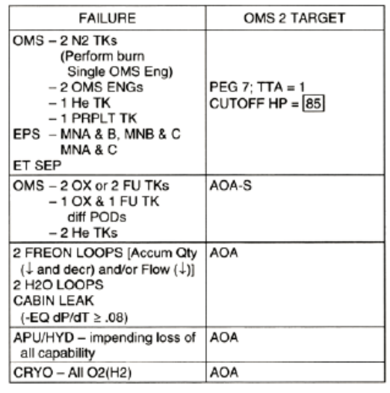
Shuttle abort modes: 4 major + Contigency abort
1. Intact abort modes
1.1 Return To Launch Site (RTLS)
1.2.Transoceanic Abort Landing (TAL)
1.3 Abort Once Around (AOA)
1.4 Abort to Orbit (ATO)
2 Emergency landing sites
3 Contingency aborts
Bailout
RTLS Scenario
AOA abort criteria

Slide 8
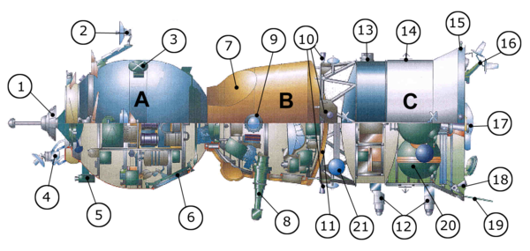
Example alternative methods: Soyuz
De-orbit burn
  - Main engine (СКД CKD) vs Orbital Manuever Engines (ДПО)
Entry
- АУС, automatically controlled entry;
- РУС, manually controlled entry;
- БС, ballistic entry; (Soyuz-5 in 1969,-TMA10 2007, TMA-11 in 2011 due to incomplete modules separation. Soyuz-TMA1 due to computer failure)
- БСР, backup ballistic entry.
Orbital module (A)
  1 docking mechanism,
  2 Kurs antenna,
  4 Kurs antenna,
  3 television transmission antenna,
  5 camera,
  6 hatch
Descent module (B)
  7 parachute compartment,
  8 periscope,
  9 porthole,
  11 heat shield
Service module (C)
  10 and 18 attitude control engines,
  21 oxygen tank,
  12 Earth sensors,
  13 Sun sensor,
  14 solar panel attachment point,
  16 Kurs antenna,
  15 thermal sensor,
  17 main propulsion,
  20 fuel tanks,
  19 communication antenna

Slide 9
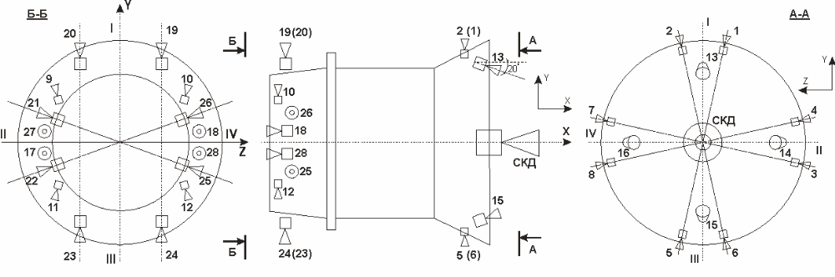
Soyuz COMBINED PROPULSION SYSTEM (КДУ)
The combined propulsion system (КДУ) is the motion control system (СУД) effector and creates thrust along the vehicle body axes (±Х, ±У, ±Z) and control moments about these axes (±Мх, ±Му, ±Мz).
The КДУ is a pressure-fed propulsion system, which uses bi-propellant liquid-fuel reactive thrusters. An oxidizer (nitrogen tetroxide) and fuel (non-symmetrical dimethylhydrazine), stored separately in different tanks, are used as propellants.

Slide 10
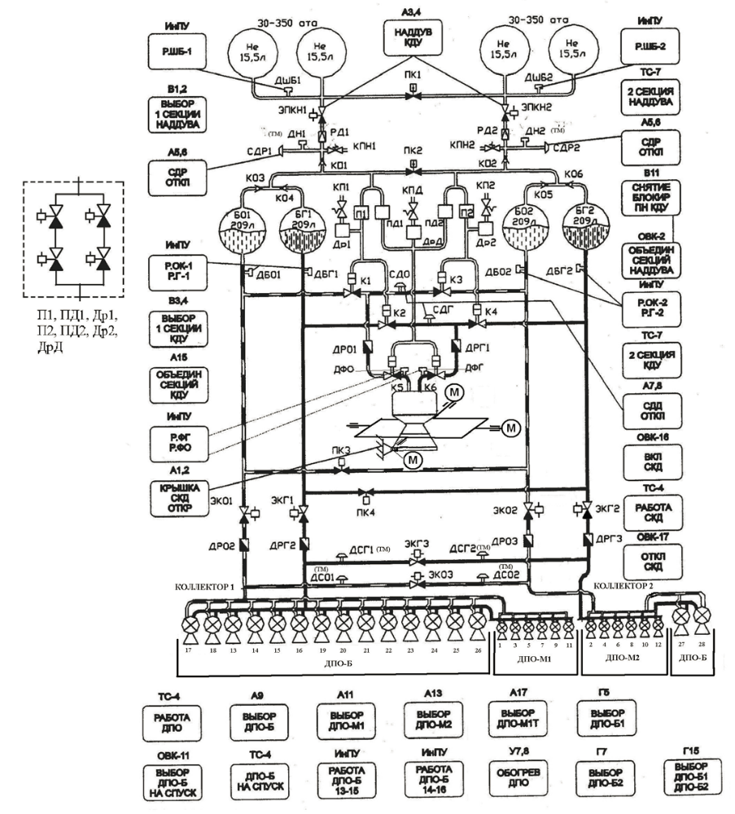
Soyuz combined propulsion system schematic

Slide 11
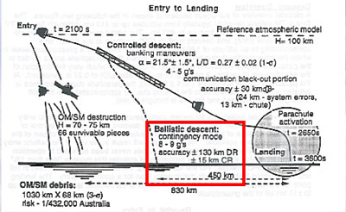
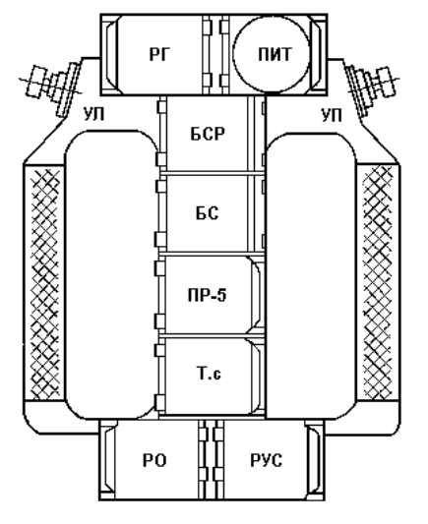
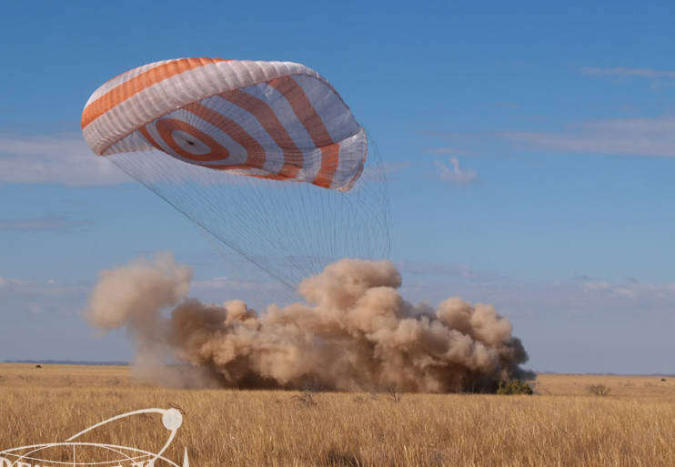
Soyuz landing modes
Manual descent control handle
http://starcity-tours.com/category/special/landing/
http://spectrum.ieee.org/aerospace/space-flight/internal-nasa-documents-give-clues-to-scary-soyuz-return-flight

Slide 12
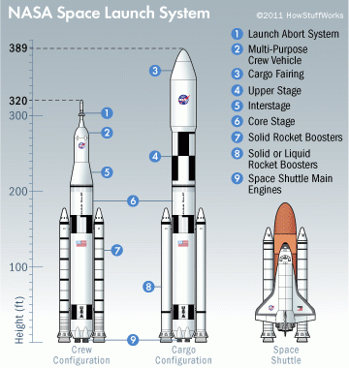
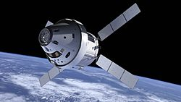
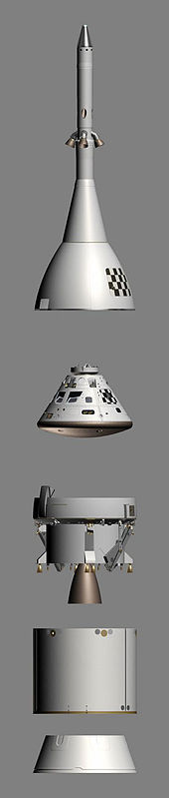
Orion and the Space Launch System (SLS)
NASA’s next human spaceflight system
•Orion multi-purpose crew vehicle (MPCV) and launch abort system (LAS)
•Crew: 2-6, stand-alone dv: > 1500 m/s
•ESA ATV service module as Orion service module; engine provided by NASA
•Unmanned test flights planned for 2014 and 2017, first manned mission ca 2021
•SLS is a Shuttle-derived heavy-lift launch vehicle in two configurations:
•Config 1 (left): initial capability without an upper stage; ca 70 mt to LEO (28,5 degree incl.)
•Config 2: evolved launch vehicle with a J-2X upper stage, 130 mt to LEO (28,5 deg. incl.)
•Initial flight of config 1 planned for 2017

Slide 13
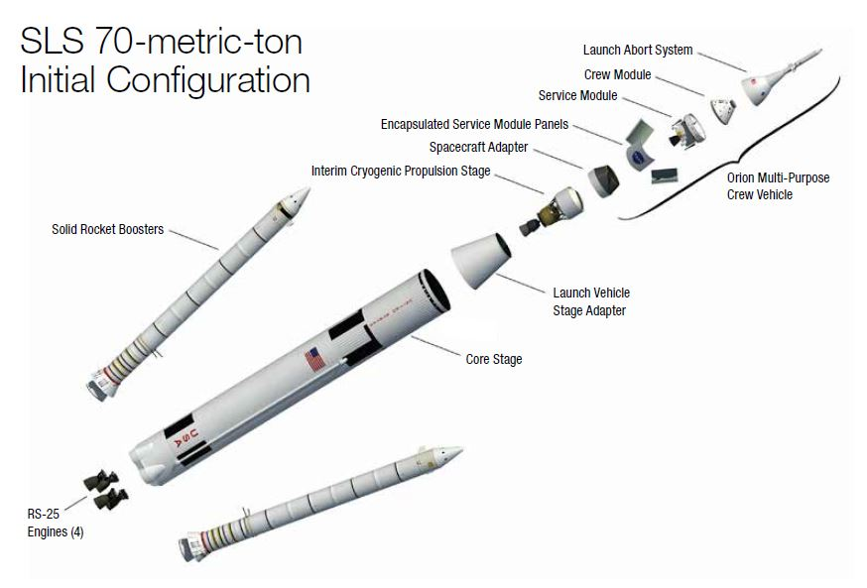
To put the power of the Aerojet Rocketdyne-built RS-25 engines into perspective, consider this:
The fuel turbine on the RS-25’s high-pressure fuel turbopump is so powerful that if it were spinning an electrical generator instead of a pump, it could power 11 locomotives; 1,315 Toyota Prius cars; 1,231,519 iPads
Pressure within the RS-25 is equivalent to the pressure a submarine experiences three miles beneath the ocean.
The four RS-25 engines on the SLS launch vehicle gobble propellant at the rate of 1,500 gallons per second. That’s enough to drain an average family-sized swimming pool in 60 seconds.

