Slide 1


LOVES ME
LOVES ME NO
T
HANNA
DENICE
MONA
ANNA

Slide 2
0 20 40 60 80 ∞
DENICE
Jan 2013
Feb 2013
find
common
????
word
most

Slide 3
0 20 40 60 80 ∞
11:13
Jan 24 2013
Hola! How did it go
at doctors? This night
I had a nightmare for
the first time in a long time. I woke up
sweating and...
show more
DENICE
Jan 2013
Feb 2013
find
common
????
word
most

Slide 4
11:13
Jan 24 2013
0 20 40 60 80 ∞
Hola! How did it go at doctors? I guess mommy told you about Ebba and Albins mom who passed away...so sad :-( usch! This night I had a nightmare for the first time in a long time. I woke up
sweating and screaming. You, me, mommy and daddy were in Åkersberga centrum and I was going to buy a sula for my boots but the line was super long and then when it was finally my turn they said "vi stänger nu"
so I got really angry and threw the sulor on the ground and said that it was mycket dålig service...anyways when we left I realized I had forgotten one of my boots there so we went back but they had closed and the whole centrum was closed, then you said that you
knew where they hide their keys so you could just open the door for me so i reluctantly agreed but then i came out with the wrong boot so you opened again and this time you went in and right as you were coming out the door locked and you couldn't get out. Then suddenly where you are standing turns into an elevator that takes you upwards and away into the dark and I start screaming at mommy and daddy to go
find a security guard while I'm following where that elevator is taking you with my eyes. It doesn't sound very scary but it was and then when Anders heard me screaming he woke me up he asked what's wrong and I kept saying "Dom har tagit Denice dom har tagit Denice" haha so weird...I think it's because I keep telling people that you're going on your trip and that
you're gonna be away for so long :-\ But don't tell mommy about the dream it will just make her more worried =P
????
show less

Slide 5
0 20 40 60 80 ∞
13:15
Jan 24 2013
Hey you! Yes I
heard :-( So
frustrating and sad.
She was at Esprit like
just around studenten
and we talked and…
show more
DENICE
Jan 2013
Feb 2013
find
common
????
word
most

Slide 6
0 20 40 60 80 ∞
Hey you! Yes I heard :-( So frustrating and sad. She was at Esprit like just around studenten and we talked and talked about Dubai and stuff.  So sad for Ebba and Albin as well…
????
show less

Slide 7
0 20 40 60 80 ∞
13:17
Jan 24 2013
And about your
dream...ha ha ha. I
don't know what to
say, I love all the
specific details! :-)
But I feel with…
show more
DENICE
Jan 2013
Feb 2013
find
common
????
word
most

Slide 8
13:17
Jan 24 2013
0 20 40 60 80 ∞
And about your dream...ha ha ha. I don't know what to say, I love all the specific details! :-) But I feel with you. A life without a Denice anymore would just not be worth living!
????
show less

Slide 9
0 20 40 60 80 ∞
13:20
Jan 24 2013
Doctors went fine.
First I did an ultraljud
and we sat there
waving at the baby
in my boob. :-) Then
I did a …
show more
DENICE
Jan 2013
Feb 2013
find
common
????
word
most

Slide 10
13:20
Jan 24 2013
0 20 40 60 80 ∞
Doctors went fine. First I did an ultraljud-and we sat there waving at the baby in my boob. :-) Then I did a mammografi (and the ladies asked me very suspiciously if I had had a boob-job done recently ) After that I did a biobsy which hurt a bit but went fine. :-) So I'll probably be getting the results in about one weeks time☺
????
show less

Slide 11
0 20 40 60 80 ∞
14:53
Jan 24 2013
Hahahahahahahaha
haha boob job!!! I
knew it!!!! :-P:-P:-P:-P
DENICE
Jan 2013
Feb 2013
find
common
????
word
most

Slide 12
0 20 40 60 80 ∞
15:28
Jan 24 2013
So not cool or
funny. :-/
DENICE
Jan 2013
Feb 2013
find
common
????
word
most

Slide 13
0 20 40 60 80 ∞
15:31
Jan 24 2013
I have been spending
the eftermiddag
listening to mommy talking. Now in the end she finishes it off with
screaming at me …
show more
DENICE
Jan 2013
Feb 2013
find
common
????
word
most

Slide 14
15:31
Jan 24 2013
0 20 40 60 80 ∞
I have been spending the eftermiddag listening to mommy talking. Now in the end she finishes it off with screaming at me of course!!:-) So that reminded me of bostadsköer.haha I am not in one now cause the one you helped me with kind of disappeared. Do u kniw any new ones?
????
show less

Slide 15
0 20 40 60 80 ∞
16:13
Jan 24 2013
No, sssb you have to actually be studying to stand in it, the rest are betal köer and you
have to stand in
them.for 30 years…
show more
DENICE
Jan 2013
Feb 2013
find
common
????
word
most

Slide 16
16:13
Jan 24 2013
0 20 40 60 80 ∞
No, sssb you have to actually be studying to stand in it, the rest are betal köer and you have to stand in them.for 30 years before u get something :-\
????
show less

Slide 17
0 20 40 60 80 ∞
16:25
Jan 24 2013
I don't know... Haha
yeah oki that's what I thought about the studying business. Is
that where your place came from?
DENICE
Jan 2013
Feb 2013
find
common
????
word
most

Slide 18
0 20 40 60 80 ∞
17:20
Jan 24 2013
Ojoj...she tends to overdramatize things when she's upset. I
assume she hasn't changed her mind
about Lund…
show more
DENICE
Jan 2013
Feb 2013
find
common
????
word
most

Slide 19
17:20
Jan 24 2013
0 20 40 60 80 ∞
Ojoj...she tends to overdramatize things when she's upset. I assume she hasn't changed her mind about Lund? Yes, mine is sssb, but check on their website about the rules...if you're gonna start studying next year I think you can stand 3 months before you start...so check to be sure, and also, the days you accumilated before might still exist just that they are "parkerade". Good luck at home and even if it gets too much try to help out and do things you know mommy appreciates without her having to ask...i'm sure that will make her less moody.
????
show less

Slide 20
0 20 40 60 80 ∞
11:26
Feb 8 2013
Hello! You probably
heard mommy and my conversation, but let
me know when you
have time to talk and
I'll give you a…
show more
DENICE
Jan 2013
Feb 2013
find
common
????
word
most

Slide 21
11:26
Feb 8 2013
0 20 40 60 80 ∞
Hello! You probably heard mommy and my conversation, but let me know when you have time to talk and I'll give you a call :-) <3
????
show less

Slide 22
0 20 40 60 80 ∞
13:09
Feb 8 2013
No problem! Good
luck on tests:-) you can
call at 15.20 while we
are in car!
DENICE
Jan 2013
Feb 2013
find
common
????
word
most

Slide 23
0 20 40 60 80 ∞
13:09
Feb 8 2013
☺
DENICE
Jan 2013
Feb 2013
find
common
????
word
most

Slide 24
0 20 40 60 80 ∞
13:53
Feb 8 2013
Should I call on your
”new" number?
DENICE
Jan 2013
Feb 2013
find
common
????
word
most

Slide 25
0 20 40 60 80 ∞
13:53
Feb 8 2013
Best if you call
mommys or daddys phone!:-)
DENICE
Jan 2013
Feb 2013
find
common
????
word
most

Slide 26
0 20 40 60 80 ∞
13:55
Feb 8 2013
Oki :-)
DENICE
Jan 2013
Feb 2013
find
common
????
word
most

Slide 27
0 20 40 60 80 ∞
13:55
Feb 8 2013
:-)
DENICE
Jan 2013
Feb 2013
find
common
????
word
most

Slide 28
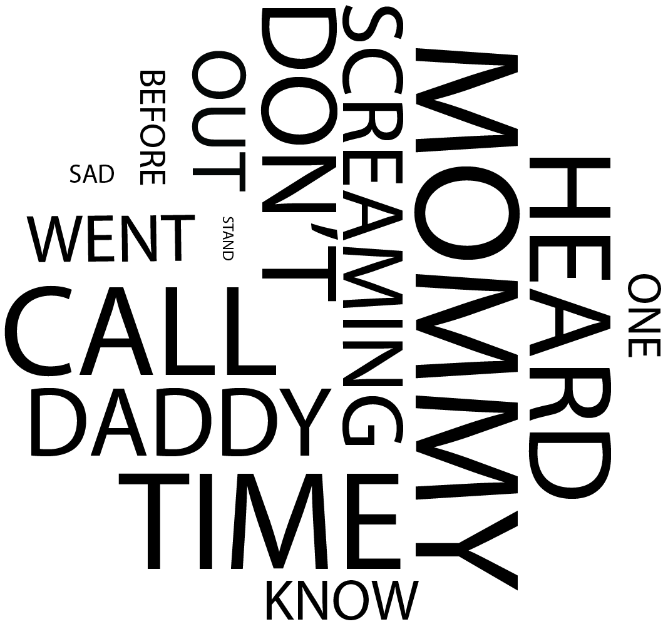
0 20 40 60 80 ∞
DENICE
Jan 2013
Feb 2013
find
common
????
word
most

Slide 29
0 20 40 60 80 ∞
DENICE
Jan 2013
Feb 2013
find
common
????
word
most

Slide 30
0 20 40 60 80 ∞
DENICE
Jan 2013
Feb 2013
find
common
????
word
most

Slide 31
0 20 40 60 80 ∞
12:14
Okt 31 2012
Hola
HANNAH
Okt 2012
Feb 2013
find
common
????
word
most

Slide 32
0 20 40 60 80 ∞
13:58
Feb 5 2013
Ja det blir perfekt,
Lisa och jag ska fika
hos mig vid ett :) puss
HANNAH
Okt 2012
Feb 2013
find
common
????
word
most

Slide 33
0 20 40 60 80 ∞
12:40
Feb 5 2013
Annars kan vi köra
mitt kl. 22 ditt kl. 15
så kan du fika med lisa
innan om det passar
dig? :)
HANNAH
Okt 2012
Feb 2013
find
common
????
word
most

Slide 34
0 20 40 60 80 ∞
12:31
Feb 5 2013
Efter elva min tid,
Lisa ska komma över
och fika någon gång på dagen men kan föreslå eftermiddag så vi
hinner skypea…
show more
HANNAH
Okt 2012
Feb 2013
find
common
????
word
most

Slide 35
12:31
Feb 5 2013
0 20 40 60 80 ∞
Efter elva min tid, Lisa ska komma över och fika någon gång på dagen men kan föreslå eftermiddag så vi hinner skypea. :) viken tid passar dig? Puss
12:40
Feb 5 2013
Efter elva min tid,
Lisa ska komma över
och fika någon gång på dagen men kan föreslå eftermiddag ...
Okt 2012
Feb 2013
find
common
????
word
most
show less

Slide 36
0 20 40 60 80 ∞
12:40
Feb 5 2013
Onsdag blir jätte bra
:) vilken tid kan du
då? Puss
HANNAH
Okt 2012
Feb 2013
find
common
????
word
most

Slide 37
0 20 40 60 80 ∞
17:32
Feb 4 2013
Åh ingen fara :)
imorgon så ska jag
vara i skolan två så då
kan jag prata tidigare
på förmiddagen, kl
10-11? Men…
show more
HANNAH
Okt 2012
Feb 2013
find
common
????
word
most

Slide 38
17:34
Feb 4 2013
0 20 40 60 80 ∞
Åh ingen fara :) imorgon så ska jag vara i skolan två så då kan jag prata tidigare på förmiddagen, kl 10-11? Men annars så blir onsdag bättre. :) puss
12:40
Feb 5 2013
Efter elva min tid,
Lisa ska komma över
och fika någon gång på dagen men kan föreslå eftermiddag ...
Okt 2012
Feb 2013
find
common
????
word
most
show less

Slide 39
0 20 40 60 80 ∞
17:20
Feb 4 2013
Åhhh kom precis
hem :( och klockan är redan efter tolv, vi
åkte direkt från jobbet
så har inte haft
internet förrän nu..
show more
HANNAH
Okt 2012
Feb 2013
find
common
????
word
most

Slide 40
17:20
Feb 4 2013
0 20 40 60 80 ∞
Åhhh kom precis hem :( och klockan är redan efter tolv, vi åkte direkt från jobbet så har inte haft internet förrän nu.. men imorn och på onsdag kan jag :) kan du någon av de dagarna? :) puss
12:40
Feb 5 2013
Efter elva min tid,
Lisa ska komma över
och fika någon gång på dagen men kan föreslå eftermiddag ...
Okt 2012
Feb 2013
find
common
????
word
most
show less

Slide 41
0 20 40 60 80 ∞
12:07
Feb 4 2013
Va sägs om Skype? :)
puss
HANNAH
Okt 2012
Feb 2013
find
common
????
word
most

Slide 42
0 20 40 60 80 ∞
15:09
Jan 31 2013
Perfekt :)
HANNAH
Okt 2012
Feb 2013
find
common
????
word
most

Slide 43
0 20 40 60 80 ∞
15:08
Jan 31 2013
Loggar in om 10 :)
HANNAH
Okt 2012
Feb 2013
find
common
????
word
most

Slide 44
0 20 40 60 80 ∞
15:08
Jan 31 2013
Är hemma strax så logga in snart så rings vi :)
HANNAH
Okt 2012
Feb 2013
find
common
????
word
most

Slide 45
0 20 40 60 80 ∞
14:48
Jan 31 2013
Det blir bra, min middag har inte kommit än så stressa inte :) puss
HANNAH
Okt 2012
Feb 2013
find
common
????
word
most

Slide 46
0 20 40 60 80 ∞
14:44
Jan 31 2013
Är på väg hem nu så loggar in så fort jag är hemma. Kanske kvart tjugo över. Kan prova från mobilen om en stund. Puss
HANNAH
Okt 2012
Feb 2013
find
common
????
word
most

Slide 47
0 20 40 60 80 ∞
14:21
Jan 31 2013
Säg till när du kan prata :) puss
HANNAH
Okt 2012
Feb 2013
find
common
????
word
most

Slide 48
0 20 40 60 80 ∞
06:19
Jan 31 2013
Ingen fara går inte och lägger mig förrän 23-24 så hör av dig när du är redo :) puss
HANNAH
Okt 2012
Feb 2013
find
common
????
word
most

Slide 49

0 20 40 60 80 ∞
HANNAH
Okt 2012
Feb 2013
find
common
????
word
most

Slide 50
0 20 40 60 80 ∞
HANNAH
Okt 2012
Feb 2013
find
common
????
word
most

Slide 51
0 20 40 60 80 ∞
HANNAH
Okt 2012
Feb 2013
find
common
????
word
most

Slide 52
0 20 40 60 80 ∞
MONA
Okt 2012
Nov 2012
find
common
????
word
most

Slide 53
0 20 40 60 80 ∞
12:14
Okt 31 2012
Hola
MONA
Okt 2012
Nov 2012
find
common
????
word
most

Slide 54
0 20 40 60 80 ∞
12:58
Okt 31 2012
Mona could you please send me the books that you had online? Xx
MONA
Okt 2012
Nov 2012
find
common
????
word
most

Slide 55
0 20 40 60 80 ∞
12:58
Okt 31 2012
For this course that we
had today..
MONA
Okt 2012
Nov 2012
find
common
????
word
most

Slide 56
0 20 40 60 80 ∞
16:15
Okt 31 2012
Kim, do you have time tomorrow for checking
lab 2 and 4? the first assignment should be done in group?
MONA
Okt 2012
Nov 2012
find
common
????
word
most

Slide 57
0 20 40 60 80 ∞
18:56
Nov 1 2012
Tomorrow is like impossible for me. But i talked to a friend that
did lab2 today and she
said that it was easy
and no…
show more
MONA
Okt 2012
Nov 2012
find
common
????
word
most

Slide 58
18:56
Nov 1 2012
Tomorrow is like impossible for me. But i talked to a friend that did lab2 today and she said that it was easy and no programming at all just trying it out with different sounds etc :) yes exact, and it needs to be handed in this week!
????
show less

Slide 59

0 20 40 60 80 ∞
MONA
Okt 2012
Nov 2012
find
common
????
word
most

Slide 60
0 20 40 60 80 ∞
MONA
Okt 2012
Nov 2012
find
common
????
word
most

Slide 61
0 20 40 60 80 ∞
MONA
Okt 2012
Nov 2012
find
common
????
word
most

