Slide 1
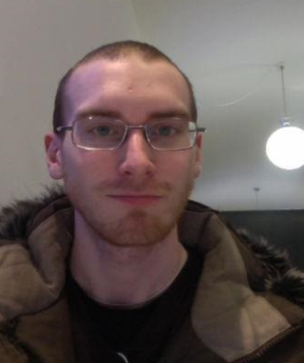
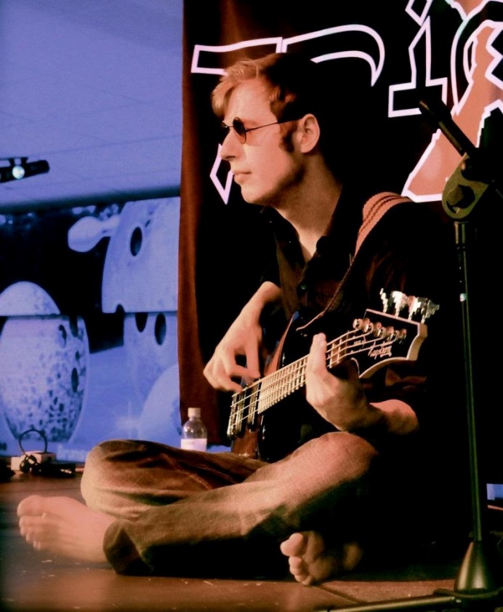

Johan
jnygr@kth.se
Anton
anthol@kth.se
Information Visualization
DH 2321
Notes:
Who are we?

Slide 2
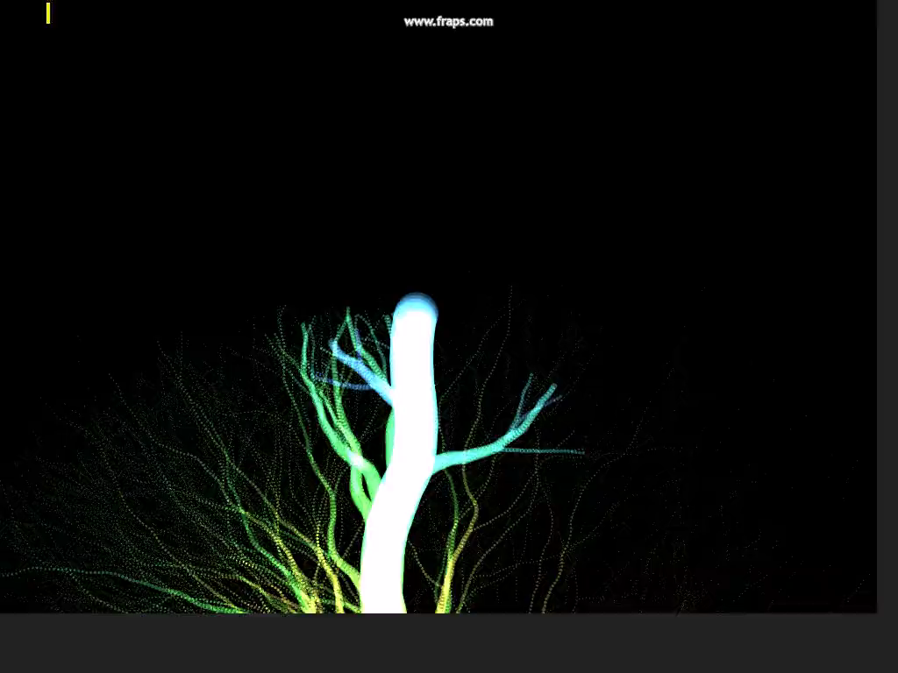
MusicTree
Notes:
Our project, MusicTree.

Slide 3
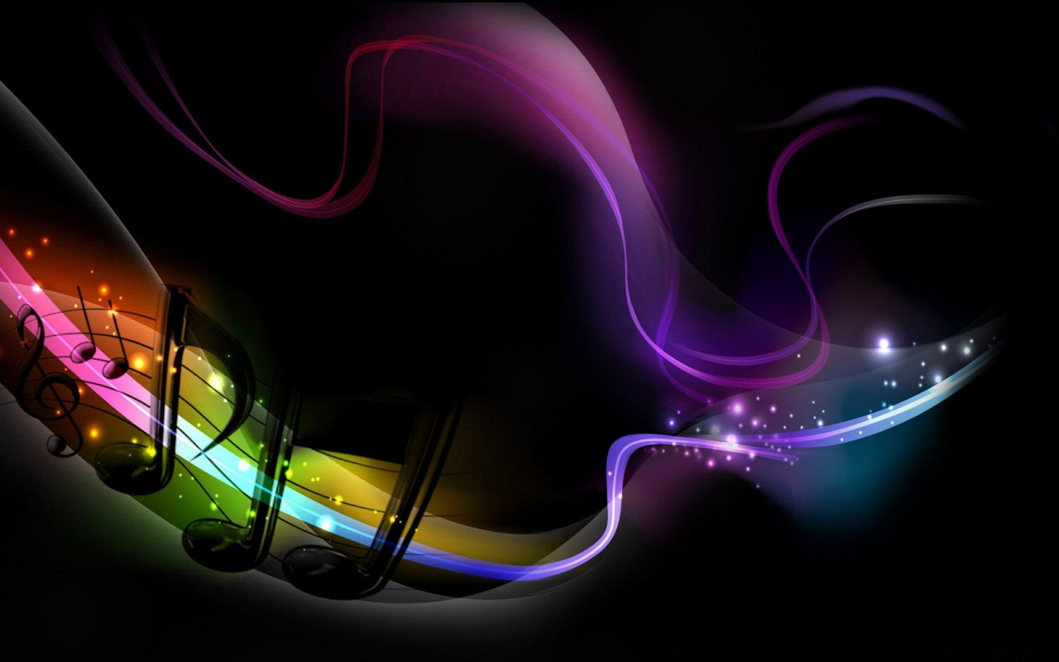
Motivation
We like music
We like graphics
We like human computer interaction
We will show you a new way to experience music
Notes:
What is music? Just a combination of sound, or something more? An art of expression, in many ways.

Slide 4
Related work

Slide 5
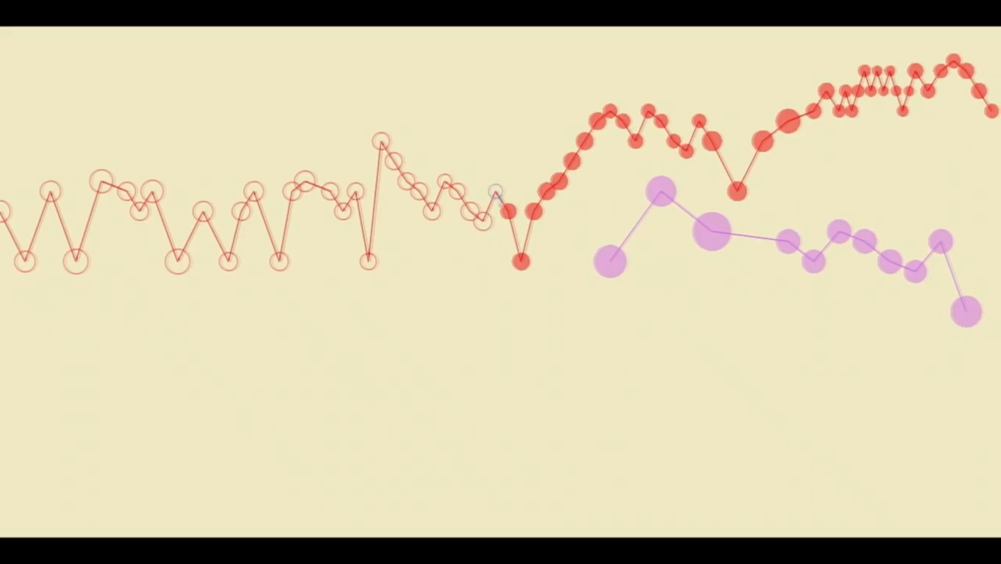
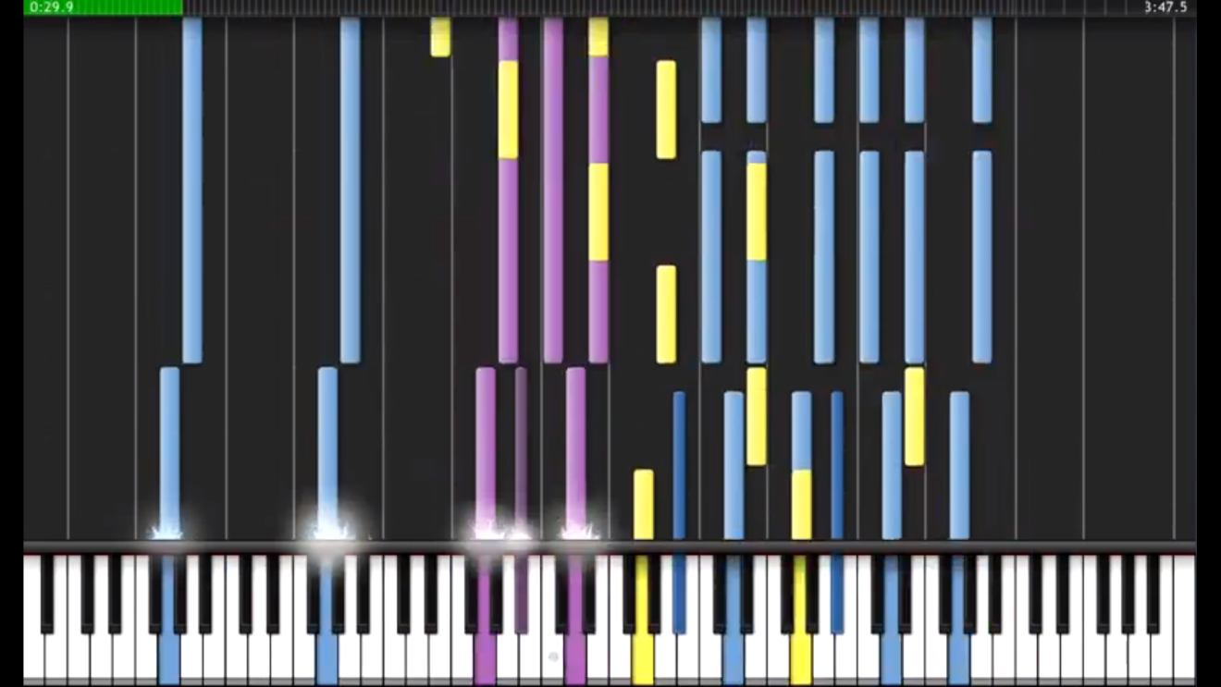
J. S. Bach, ”Little” Fugue
A. P. Anderson, 2011
MAM player
Night of Darkness
4716736151529157, 2012
Synthesia The Game
Notes:
Other work. MIDI based music visualizers, Bachs Little Fugue in G minor made in Cubase and Night of Darkness, 481783514142957’s remix in Synthesia the Game.

Slide 6

Audio Visualization Smoke with Trapcode Particular
Vinh Son Nguyen, 2011
Notes:
Audio Visualization Smoke with Trapcode Particular, by Vinh Son Nguyen.

Slide 7
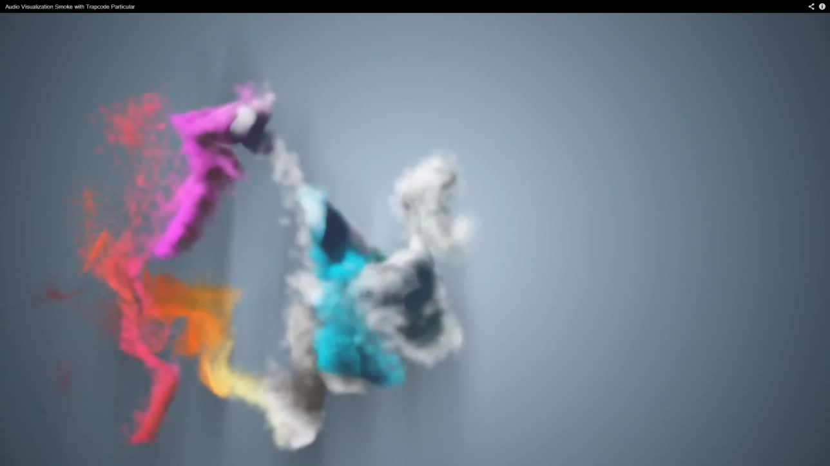
Notes:
We wanted to combine the artistic feel of beat based visualizations with the MIDI based sence of cohearence. We wanted something that showed every note, and grew with time.

Slide 8
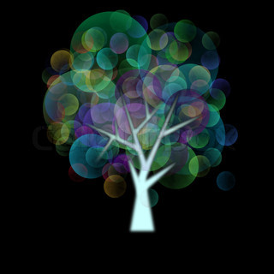
We want to visualize individual notes
We want to keep the immersive visual experience from audio based visualizations
We want to do it in a way no one has experienced before
Notes:
Introducing the tree. We wanted to create a living embodiment of the music that captures each note but that does not give you a chaotic feeling of overburden.

Slide 9
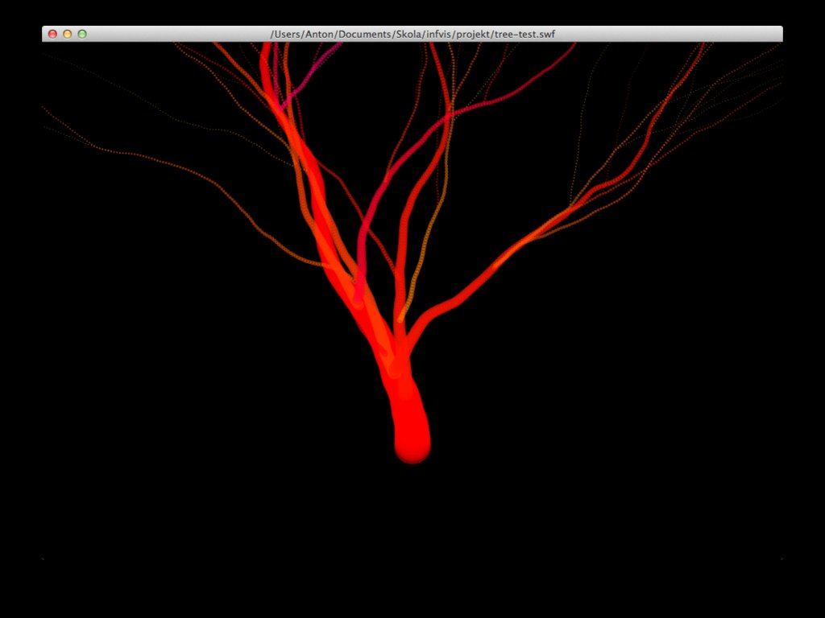
Notes:
So we began constructing a prototype in flash that would grow a random tree given a set of parameters.

Slide 10
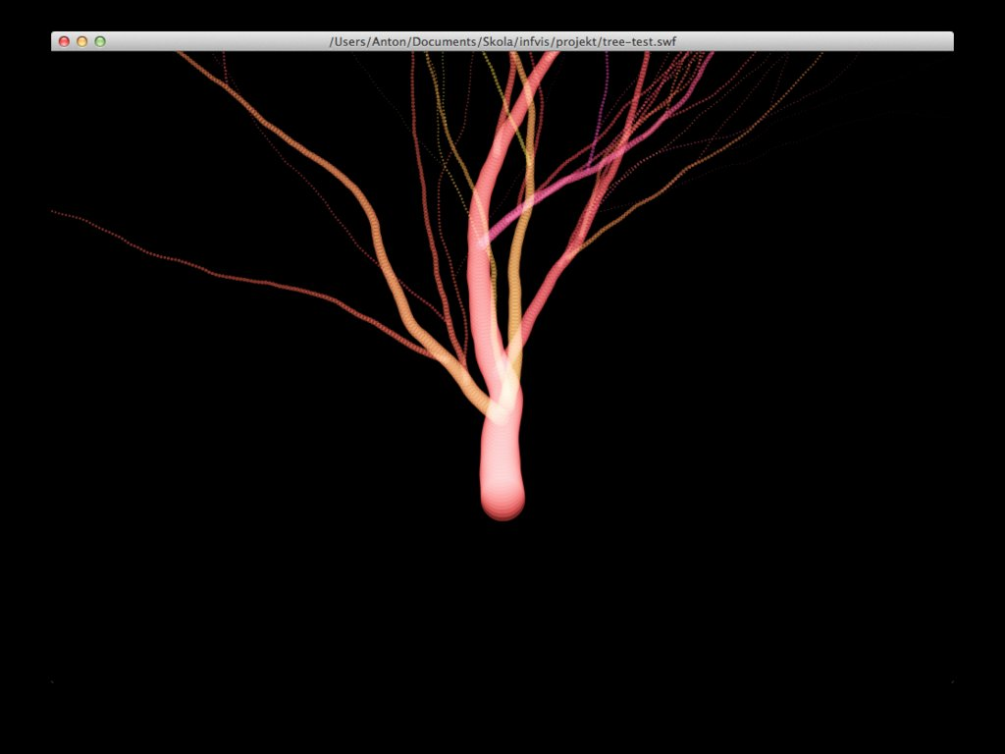
Notes:
We gave the tree a neon feel as we did not want it to be bland, we wanted it to be interesting.

Slide 11
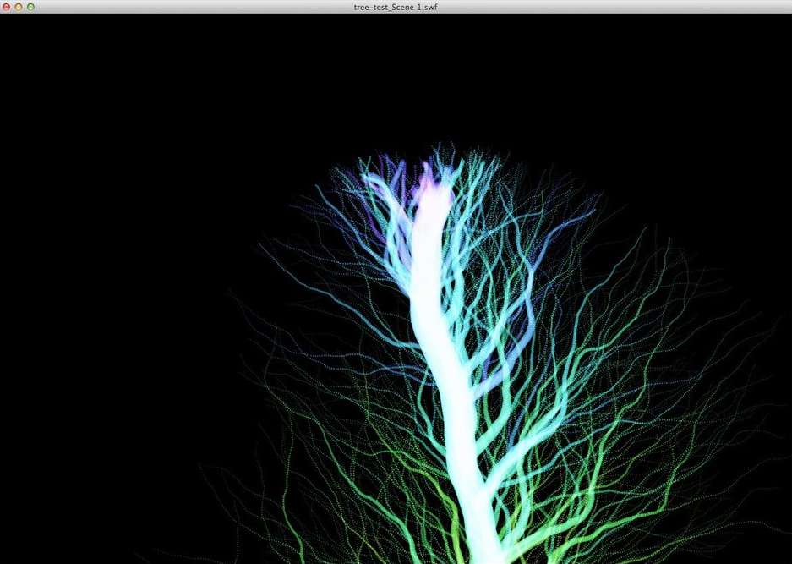
Notes:
And in the end, we got pretty good results. Off course the trees as you saw at the begining grows continously until the song ends, which means that we decided to move along with it which gave a sense of time to our visualization.

Slide 12
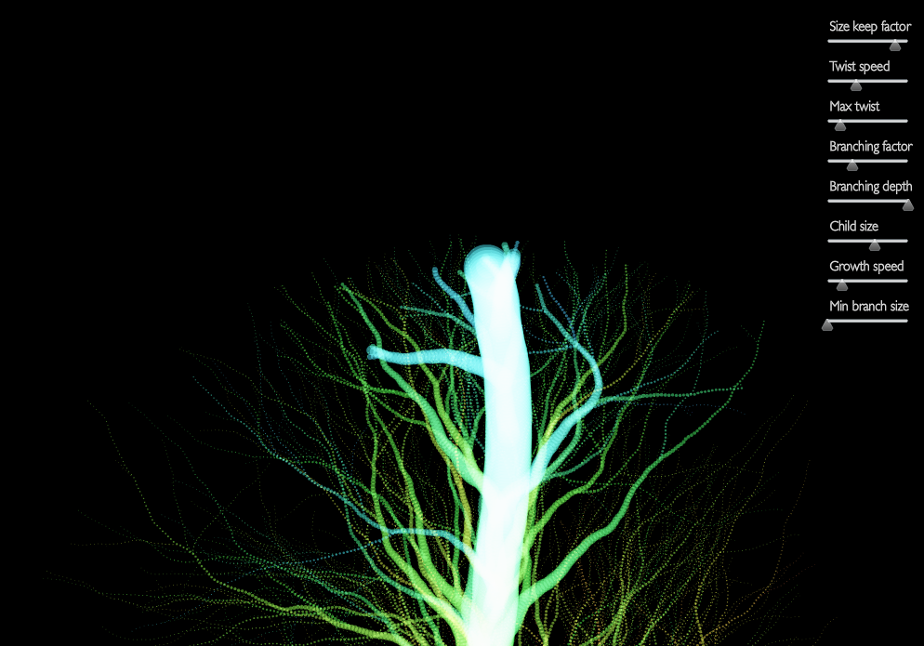
Flash prototype available at -
http://www.develophant.com/musictree/tree-test.html
Notes:
In the end we added a set of parameters so that the user could change the tree as he or she saw fit.
This version is available at http://www.develophant.com/musictree/tree-test.html

Slide 13

Notes:
So, we had contructed a randomly generated tree, but then we ran into a problem, the music. Reading MIDI files in flash wasn’t as easy as we had thought so we switched platform to HTML5 and JavaScript.

Slide 14
Notes:
Bohemian Raphsody

Slide 15
MIDI events
Global settings
Branch Events
Branch settings
MIDI events
MIDI events
Note on
Trunk growth speed
New trunk branch
Branch decay
Note on
Note on
Note off
Trunk size
New subbranch
Branch size
Note off
Note off
CC change
Trunk max twist
Max twist
CC change
CC change
Branch twistness
Branch twistness
Note properties
Channel (instrument)
Branch speed
Trunk hue
Note frecuency
Transparency
Trunk brightness
Velocity
Hue
Blur
Brightness
Background
Notes:
We rebuilt the engine in JavaScript and added the sound. And the sounds effect on the tree. These effects can all be altered with a controller.

Slide 16
Notes:
Demo, of controller and its effects on a tree. Möjligt att vi behöver mer om metod och teknik? Prata om hur vi laddar in midifilerna?

Slide 17
What did we learn?
Flash and MIDI did not mix with us
Ideas change over time
Technical stuff
Using MusicTree is easy, making it look awesome is harder
Notes:
What we learned.

Slide 18
Conclusions and further work
Add missing features
Explore different settings

Slide 19
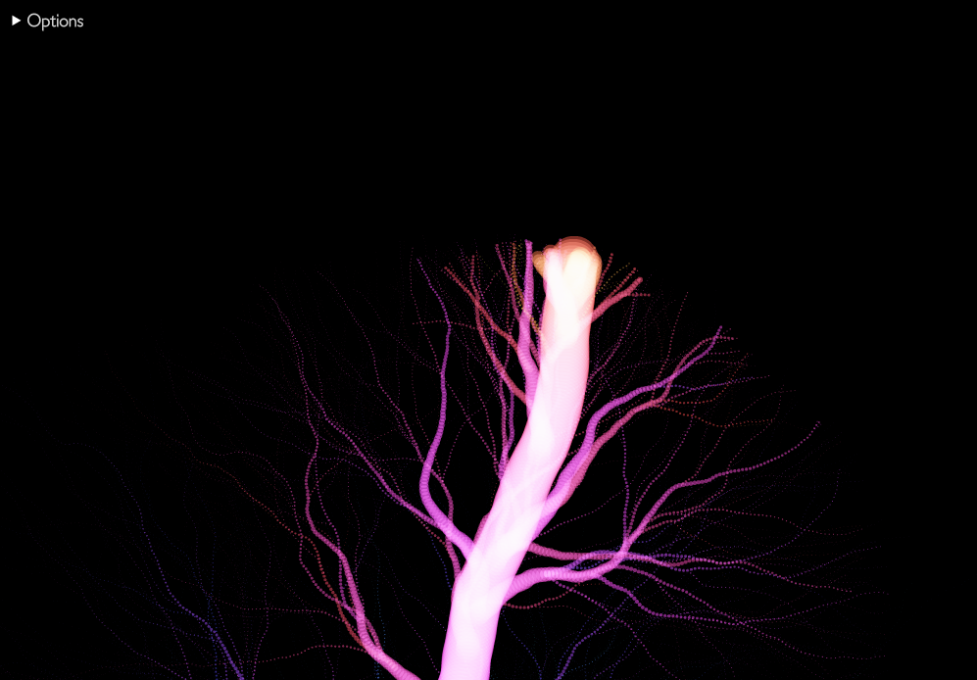
Thank you!
Questions?
antohol@kth.se
jnygr@kth.se
www.develophant.com

